Slide 1
Math and Public Health:
A Focus on Impact
Miriam Nuño, PhD
Professor of Biostatistics
Department of Public Health Sciences, UC Davis
December 19, 2024

Slide 2
Outline
My personal and academic path
My collaborators – a lens on diversity and health equity
My collaborative research, some examples
Future directions: transforming health equity
Notes:
Math and Global Public Health: A Focus on Impact

Slide 3

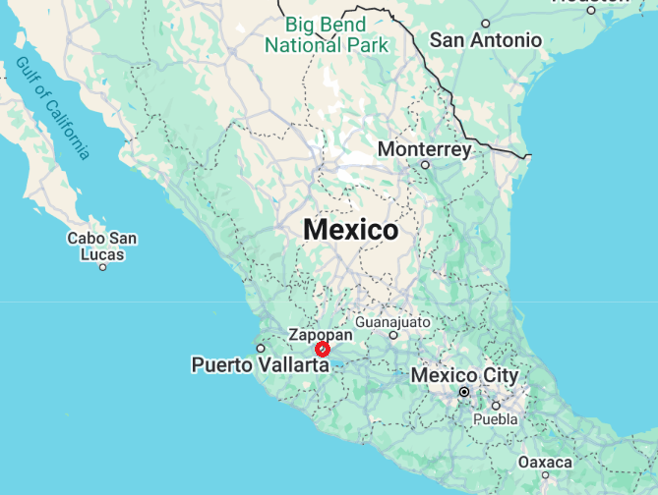


About Me
Immigrated to the US at age 14
One of six siblings
Born in Guadalajara, México
Love mathematics &
public health
My family

Slide 4
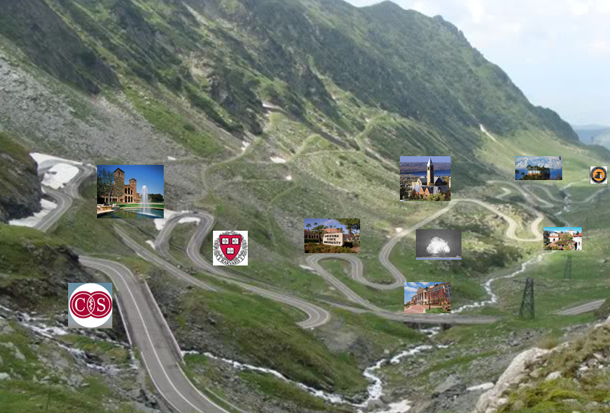

About My Academic Path
UC Riverside, CA
Claremont Graduate University, CA
Cornell University, NY
Los Alamos National Laboratory, NM
Raleigh, NC
Harvard School of Public Health, MA
UCLA, CA
Cedars-Sinai Medical Center, CA
UC Davis, CA
Now
Start

Slide 5
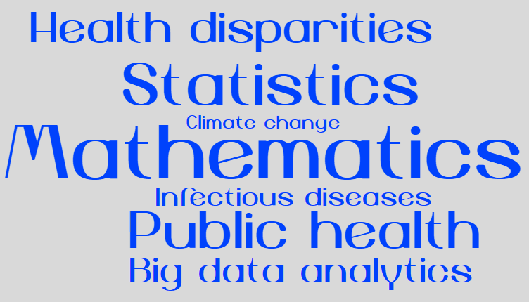
My Roles in Public Health and Social Change
Notes:
.

Slide 6
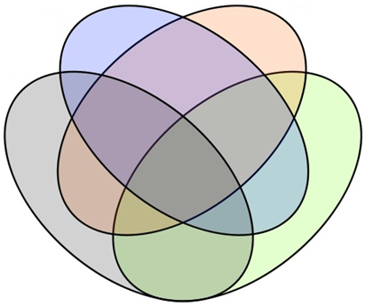
Social Change Ecosystem
A: strengths
A
B
B: areas for growth
D
D: values
C
C: motivations
GREATER SELF AWARENESS

Slide 7
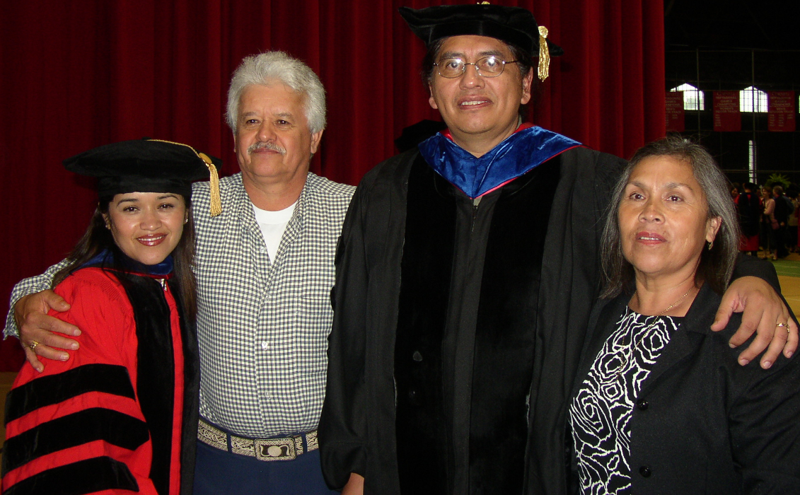



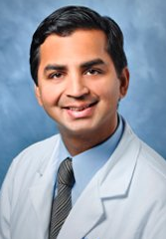
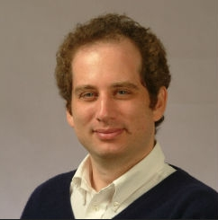
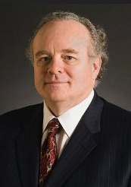
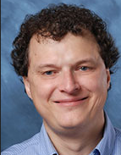






My Mentors
Miss McLaren
Miss Nacleiro
Notes:
Expand to update

Slide 8

My Research Team
https://sofiaresearchteam.org/
Research Areas: 1) Infectious Diseases, 2) Health Outcomes,
3) Climate Change Impacts on Health and Outcomes

Slide 9


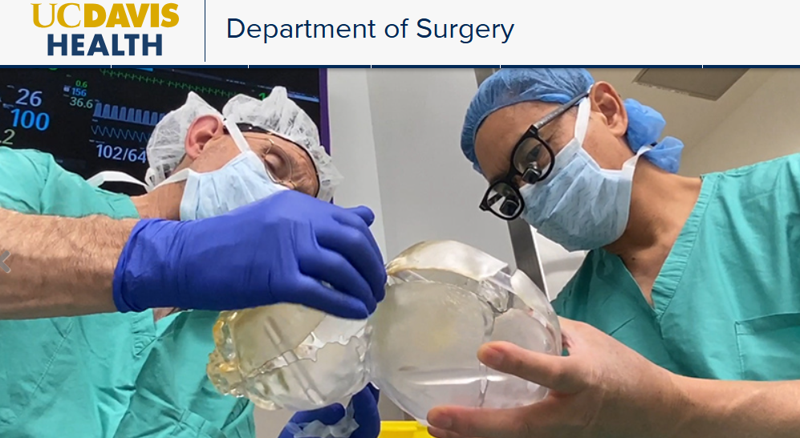
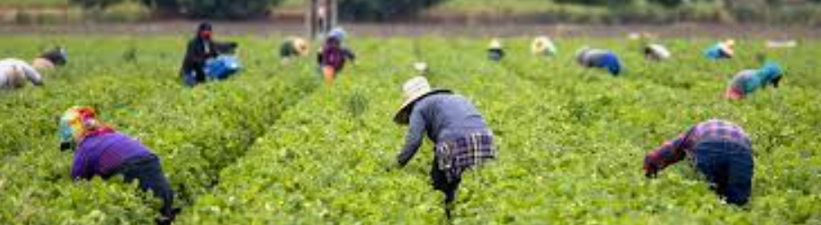

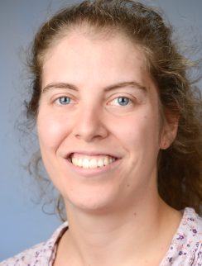






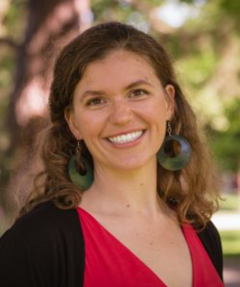




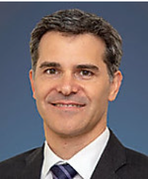



My Collaborators
Community-based participatory research

Slide 10
MY COLLABORATIVE RESEARCH
SOME EXAMPLES

Slide 11
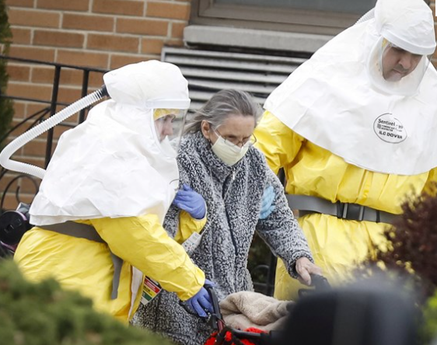
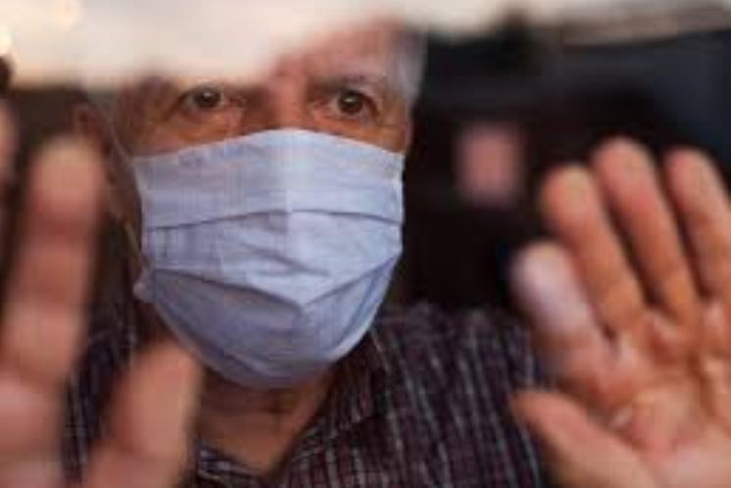

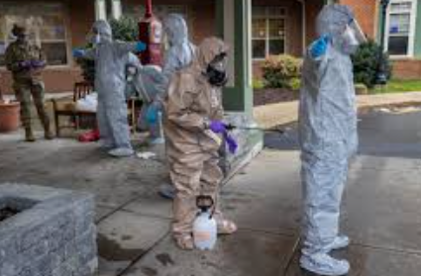

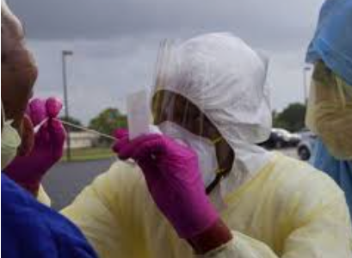
Project 1
Testing and Vaccination to Reduce the Impact of COVID-19 in Nursing Homes: An-Agent Based Approach
Notes:
Vulnerable Populations

Slide 12
Testing and vaccination to reduce the impact of COVID-19 in nursing homes
Motivation: Nursing homes experiences a disproportionate
morbidity and mortality associated with COVID-19.
Approach: Using an agent-based approach to model the dynamics
of COVID-19 spread in a nursing home in Los Angeles, CA.
Findings: Nearly 80% of asymptomatic cases isolation is required
to provide significant reduction attack or mortality in rates in nursing homes.

Slide 13
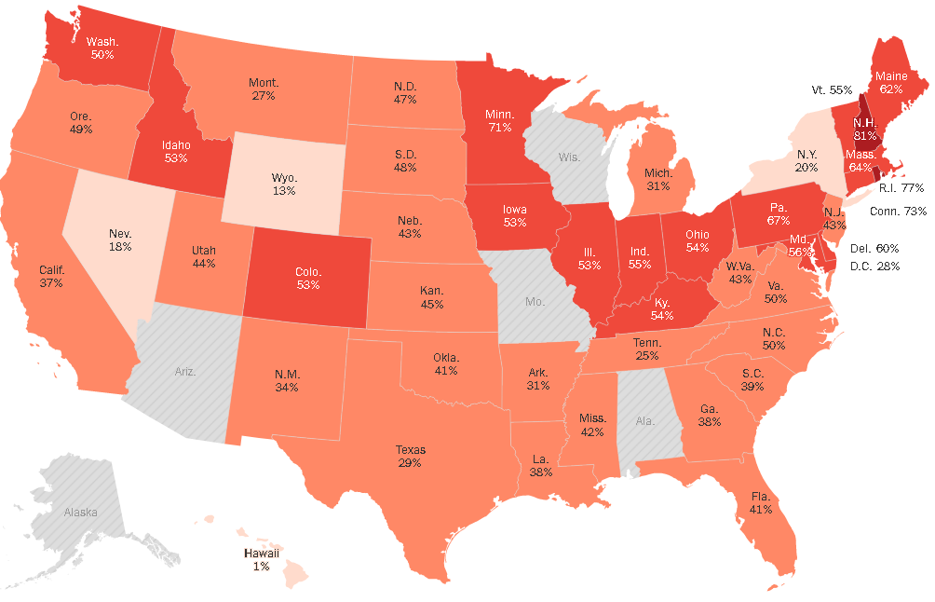
Deaths of COVID-19 in Nursing Homes
Facts:
<1% of US population
7% of all US Cases (479,000+)
41% of all US deaths (77,000+)
Up to 80% of deaths are inked to nursing homes in some states
Figure 1. Deaths of COVID-19 in Nursing Homes, US.
Notes:
Despite being less than 1% of the U.S. population, 41% of all COVID deaths and 8% of all COVID cases are linked back to nursing homes (NHs).

Slide 14
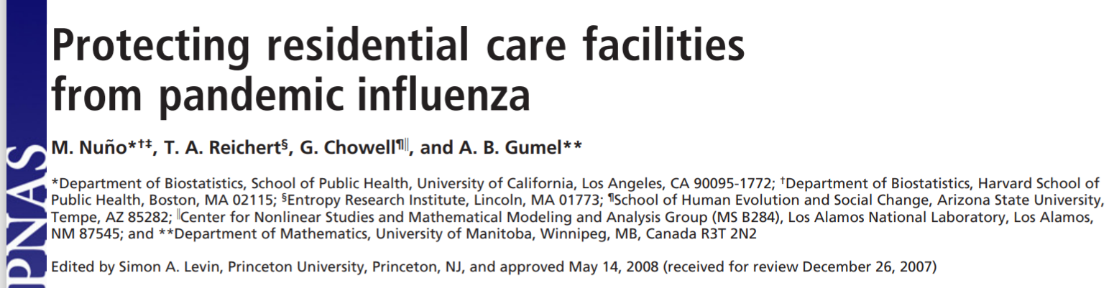
Building on previous knowledge to address
a COVID-19 challenge in nursing homes

Slide 15
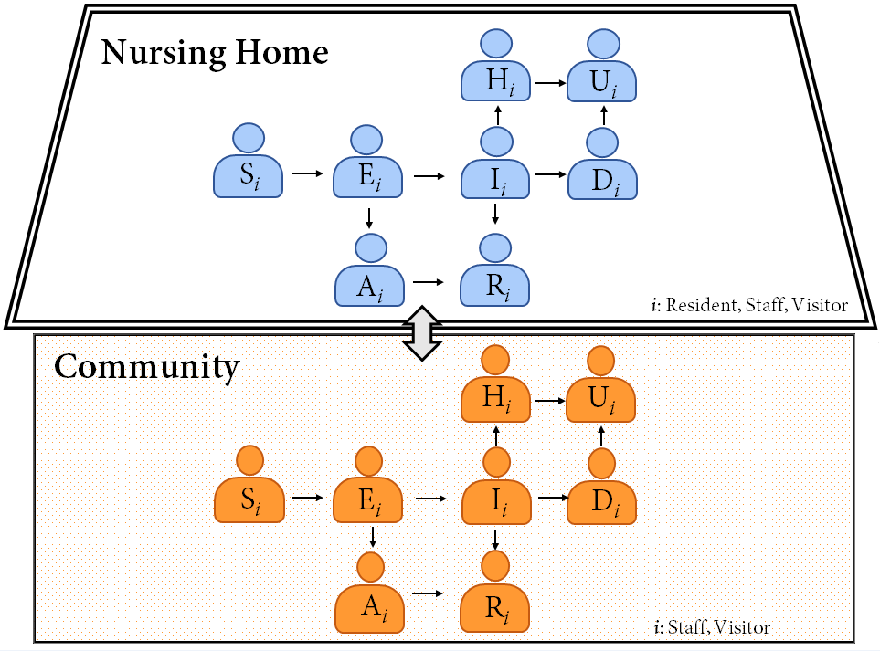
Our Approach: Agent-Based Model
Figure 2. Schematic representation of interactions of individuals in the community and nursing home.

Slide 16
Non-pharmaceutical interventions (NPIs) to reduce the spread of virus in nursing homes
Identify and exclude potentially infected residents, staff or visitors
Personal protective equipment (PPE) included in all scenarios/categories
Staff and visitors entering the facility are monitored for elevated temperatures
Changes in staff working schedule
Visitor restrictions

Slide 17
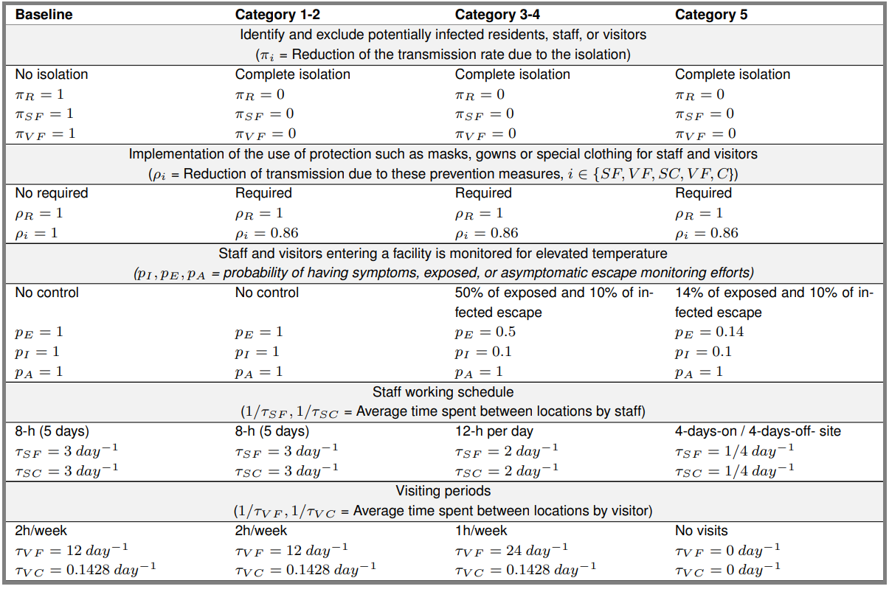
NPI Scenarios

Slide 18
NPI Scenarios

Slide 19
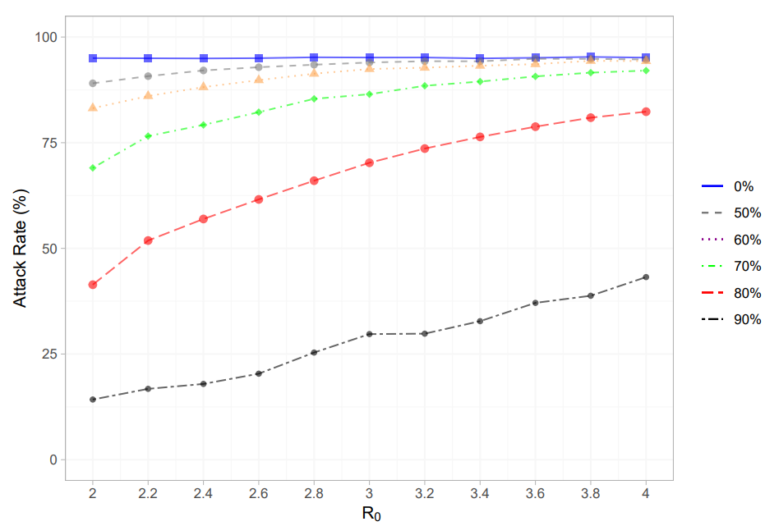
Results: Category 5
Asymptomatic
Isolation
Figure 3. Attack rate estimates for various scenarios of R₀ and isolation.
Notes:
Initial R₀ for the ancestral SARS-CoV-2 virus was 2.0–3.5, consistent with other respiratory viruses like SARS-CoV and MERS-CoV.
Delta and Omicron, significantly increased transmissibility, with R₀ estimates reaching 5.0–10+ for Omicron.
It represents the average number of secondary infections generated by one infected individual in a fully susceptible population, under ideal conditions.

Slide 20
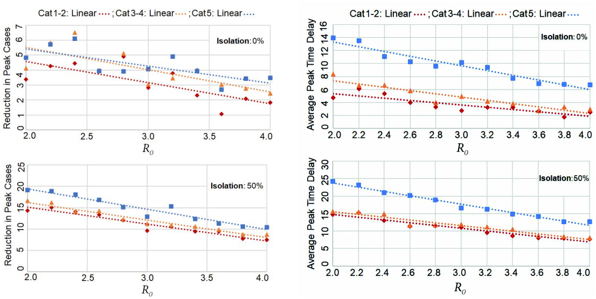
Results: Peak Cases and Peak Times
Figure 4. Estimates of reduction in peak cases and peak time delays.
Notes:
When compared to baseline across all values of R0, peak times were delayed by an average of 3.6 (1.0-6.2), 4.8 (1.3-8.4), and 9.7 (4.7-14.6) days for Categories 1-2, Categories 3-4, and Category 5, respectively. While Categories 1-2 and Categories 3-4 were not significantly different from each other, Category 5 consistently showed longer delays than the other two (p = 0.0004 and 0.001). See Supplementary Fig

Slide 21
Concluding Remarks
Community outbreaks were almost always followed by an outbreak in a facility
(stringent NPI scenarios are unlikely to prevent introduction altogether)
Even the most restrictive intervention plan (Category 5), did not see large differences in attack or mortality rate until 80% of asymptomatic cases were successfully isolated.
Even the most stringent social control measures were undermined by the long period of infectivity before a carrier becomes symptomatic.
Significant reductions in outbreak peak cases and average peak times were observed with the implementation of isolation measures.

Slide 22
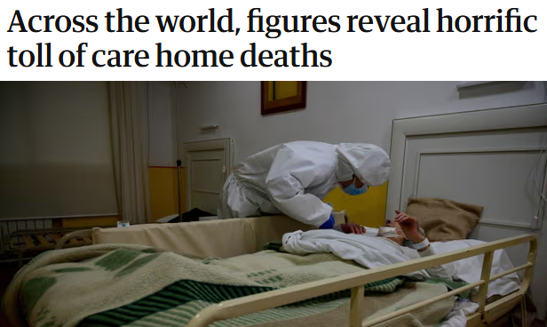
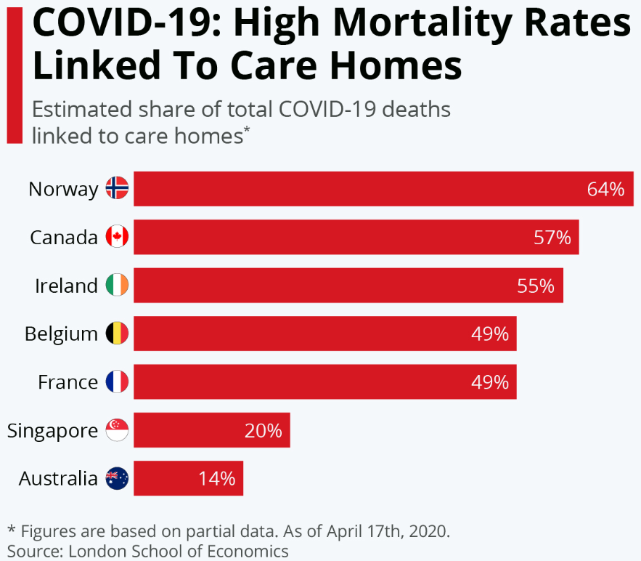

Key Global Implications

Slide 23
Key Global Implications and Opportunities
Protecting high-risk populations across counties via global efforts that involve routine testing and ensure equitable access to vaccinations to significantly reduce outbreaks and deaths in these vulnerable populations.
Enhancing Global Health Policies for Long-Term Care facilities by prioritizing investments in long-term care infrastructure, staffing, and digital health technologies to improve surveillance and vaccine delivery in these facilities [create a global response model to address infectious diseases that disproportionately affect older adults].
Global Health Collaboration through shared data, best practices, and innovations (e.g., mobile vaccination units, rapid outbreak containment protocols) across countries to mitigate the impact of COVID in nursing homes worldwide.

Slide 24
Project 2:
Assessing the impact of COVID-19 vaccination on
California’s Return to Normalcy
Motivation: Traditional SEIR models with fixed model parameters are too simplistic and divergent from real-world data guide future trends.
Approach: We implemented a real-time Bayesian data assimilation approach to provide projections of incident cases and deaths in California following the reopening of its economy on June 15, 2021.
Findings: Preventive measures with the capacity to impact transmission and the effective susceptible population should be considered, at least until vaccination rates across California reach equitable levels of protection.

Slide 25
Motivation
On June 15, 2021, the California department of public health (CDPH) issued plans
and guidance for full easing of all business restrictions, contingent on case,
vaccination, and equity measurement stay on track.
In this study, we addressed the adequacy and deficiency of vaccine uptake within California and the possibility and severity of resurgence of COVID-19 as restrictions are lifted given the current vaccination rates.

Slide 26
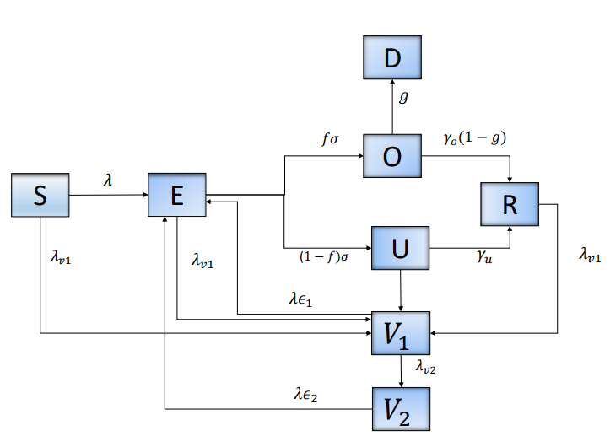
Approach: Model Structure
Figure 5. Flow Diagram of SARS-CoV-2 transmission with vaccination.
Notes:
We model the process of vaccination by considering that: (1) individuals in all epidemiological classes, with the exception of those diagnosed as positive are vaccinated, (2) vaccine is partially effective, suggesting that some individuals vaccinated can be infected, (3) vaccine efficacy is different after first and second dose administration, and (4) vaccination rate is estimated using daily data of first and second doses administered in California.

Slide 27
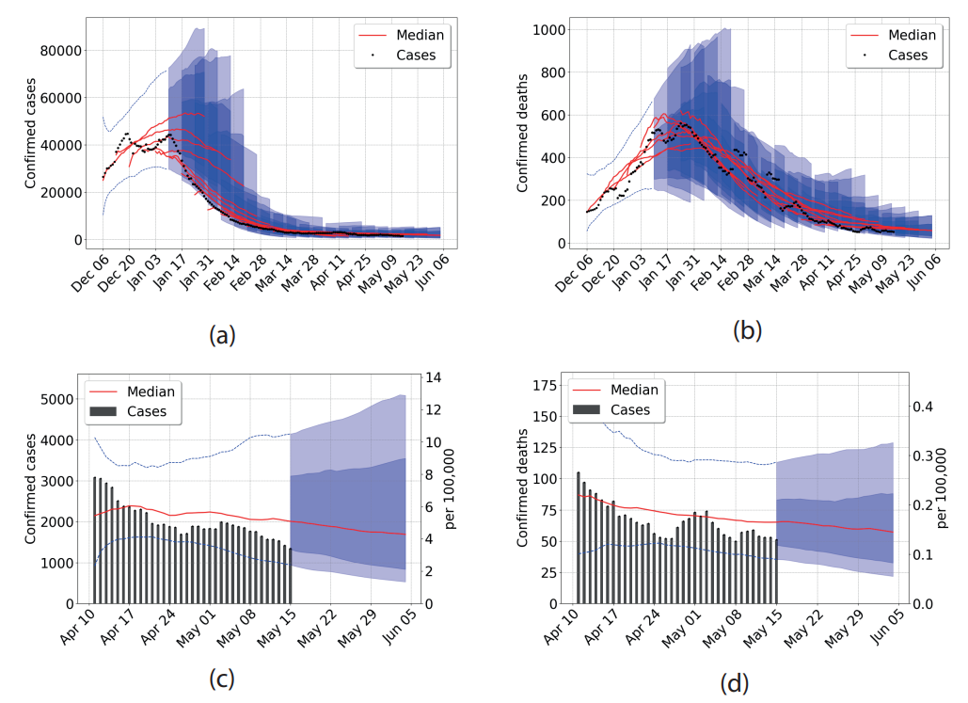
Bayesian Sequential Forecasting Framework
Figure 6. Data from April 8 to May 18, 2021. (a) Confirmed cases (b) Confirmed deaths. Central red lines indicate the median incidence forecast. The darker shaded region indicates the interquartile forecast range, and the lighter shaded region indicates the 5–95th percentile range. All displayed forecast duration’s are ten days from the point of prediction.

Slide 28
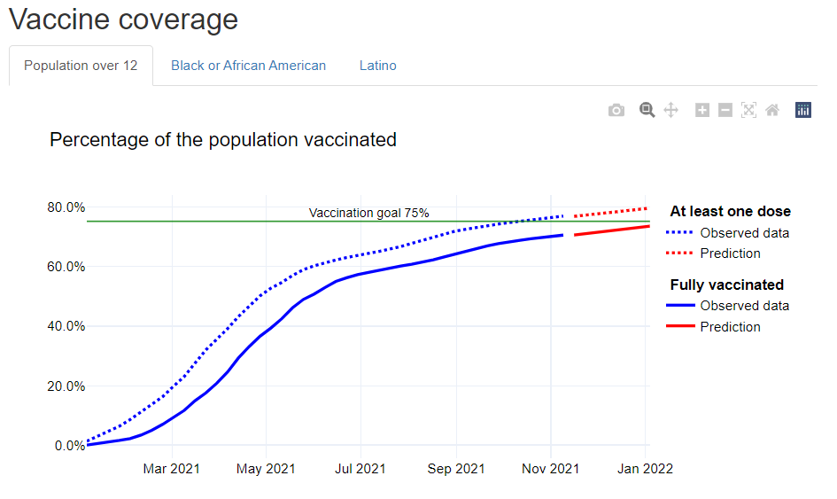
Lessons Learned –
Implications for technological advance
Geographic Pandemic Preparedness of COVID-19 in US Nursing Homes
Figure 7. Vaccination coverage in California.
Notes:
https://rpubs.com/Cricelio/Sacramento

Slide 29
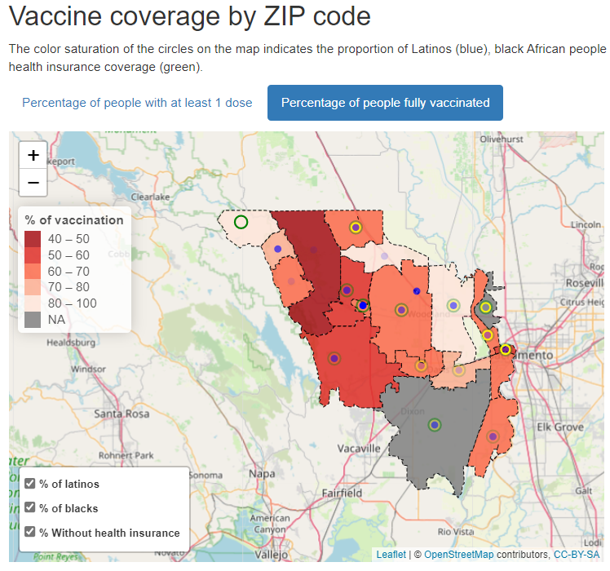
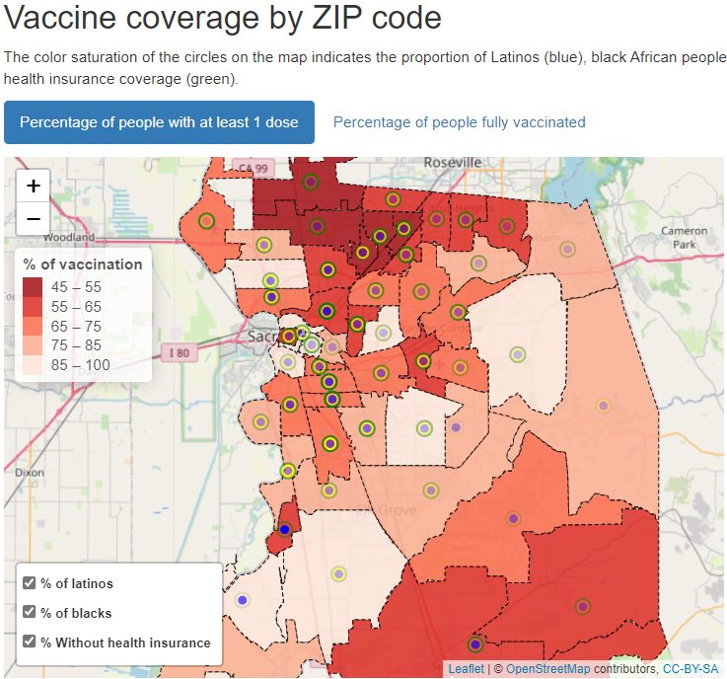
Precision Public Health to Protect Vulnerable Communities
Yolo County
Sacramento County

Slide 30
Project 3:
Optimizing Spatial Distribution of Wastewater-based Epidemiology to Advance Health Equity
Goal: To obtain a balanced spatial distribution, inclusive population coverage, and efficient representation of disadvantaged groups in the allocation of resources for WBE in California.
The modeling framework concentrates on areas with high population density and gives priority to vulnerable regions, as well as identifying signals that display significant variations from other monitored sources.
We evaluate various scenarios, considering different weighting factors, to optimize the allocation of WWTPs with monitoring systems. This optimization framework provides an opportunity to enhance WBE by providing customized monitoring strategies created to address specific priorities and situations, thus enhancing the decision-making processes in public health responses

Slide 31
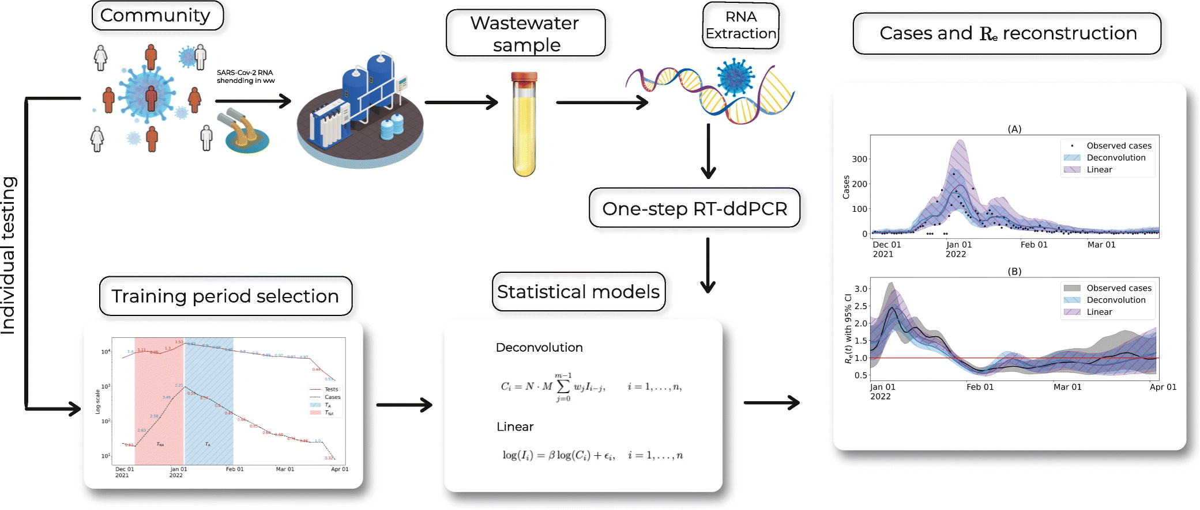
Wastewater-Based Epidemiology (WBE)
Notes:
Wastewater-Based Epidemiology (WBE) is an emerging public health surveillance approach that involves analyzing wastewater (sewage) to monitor the presence of biological markers, such as pathogens, chemicals, and genetic material, in a given community. It serves as an early detection tool to identify and track the spread of diseases, monitor substance use, and assess population health trends.

Slide 32
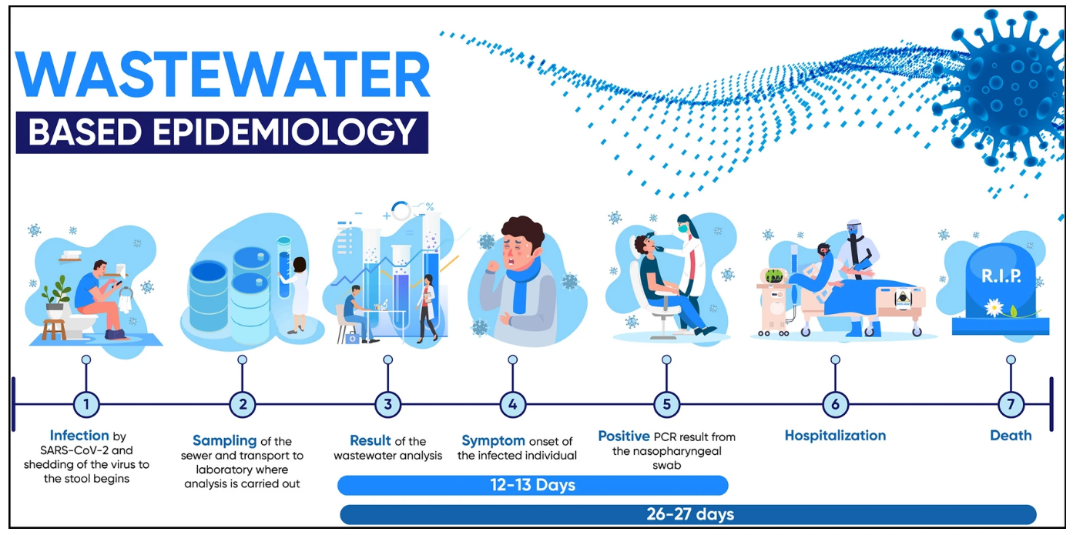
Scientific Reports (Sci Rep) ISSN 2045-2322 (online)
Notes:
Visual presentation of wastewater based epidemiology. Increase in concentration of viral particles in the wastewater are considered to be around 12 days ahead before increase in clinical PCR testing and around 26 days before increase in deaths.

Slide 33
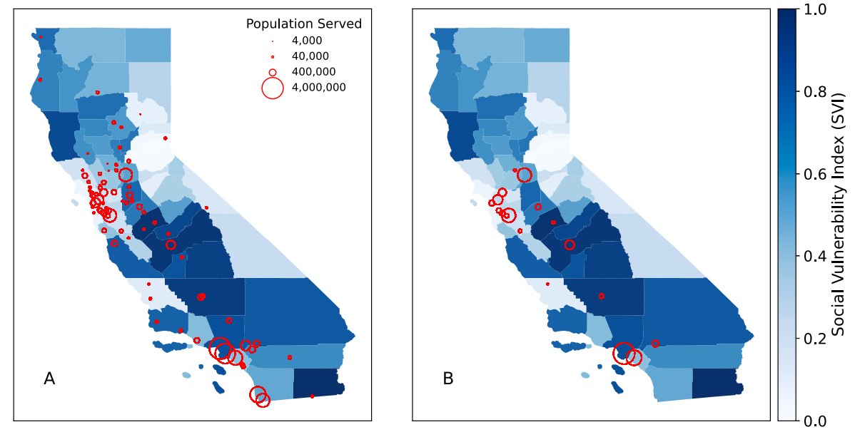
Wastewater Treatment Plants in California
Notes:
Our data. Fig. 1. Locations of WWTPs monitoring for SARS-CoV-2 in California from March 21, 2022, to May 21, 2023, shown by county-level SVI and the population served by each facility. A. Distribution of all 84 WWTPs active during the study period. B. A subset of 19 WWTPs that provided wastewater data throughout the entire study period. (For interpretation of the references to color in this figure legend, the reader is referred to the web version of this article.)

Slide 34
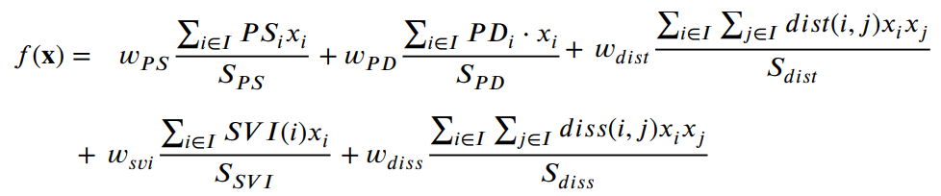
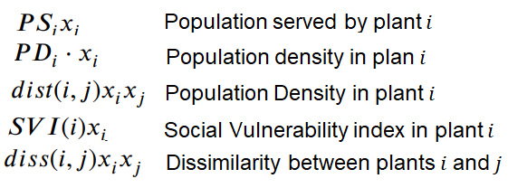

Optimization Problem Formulation
Distance between plant $i$ and $j$
Notes:
The terms 𝑃𝑆𝑖 , 𝑃𝐷𝑖 , 𝑑𝑖𝑠𝑡(𝑖,𝑗), 𝑆𝑉 𝐼(𝑖), and 𝑑𝑖𝑠𝑠(𝑖,𝑗) correspond to the population served by plant 𝑖, city’s population density associated with plant 𝑖, the distance between plant 𝑖 and plant 𝑗, SVI of the county associated with plant 𝑖, and dissimilarity between WWTP signals, respectively.

Slide 35
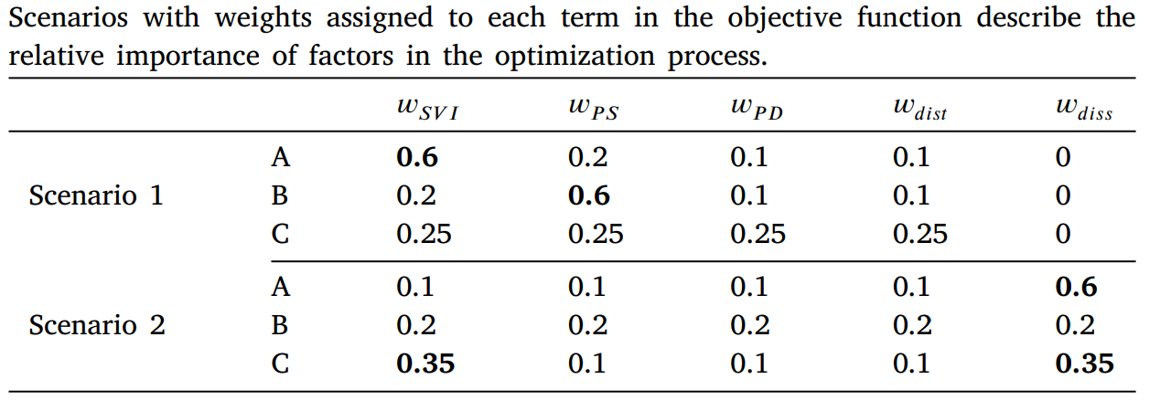
Resource Planning Scenarios
Notes:
Scenario 1: Disease-agnostic optimization approach. Scenario 1A: Prioritizing SVI; Scenario 1B: Prioritizing population served; – Scenario 1C: A balanced approach.
Scenario 2: Prioritizing dissimilarities in our optimization process can improve our capacity for early detection, response, and tailored interventions. Fig. 5A illustrates the WWTPs selected in the optimization problem prioritizing WW signal dissimilarity, initially with 19 plants (Fig. 5, Baseline). Subsequently, it showcases the plants that remained after adopting an equal factors approach (Fig. 5B) and a balanced approach for SVI and disease signal dissimilarity (Fig. 5C). Figure S.5 in SM displays the dissimilarity matrix for each optimal solution and scenario. In this particular scenario, prioritizing the dissimilarity term means that we are placing emphasis on highlighting the distinctions between the selected WWTPs with regard to their wastewater signal characteristics.

Slide 36
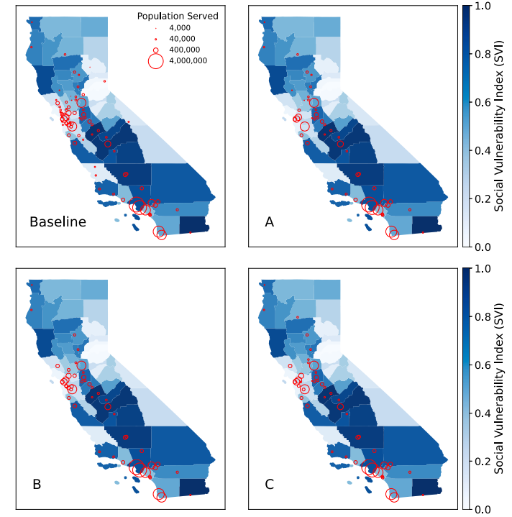
Results:
Optimal Solutions for Scenario 1
Assuming a 40% reduction in active plants:
Baseline (n=84 plants)
A: Prioritizing SVI
B: Prioritizing Population Served
C: Balanced Approach
Notes:
Fig. 2. Optimal solutions for Scenario 1, assuming a 40% reduction of active plants (Baseline: 𝑛 = 84) and different prioritization schemes: A. Prioritizing SVI, B. Prioritizing Population Served, and C. Balanced approach. (For interpretation of the references to color in this figure legend, the reader is referred to the web version of this article.)

Slide 37
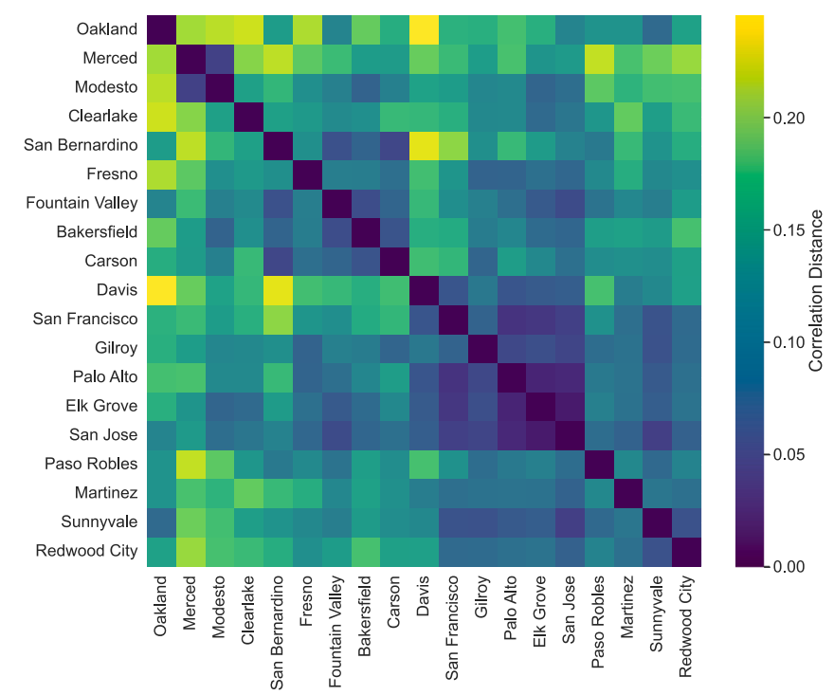
Dissimilarity Matrix for WWTPs to Optimize Surveillance
Notes:
Dissimilarity matrix depicting wavelet coefficients for 19 WWTPs. (For interpretation of the references to color in this figure legend, the reader is referred to the web version of this article.)

Slide 38
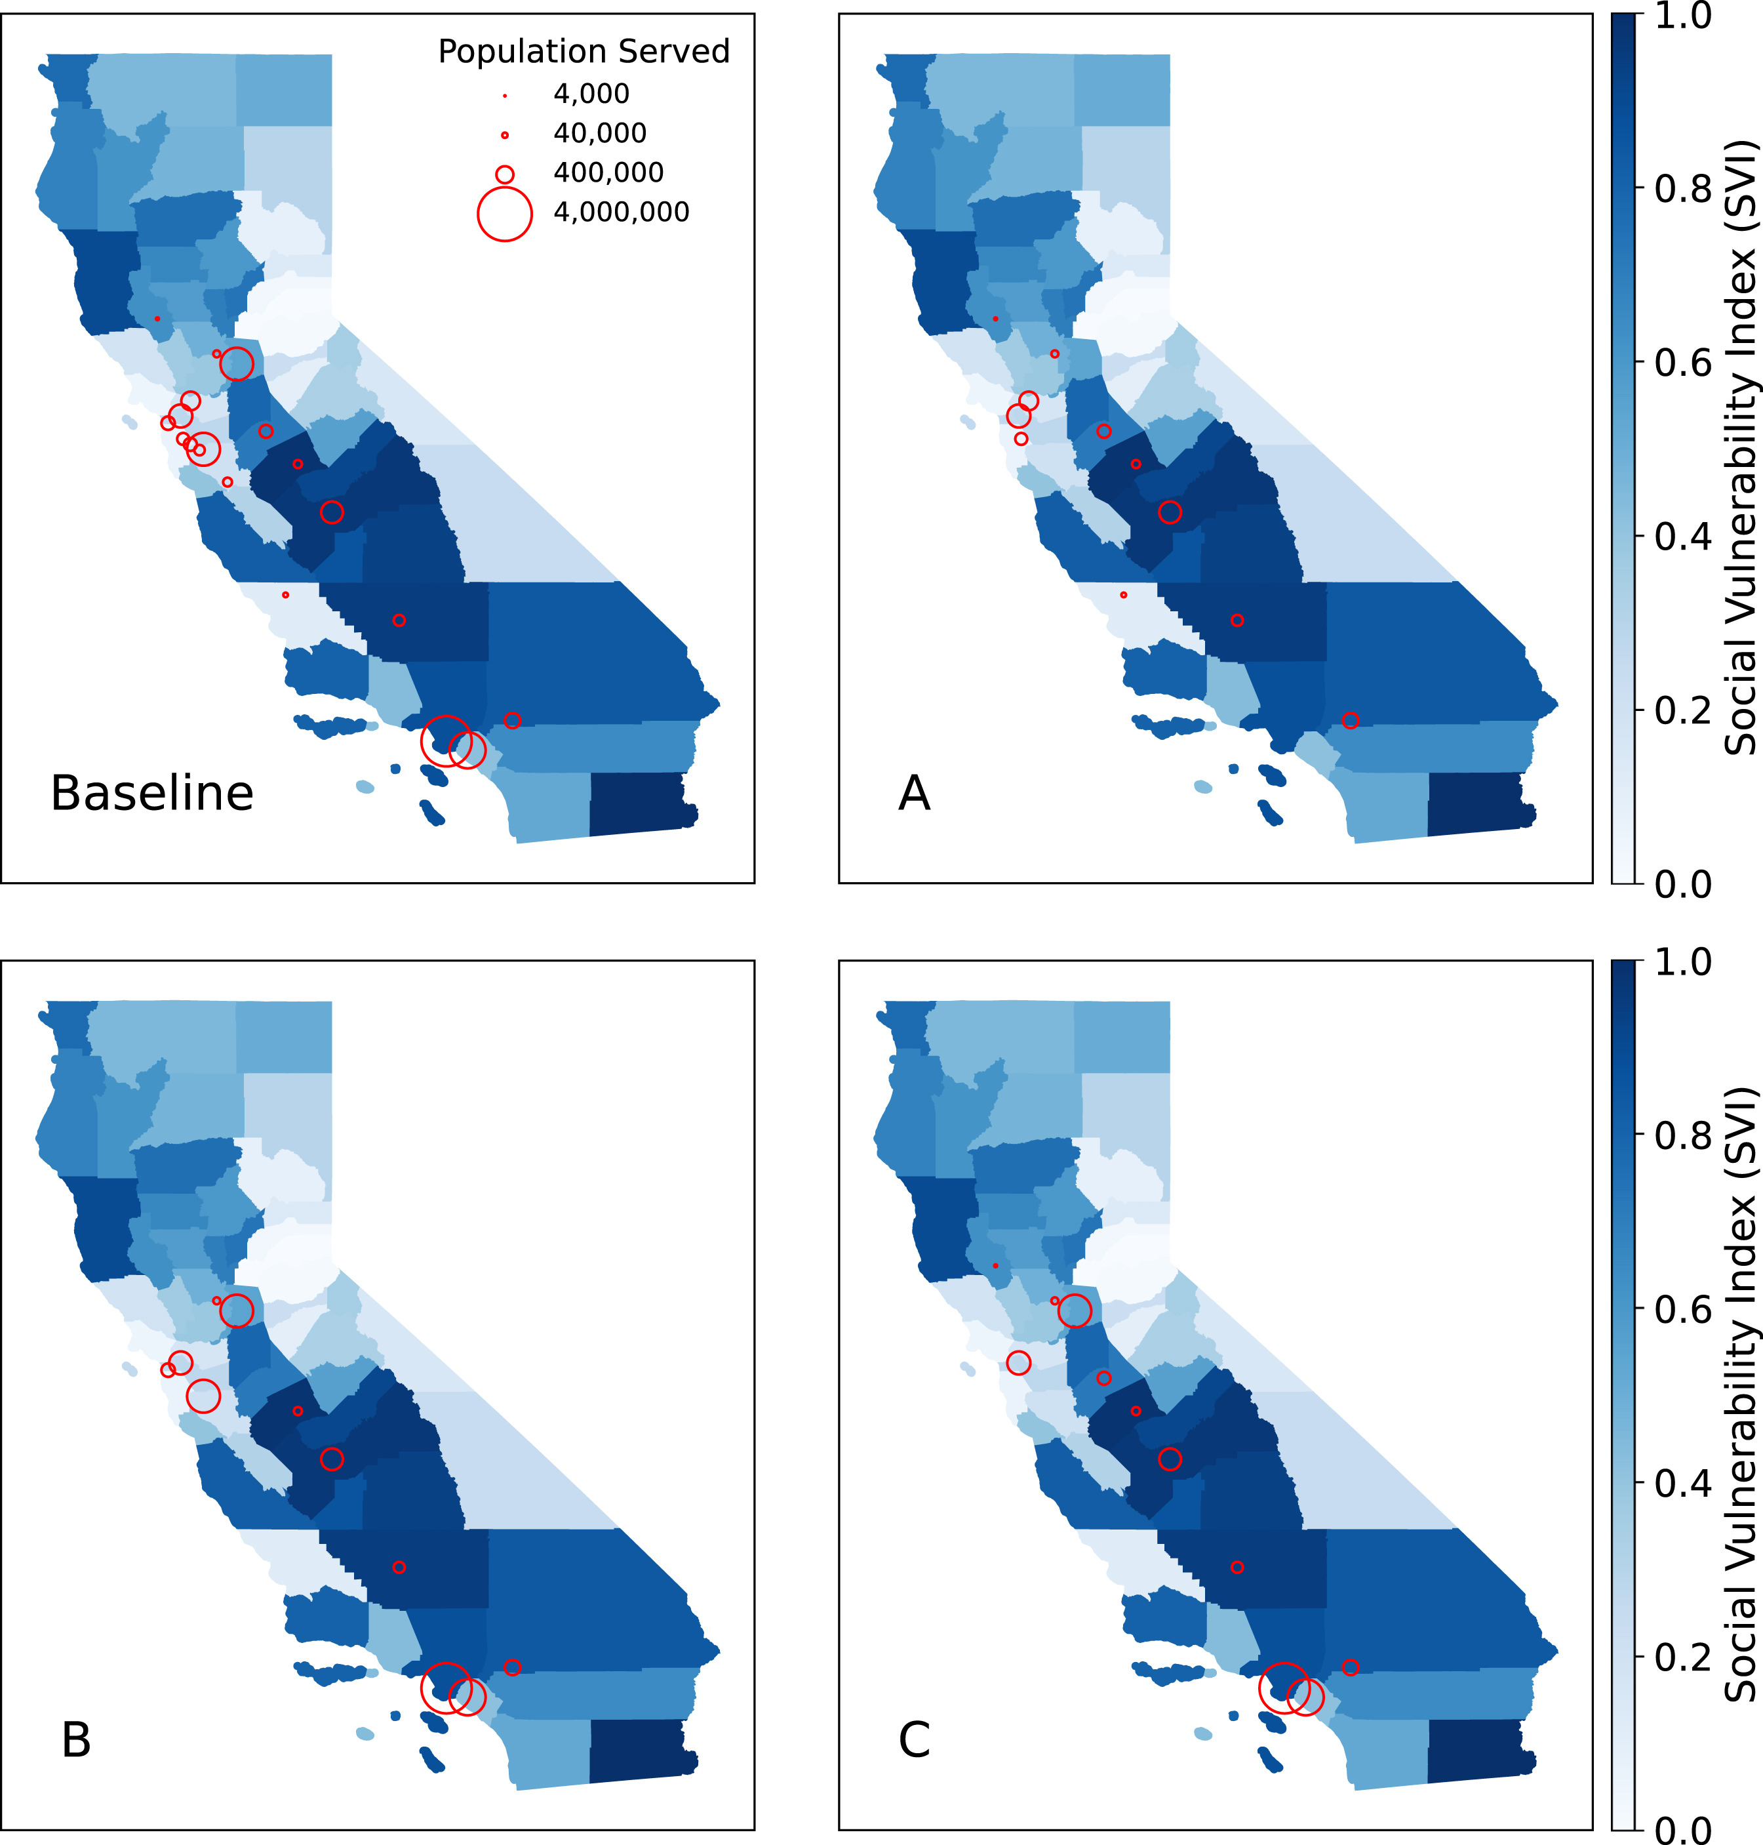
Results:
Optimal Solutions for Scenario 2
Prioritizing WWTP Dissimilarity
Baseline (n=19 plants)
A: Prioritizing signal dissimilarity
B: Equal factors
C: Higher weights for SVI and signal dissimilarity
Notes:
Scenario 2Prioritizing dissimilarities in our optimization process can improve our capacity for early detection, response, and tailored interventions. Fig. 5A illustrates the WWTPs selected in the optimization problem prioritizing WW signal dissimilarity, initially with 19 plants (Fig. 5, Baseline). A. Prioritizing disease signal dissimilarity. B. Equal factors. C. Higher weights for SVI and disease signal dissimilarity.

Slide 39
Conclusions
Promoting Health Equity through Surveillance Optimization: Prioritizing social vulnerability ensures that historically underserved communities receive resource and attention needed for effect disease surveillance and response.
Scalable and Adaptable Framework with the potential for global impact to address multiple infectious diseases, enhancing preparedness for future public health crises.
WBE as Critical Tool Path Forward for Public Health to monitor public health trends, drug use, and emerging threats to improve health outcomes.
Notes:
Wastewater-Based Epidemiology is a powerful, scalable, and cost-effective method for monitoring public health trends and emerging threats. By analyzing wastewater, researchers and policymakers can detect diseases, track substance use, and respond to health crises early, ultimately improving population health outcomes.

Slide 40
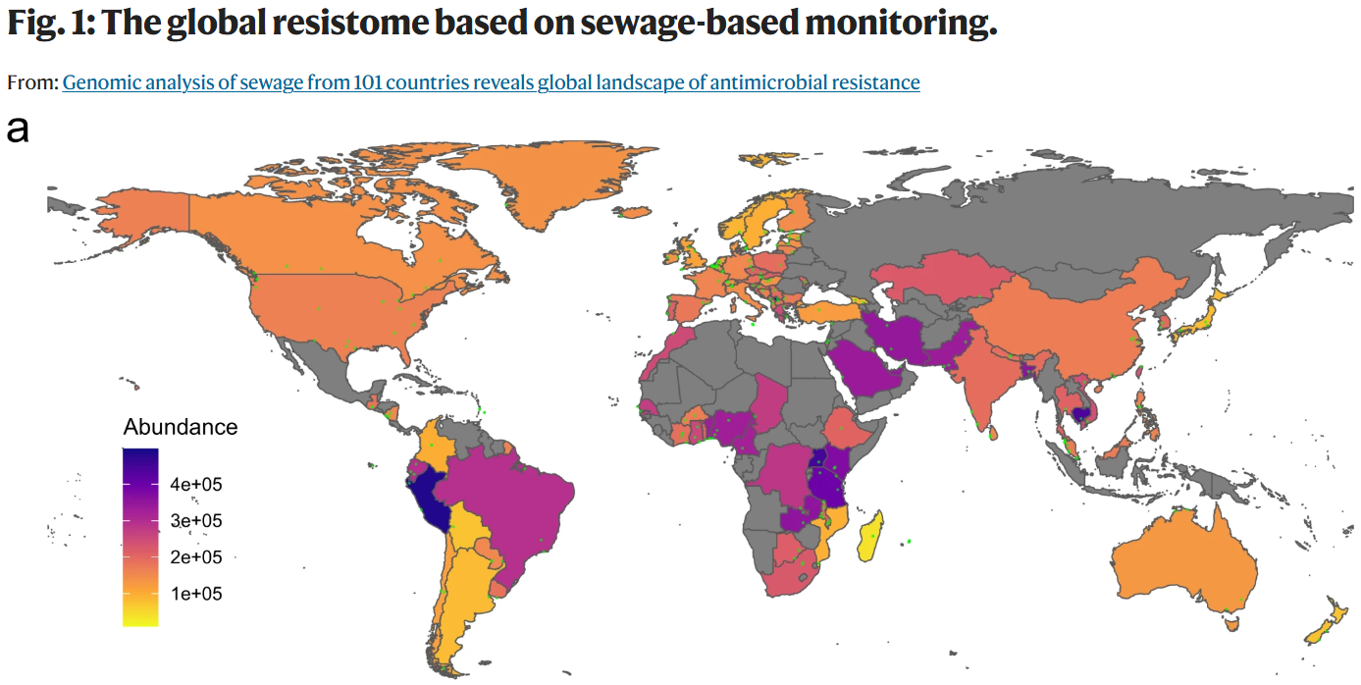
Nature Communications volume 13, Article number: 7251 (2022)

Slide 41

Thank you!
Any questions?
mnuno@ucdavis.edu
https://sofiaresearchteam.org

