Slide 1
SUCCESS IN GLOBAL HEALTH CAREERS
( OR IN OTHER WORDS CLIMBING THE MOUNTAIN)
Elizabeth Anne Bukusi,
MBChB, M.Med (ObGyn), MPH, PhD , PGD(Research Ethics). MBE (Research Ethics) .
Chief Research Officer,
KEMRI
GLOCAL 2018 JUNE

Slide 2
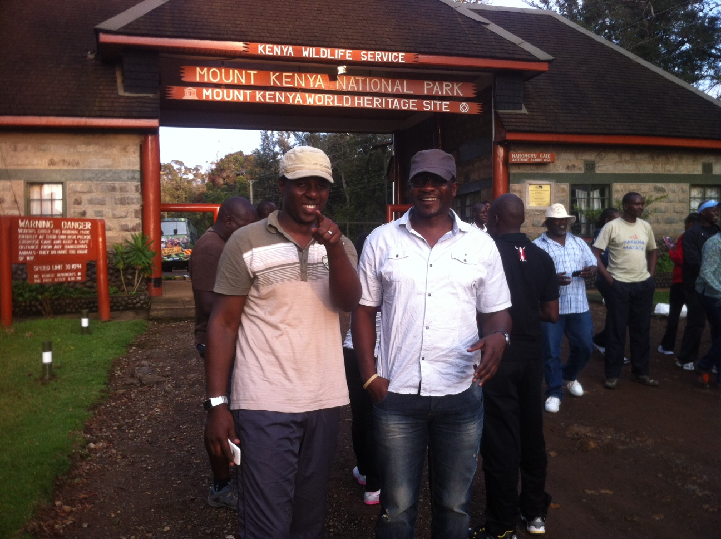

Slide 3
OUTLINE
Climbing the mountain
  Curiosity and willingness to learn
  Collaboration
  Networking
  Work life balance
  Persistence
  Open doors and closed windows
  Dissemination
  Integrity

Slide 4
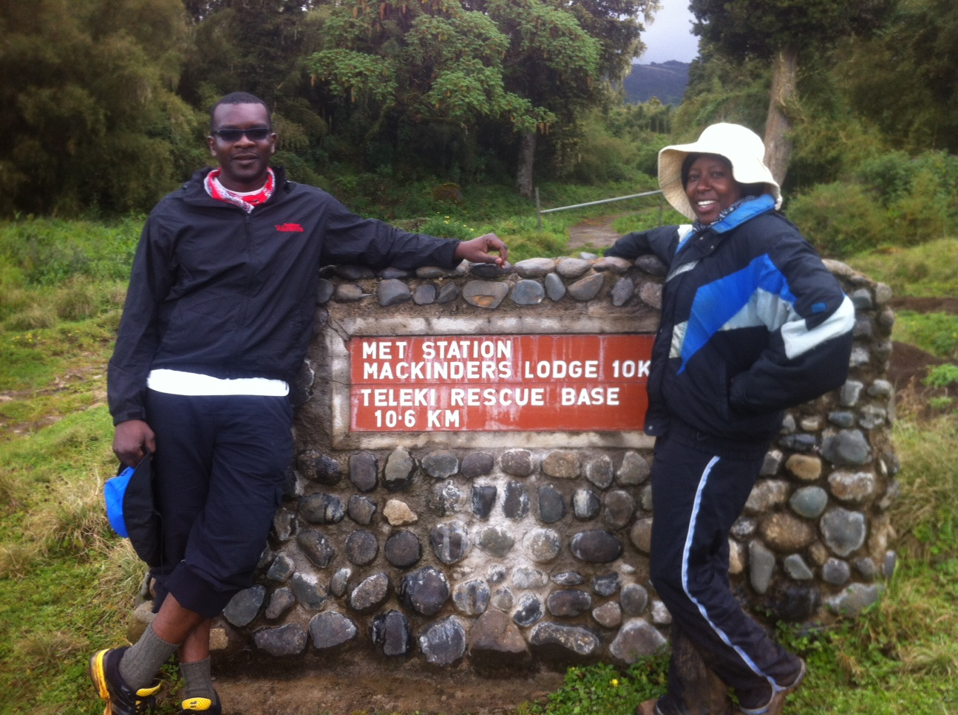

Slide 5
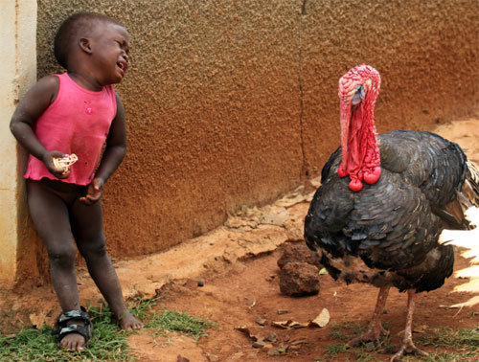
  Curiosity and willingness to learn

Slide 6
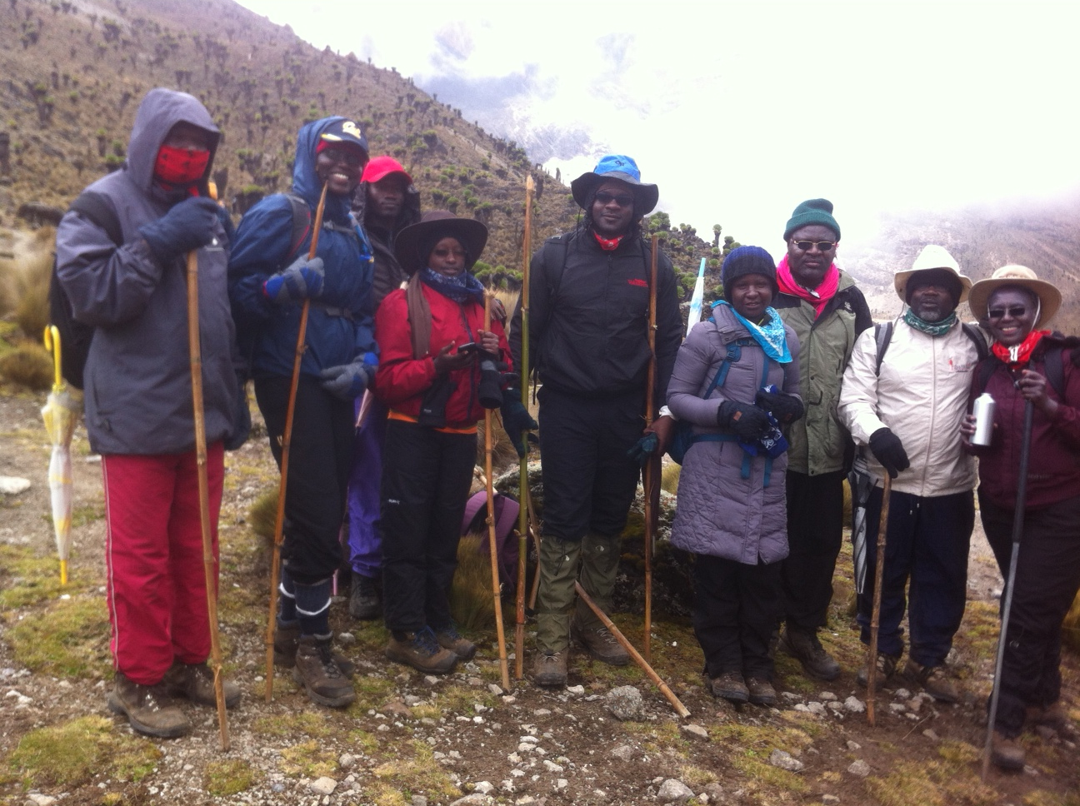

Slide 7
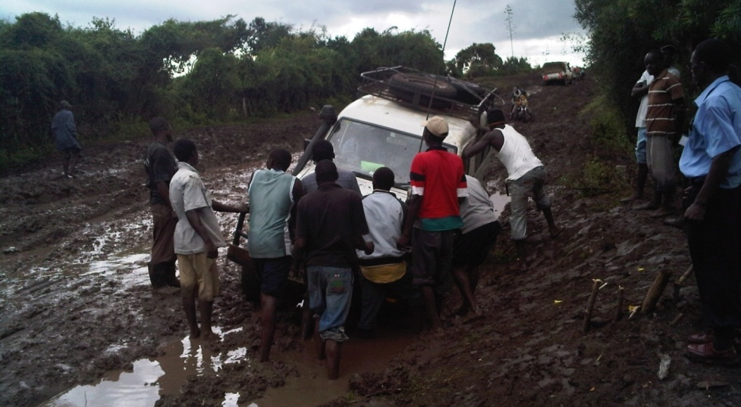
Collaboration

Slide 8
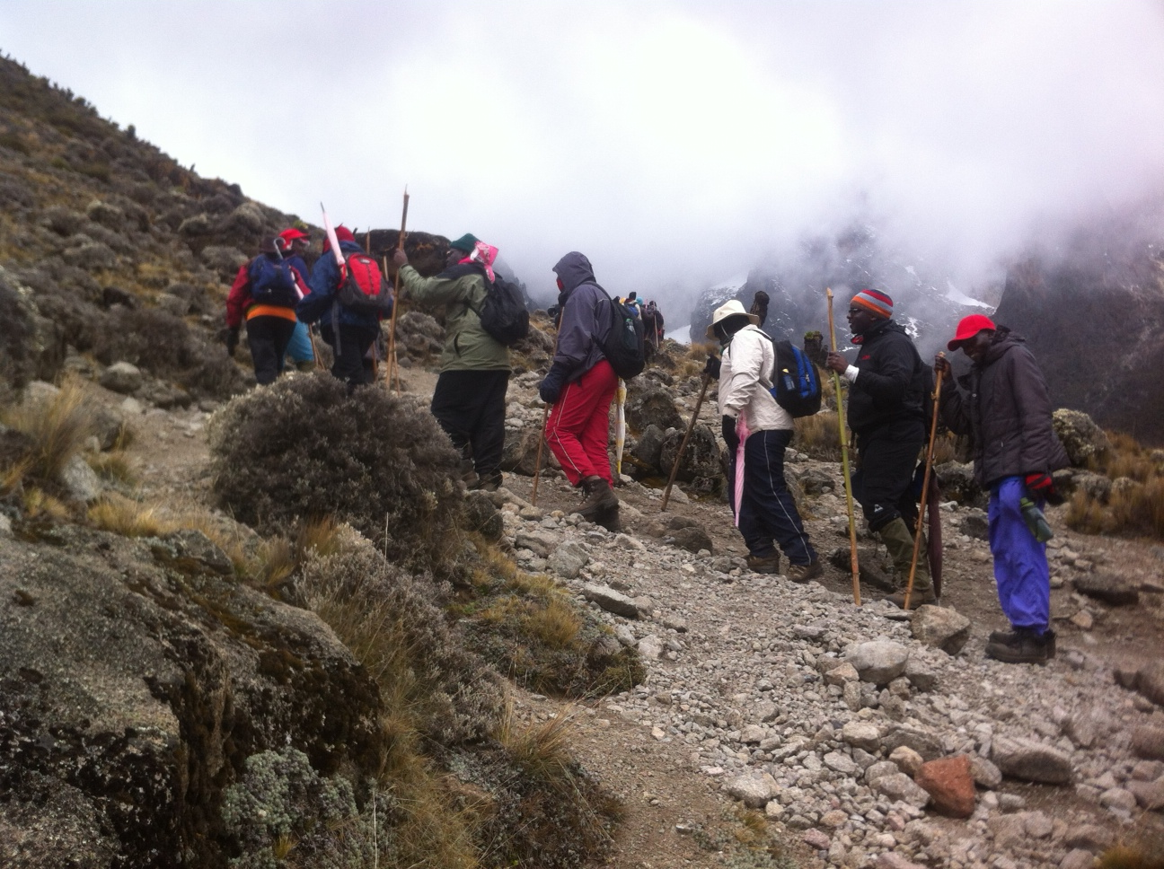

Slide 9
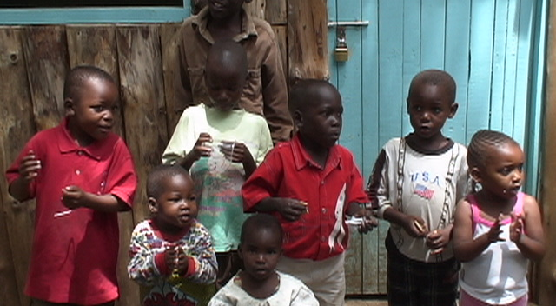
Networking

Slide 10
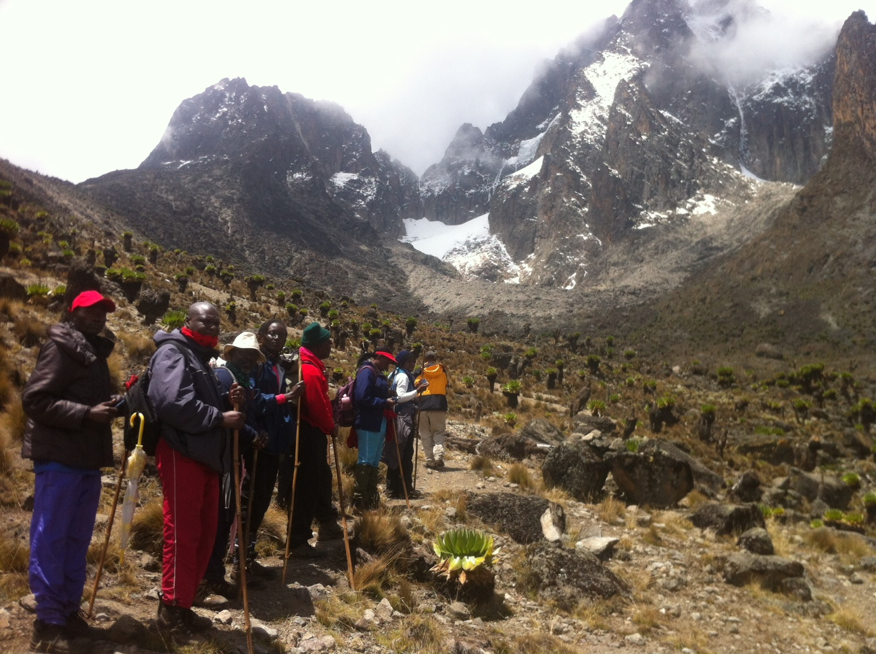

Slide 11
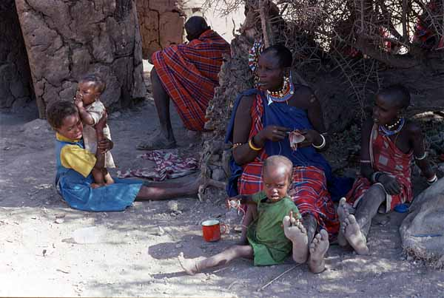
  Work life balance

Slide 12
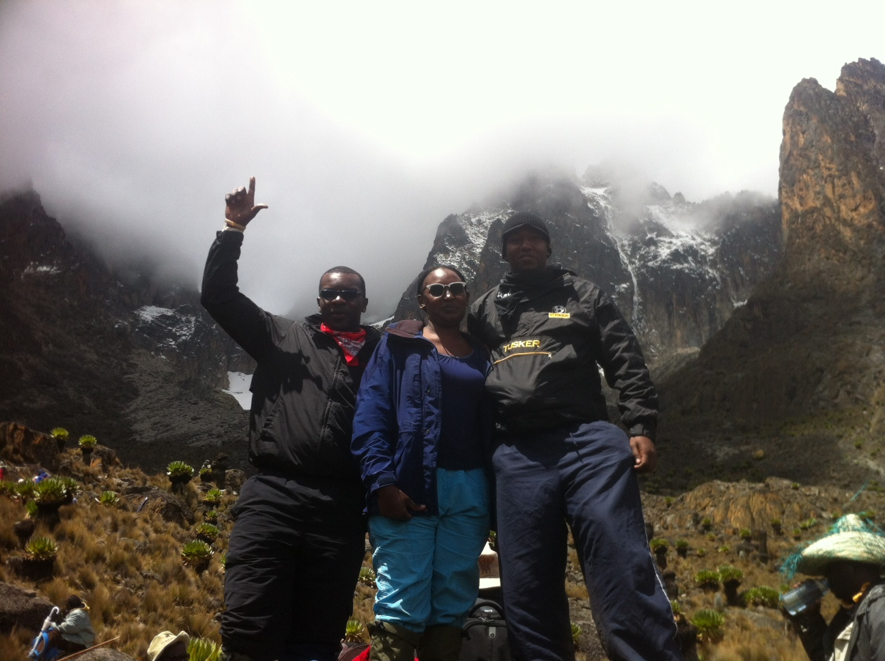

Slide 13
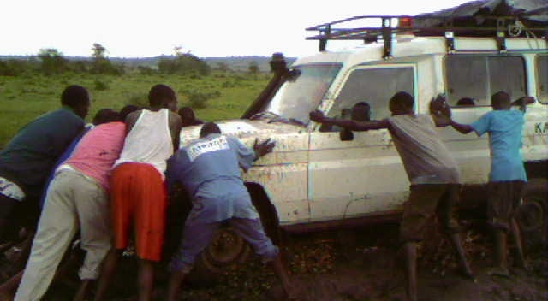
  Persistence

Slide 14
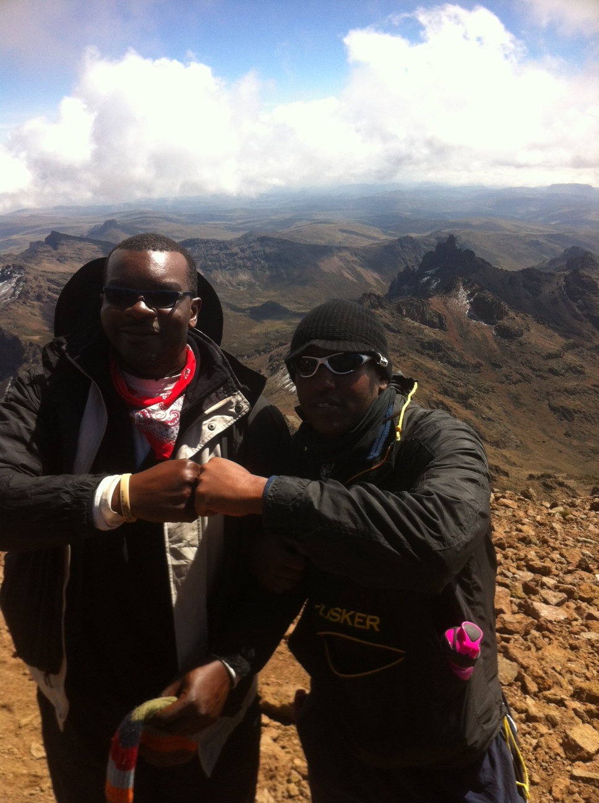

Slide 15
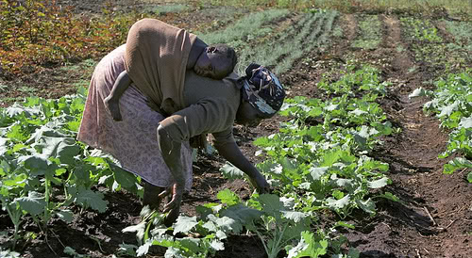
  Open doors and closed windows

Slide 16
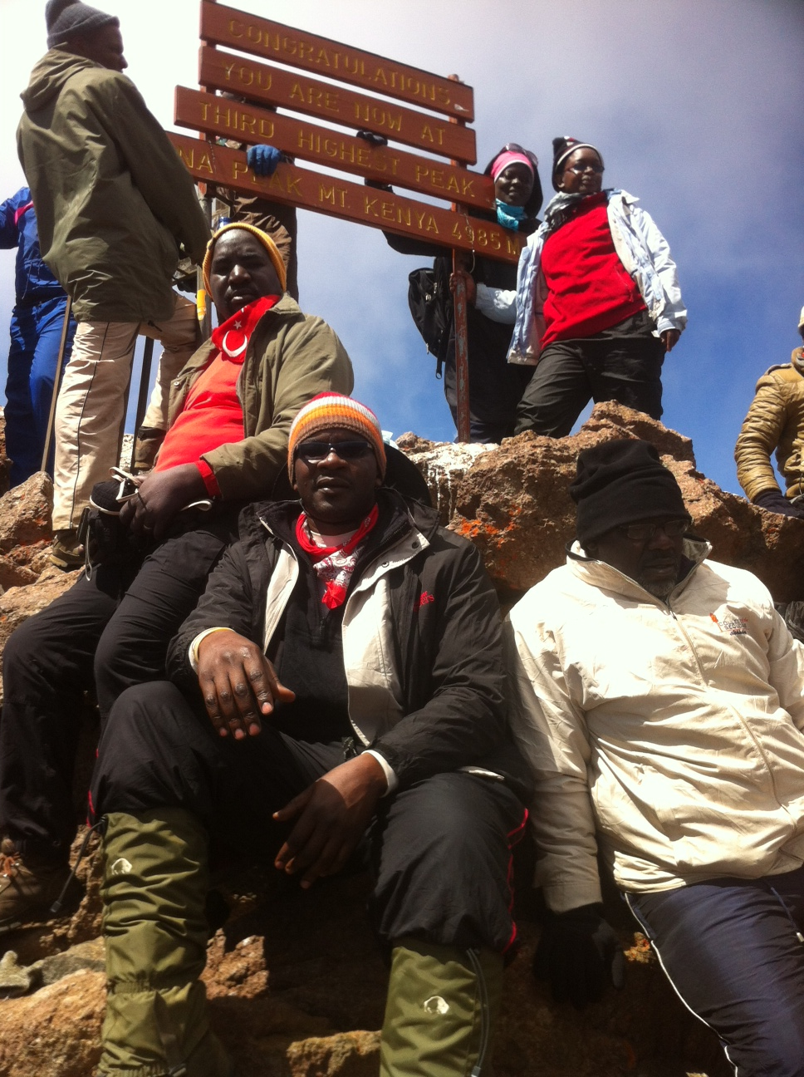

Slide 17
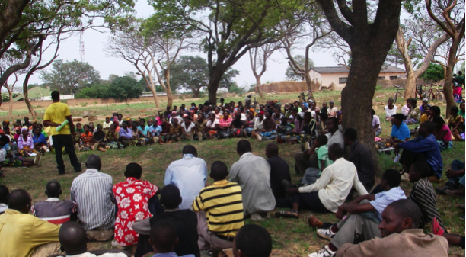
  Dissemination

Slide 18
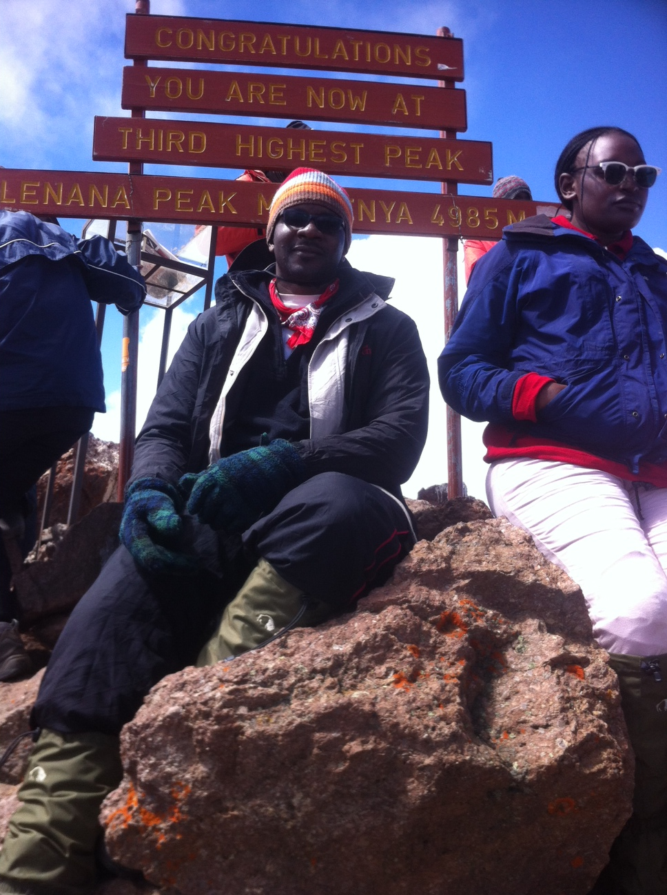

Slide 19
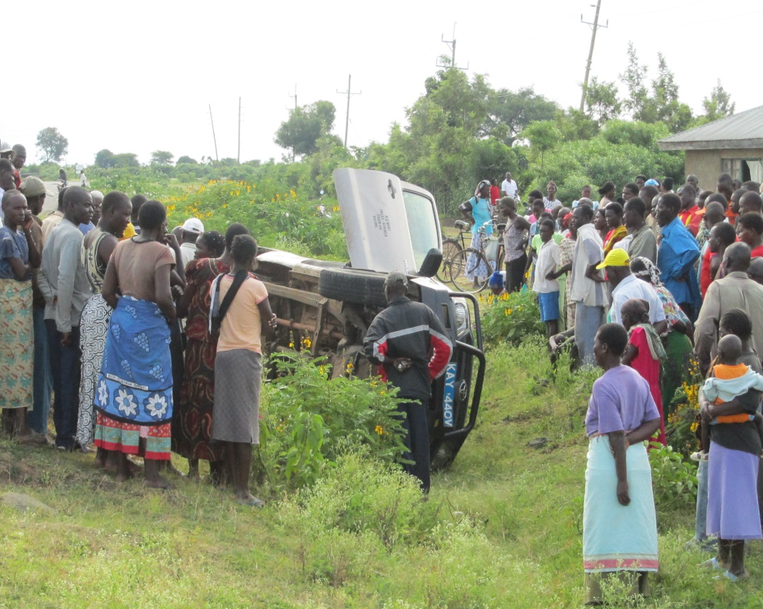
  Integrity

Slide 20
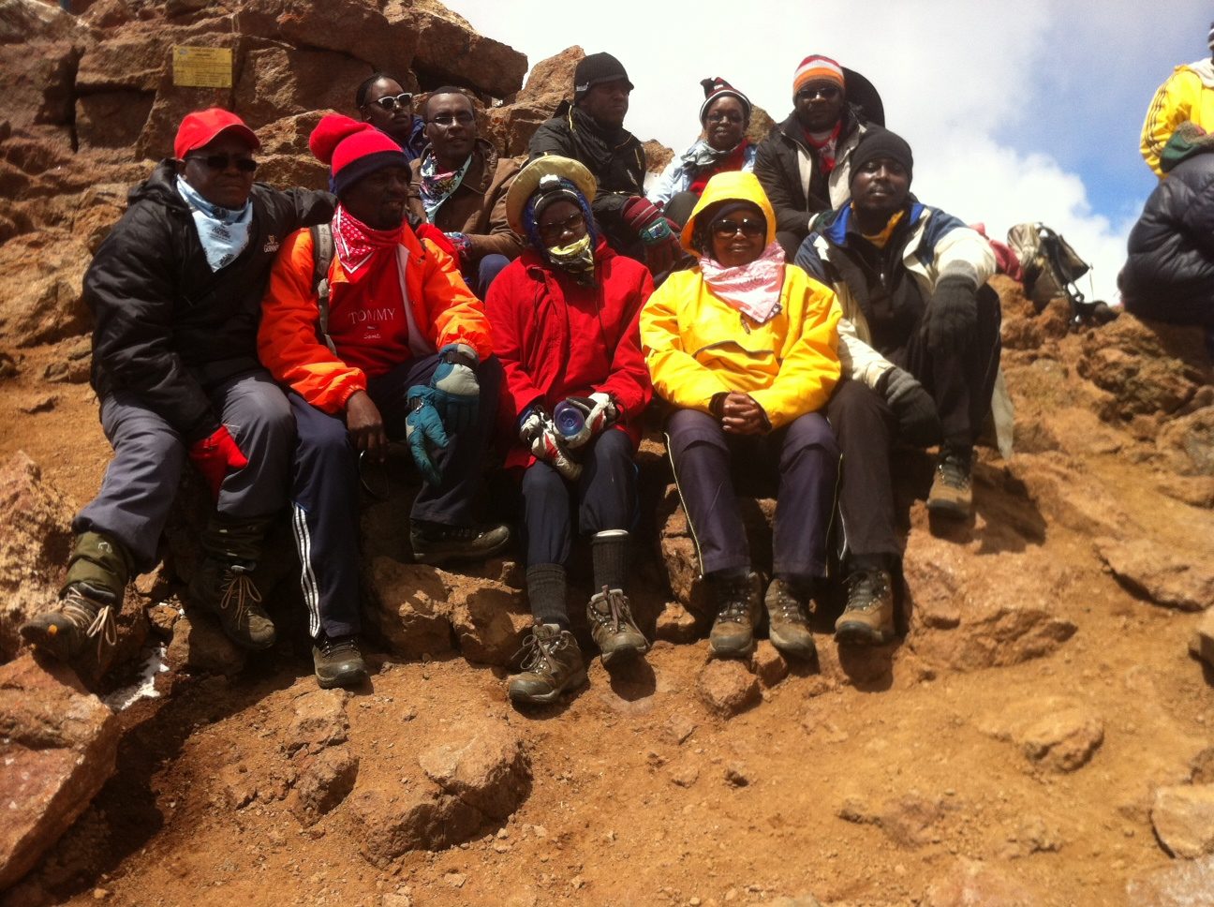

Slide 21
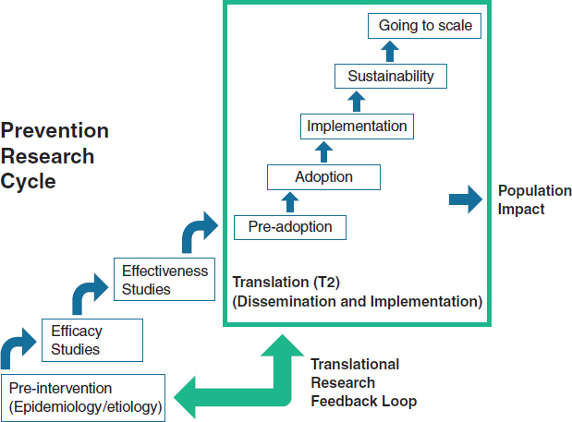

Slide 22
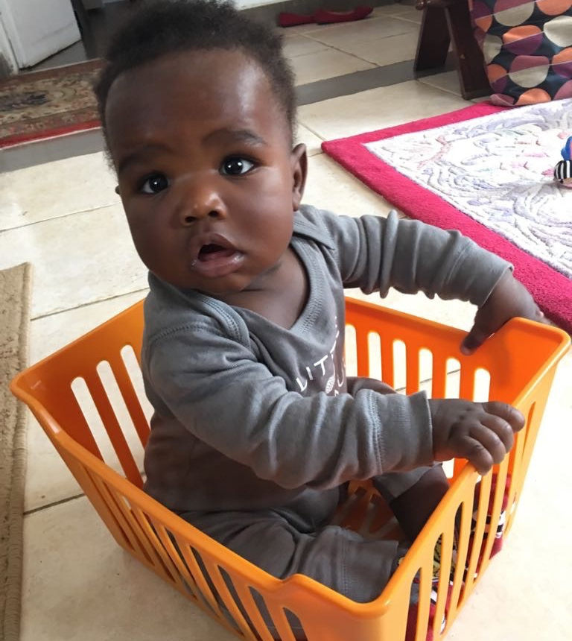
In Summary
It will not be easy, but it will be worth it

Slide 23
