Slide 1


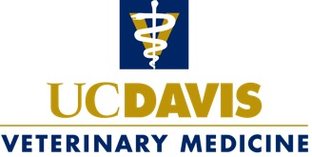
Not for me!
Research?
Patricia Conrad
DVM, PhD
Distinguished Professor
Associate Dean for Global Programs
and
Co-Director
UC Global Health Institute
Notes:
THANK YOU!
Stand-up – to be vet
Right hand- may like research
Left hand – Research is for me!
Tell a little known secret - confession

Slide 2
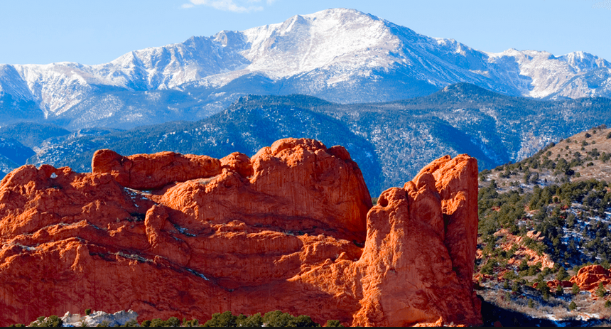
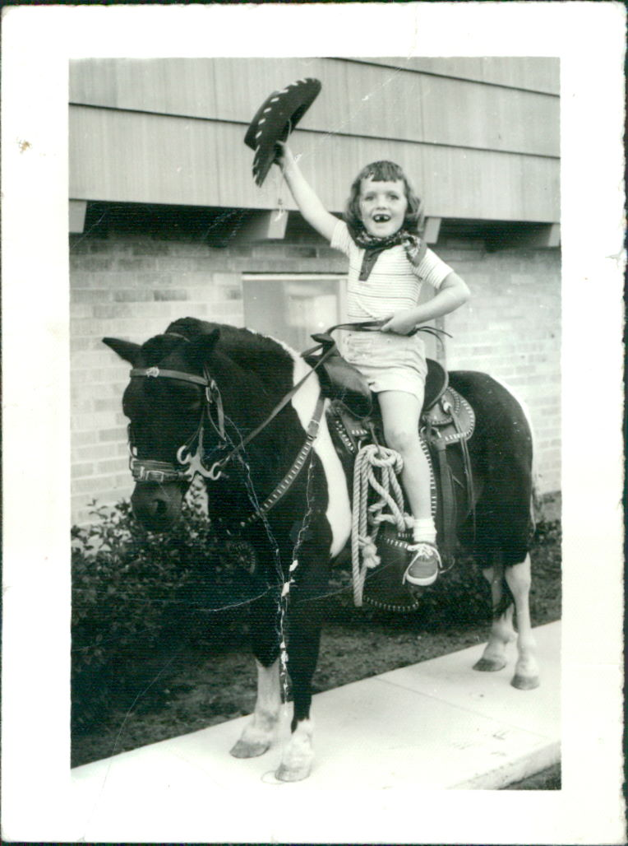
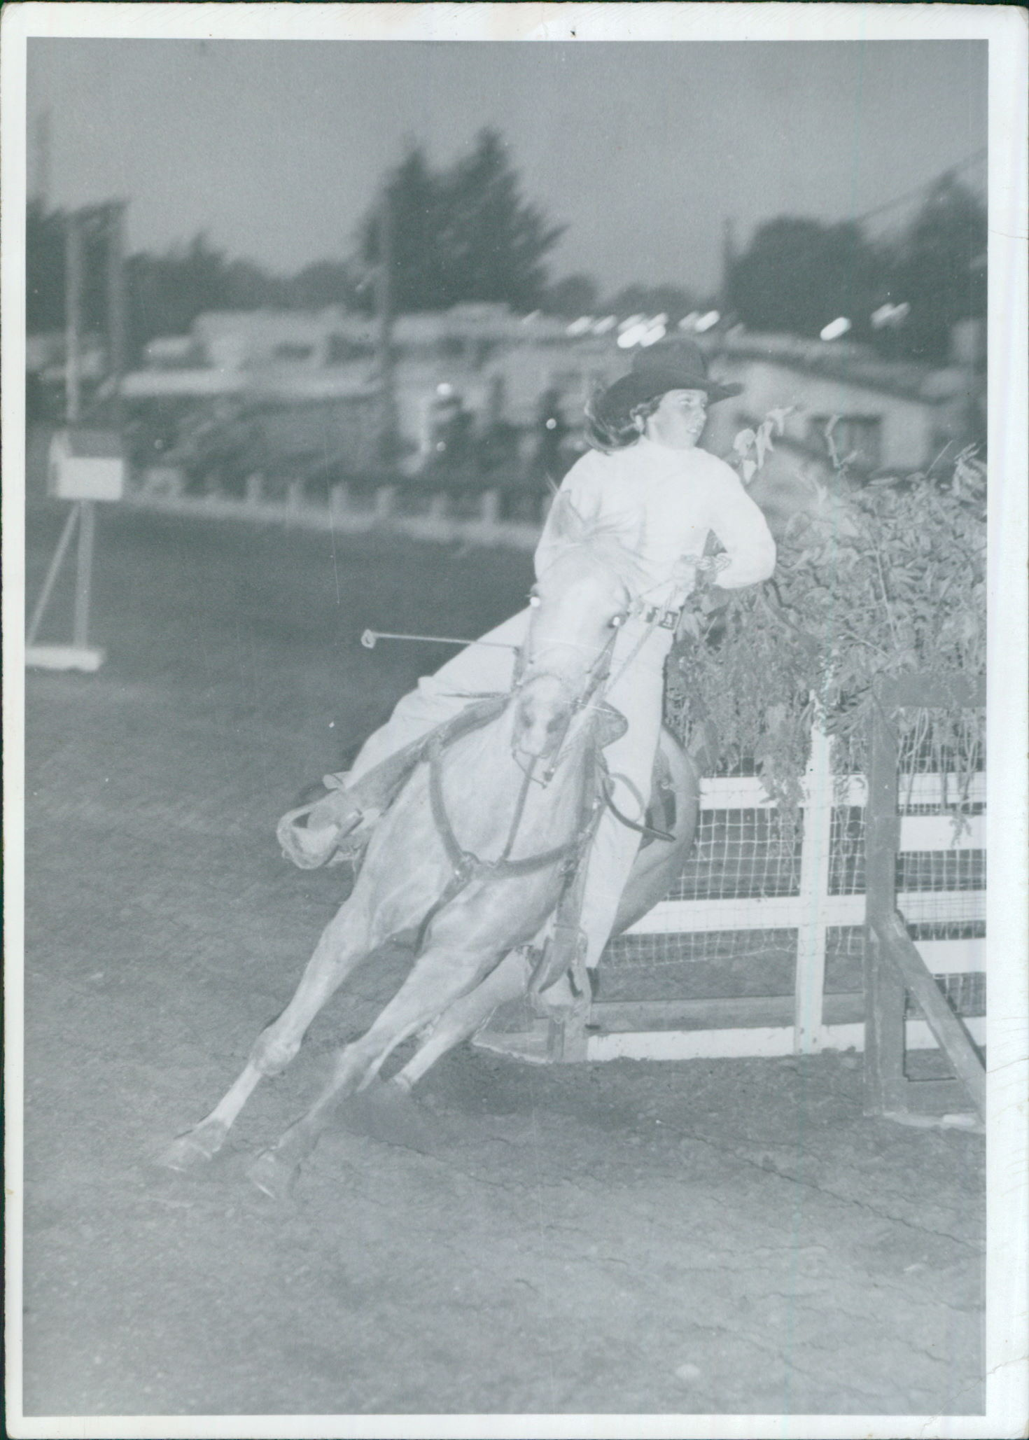
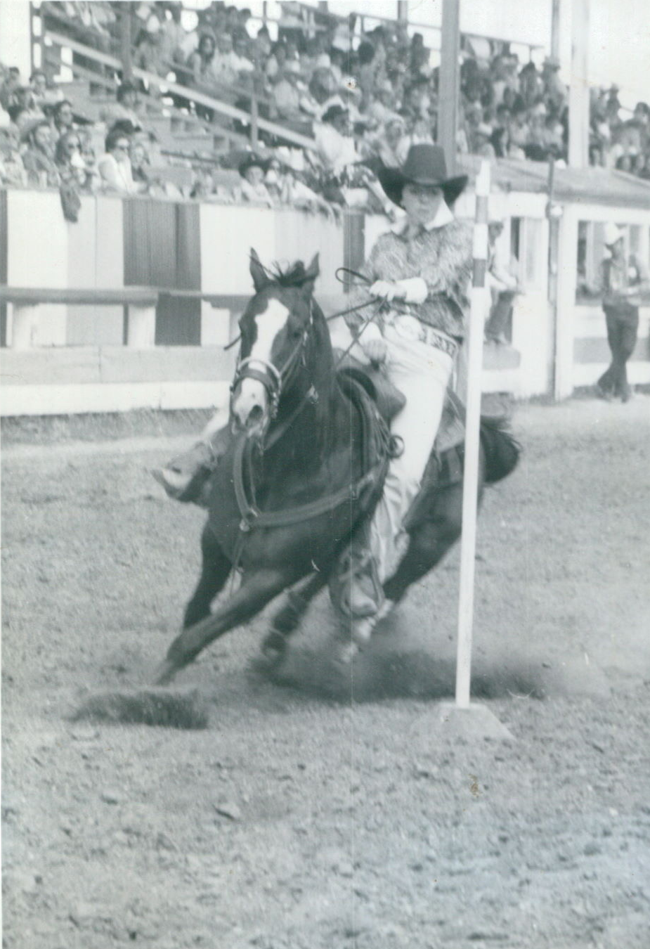
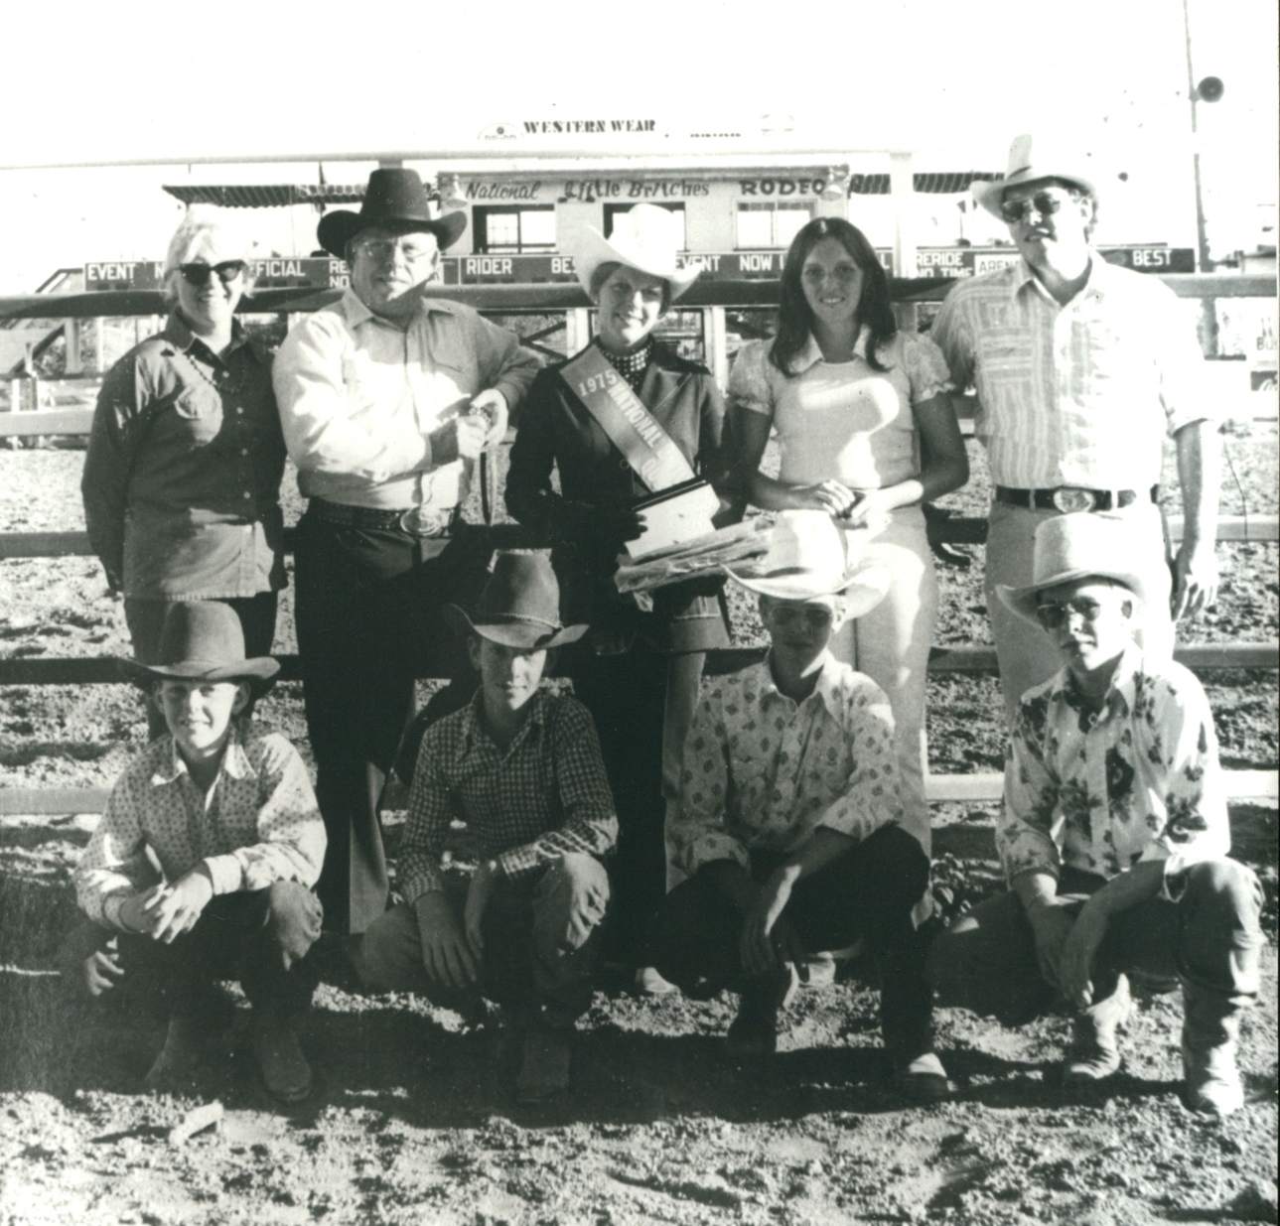

Slide 3
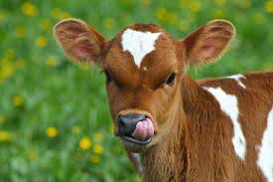
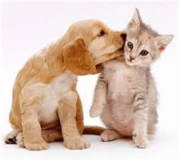

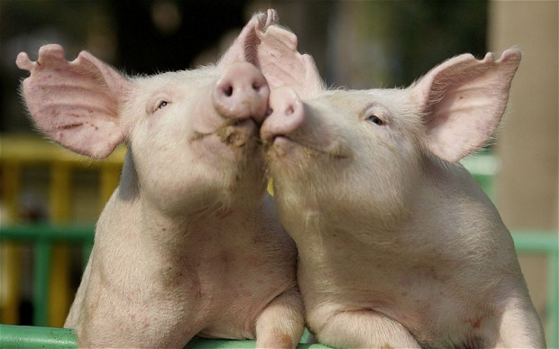
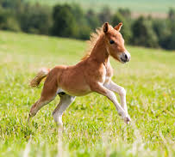
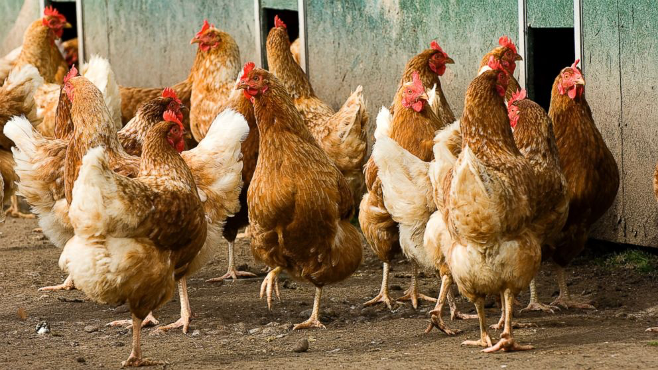
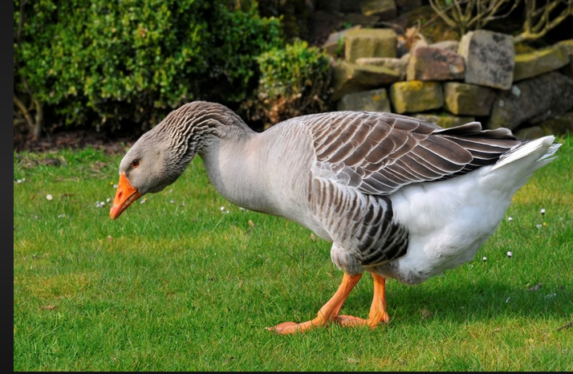
Rural Veterinarian
Notes:
-----------------
Crashin down -1st year –lost job – med tech
Don’t give-up your dream – Accept the help – those who support your dream
4-H Board, Faculty –financial aid

Slide 4
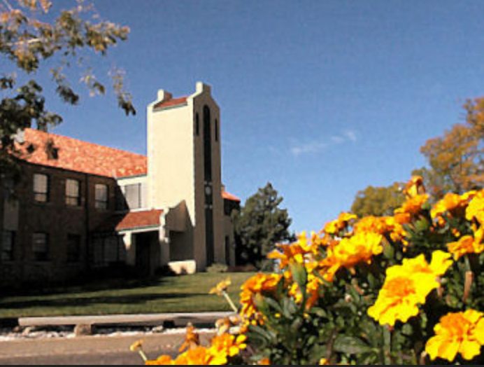

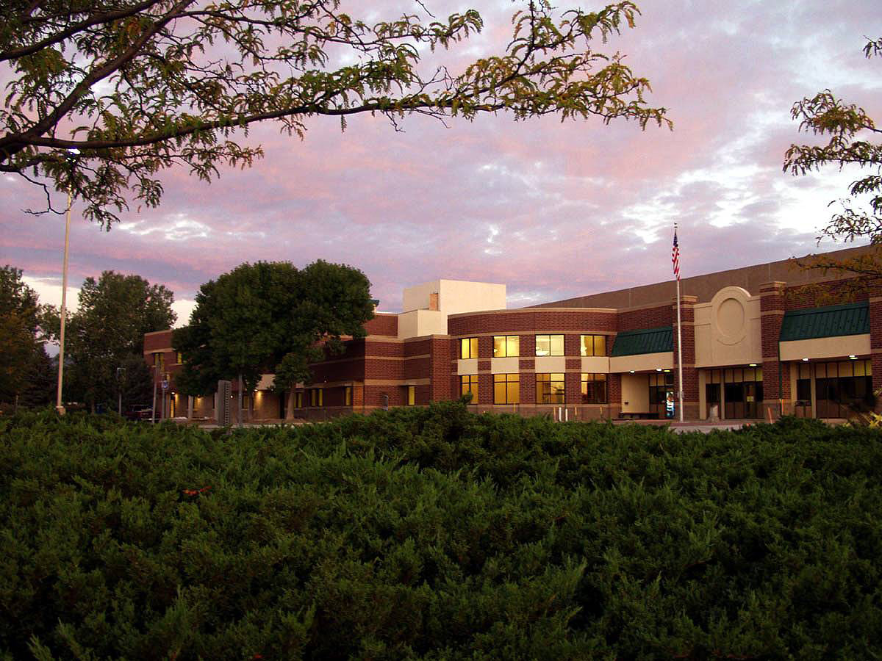
Work-Study
Research
NOT FOR ME!
Colorado State University
Notes:
Where to start?
Not as simple as a google search – many deadends
May find information in unexpected places- faculty- with accents/Deans/Ass Deans/ / bulletin board
Marshall Scholarship

Slide 5
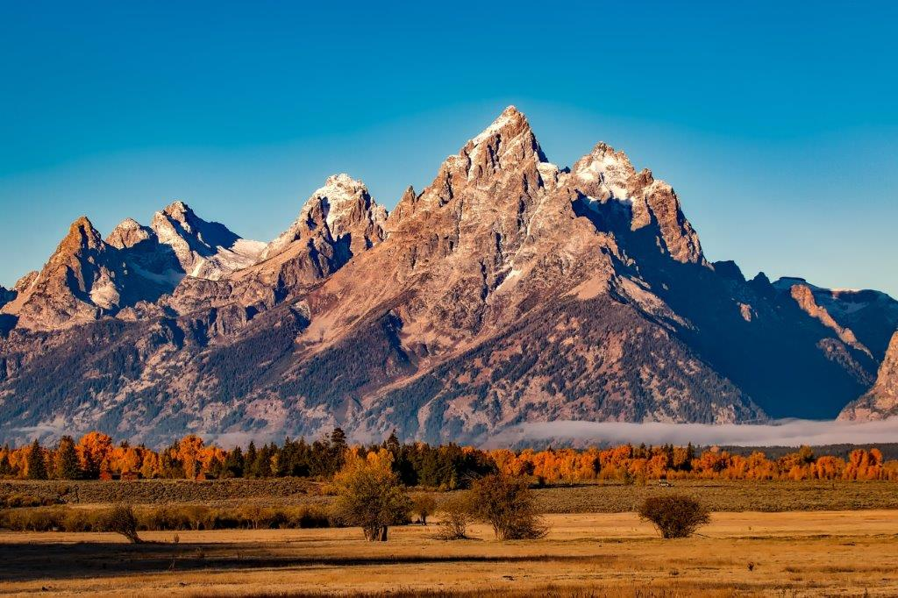


Take a Vacation

Slide 6
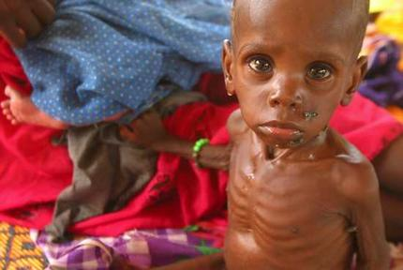
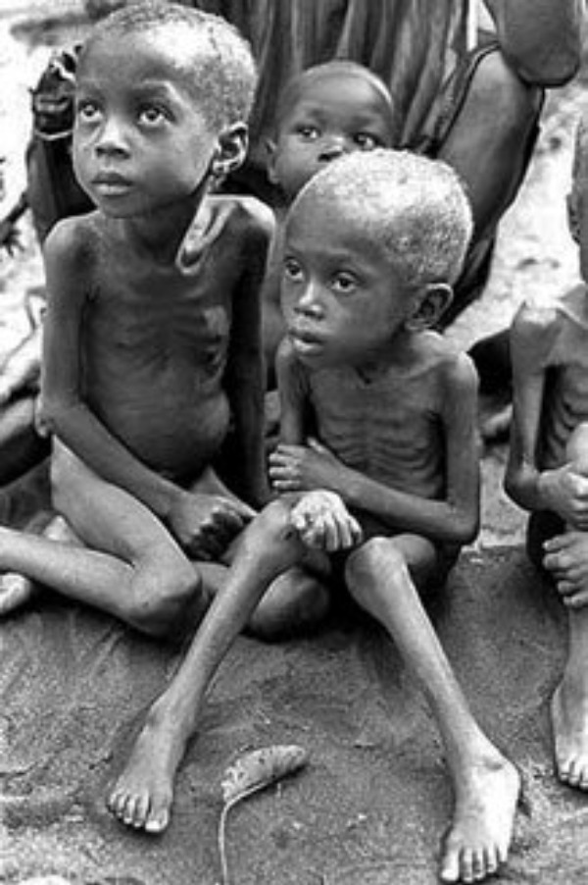
Hunger
in
Africa
Notes:
But even that species may benefit from our help. Although we as veterinarians may not be able to save the starving children in places like Darfur or at that time BiaAfria…there are ways that we can contribute to the reducing hunger and malnutrition particiularly in areas

Slide 7
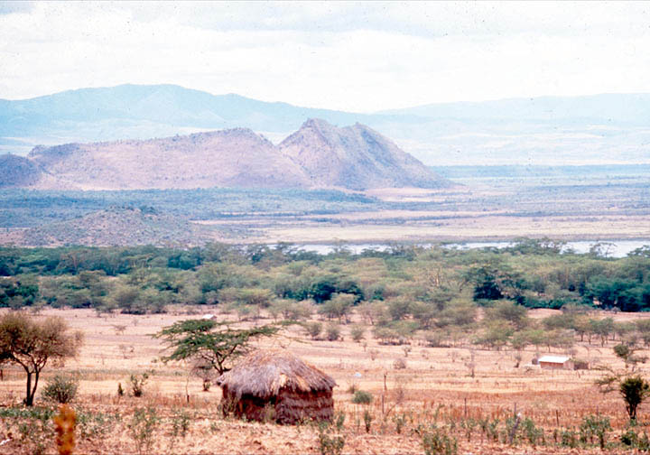
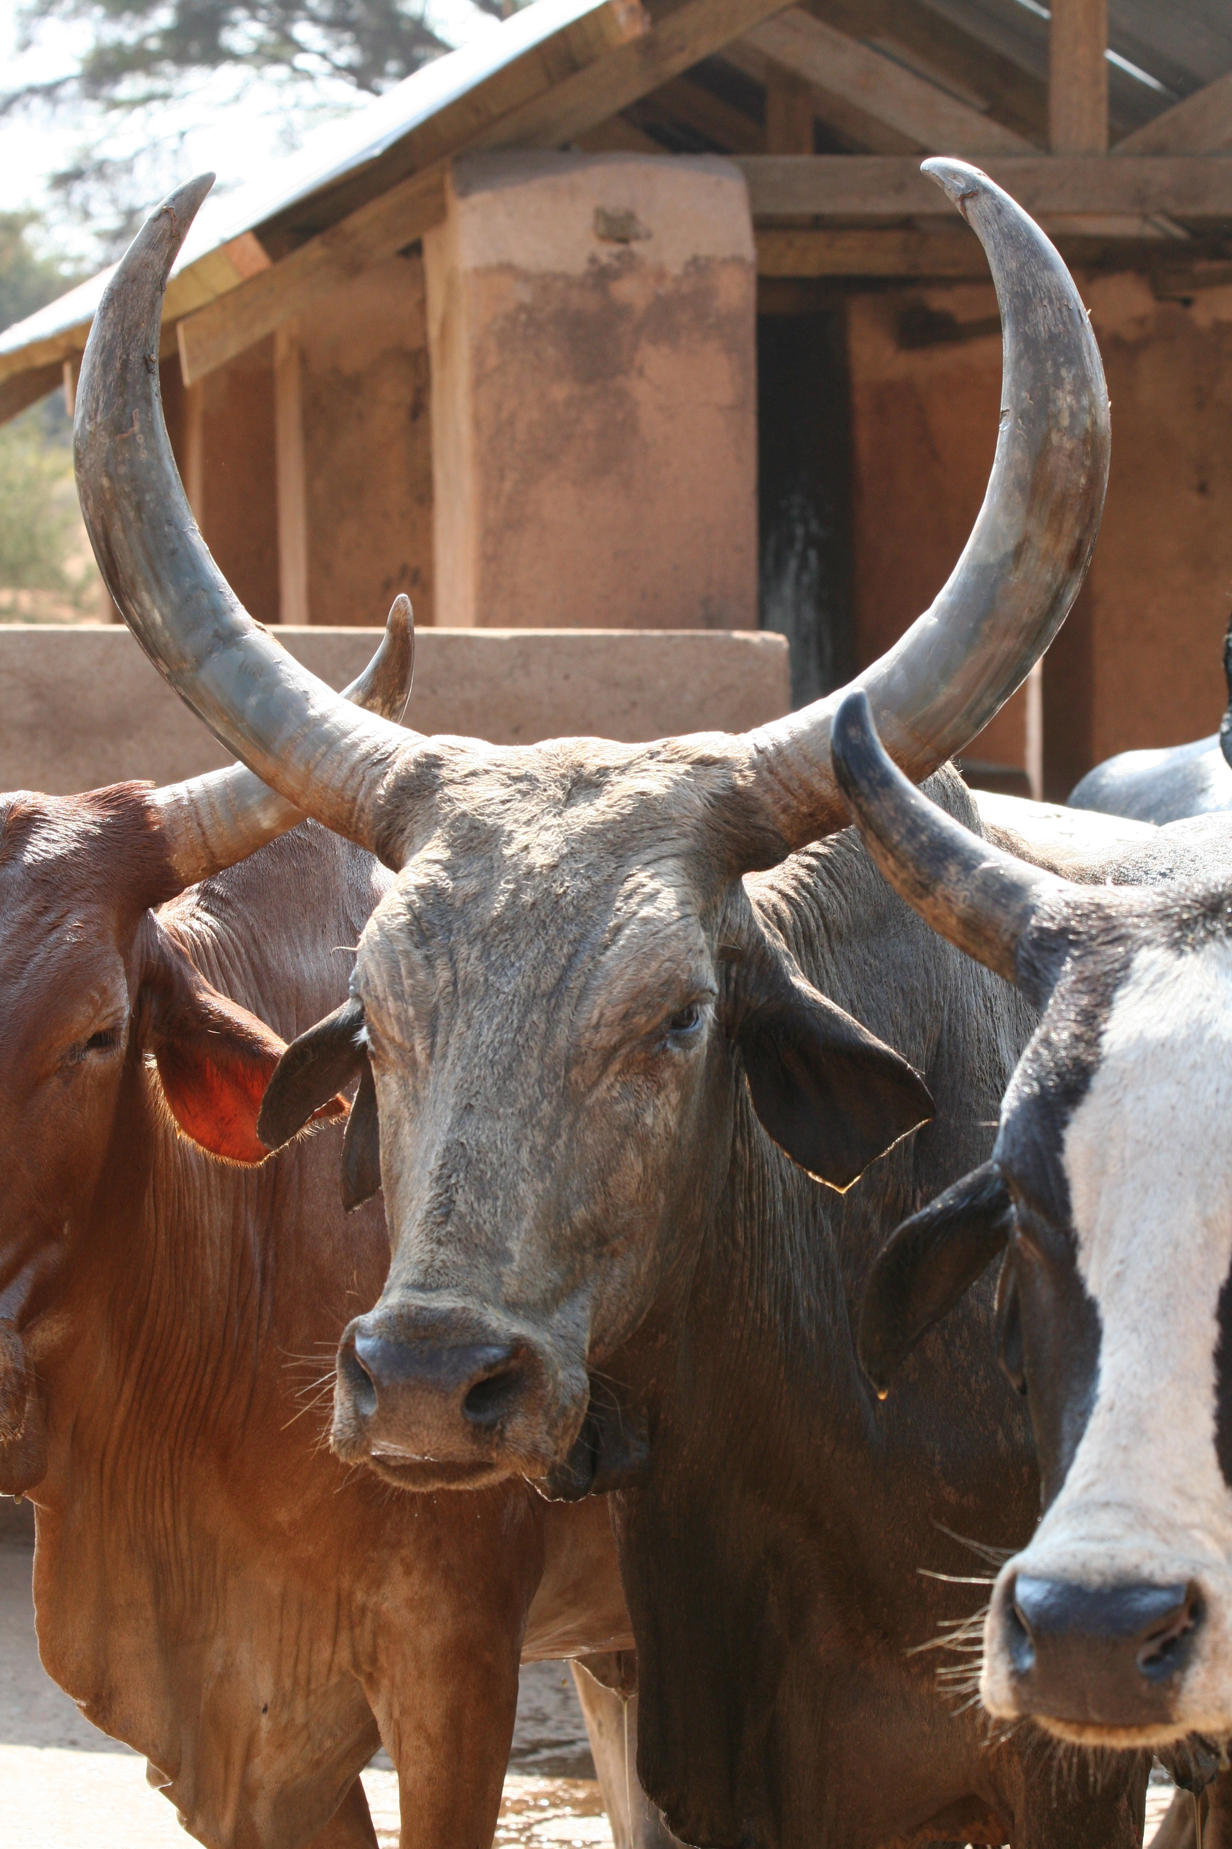
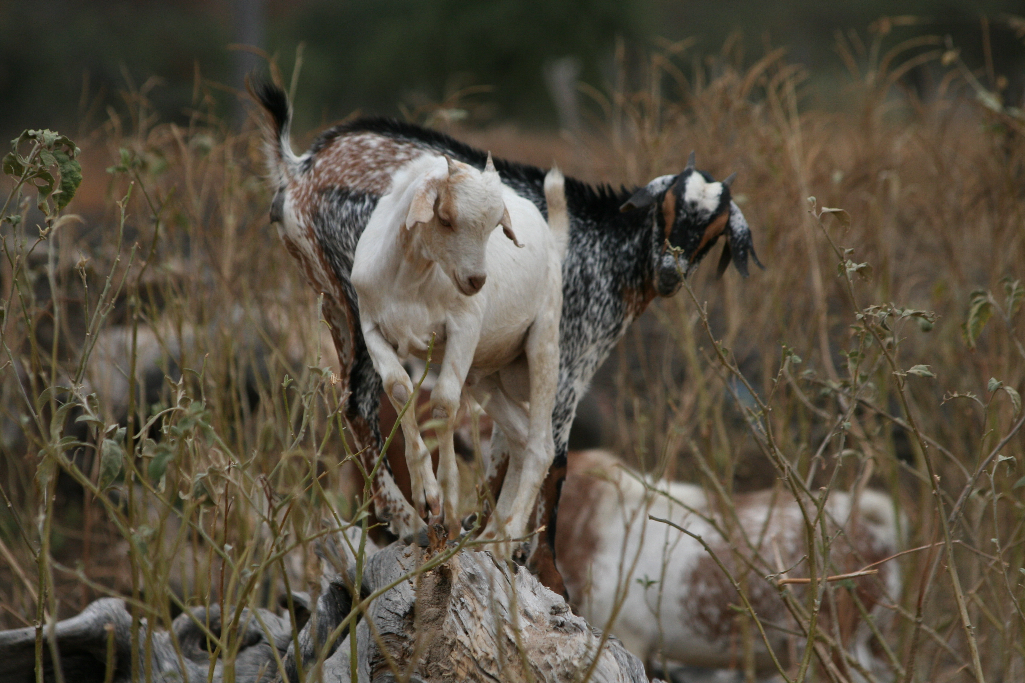
Notes:
Particularly in low resource and arid countries where much of the land is not arable and livestock production is critical

Slide 8


Edinburgh
Scotland
Notes:
Where to start?
Not as simple as a google search – many deadends
May find information in unexpected places- faculty- with accents/Deans/Ass Deans/ / bulletin board
Marshall Scholarship

Slide 9
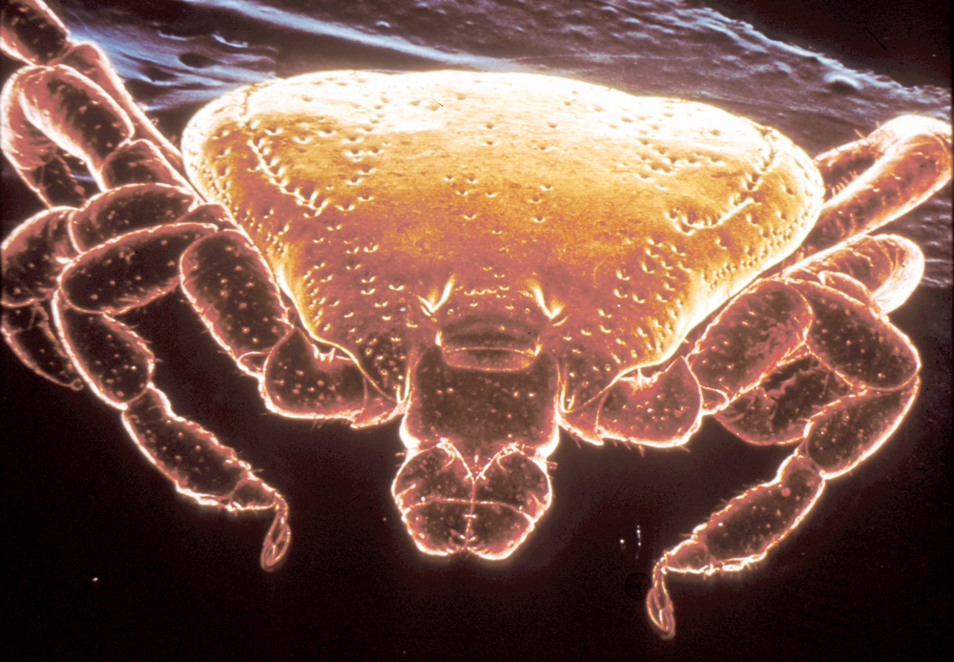

Centre for Tropical Veterinary Medicine
University of Edinburgh
East Coast Fever
Notes:
Incredible living in Briton with people from Africa, LA, Britian
Develop my own ideas and project – challenging – so different from veterinary school- creative – what if? How?
Why PhD – dr. of Philosophy not Dr of research
Value of negative results
Not working more….Working smarter
Job opportunities – academia in Europe & USA, government
Research – Not for me
PhD more than just a license to travel – key to international opportunities

Slide 10

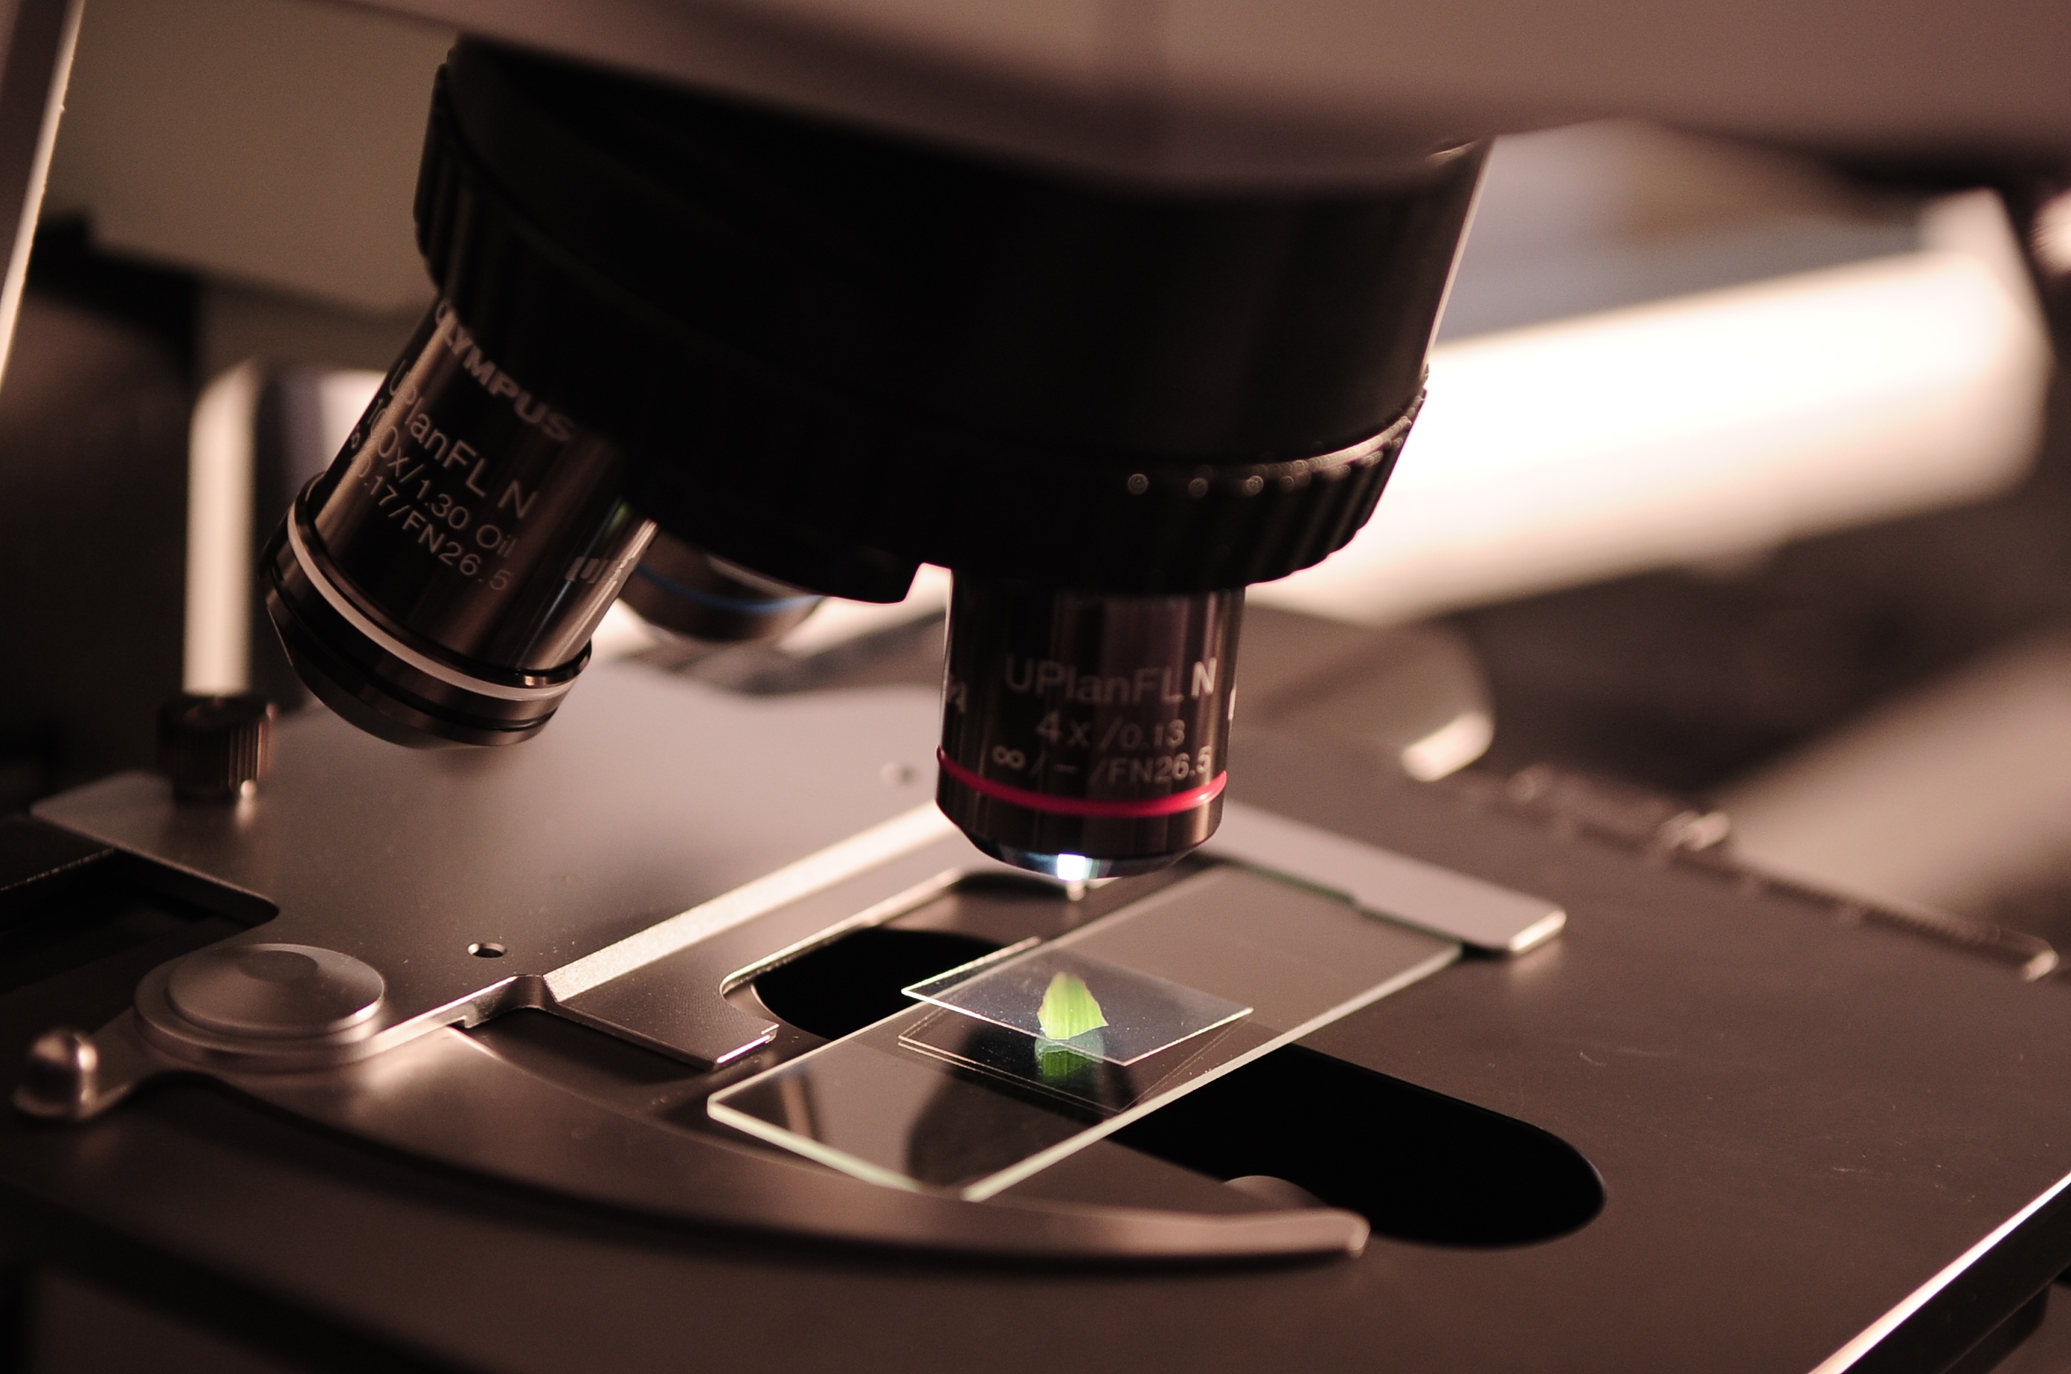

Continuous cultivation
of Theileria in RBC
STILL
NOT FOR ME!
T. parva does not multiple
Notes:
May add Theileria dividing stages

Slide 11
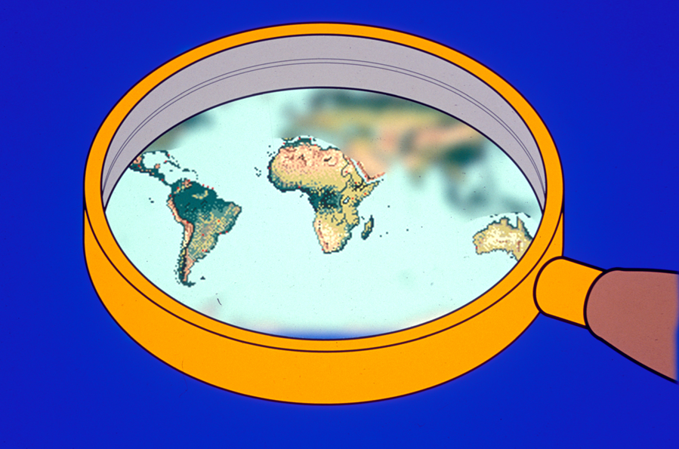
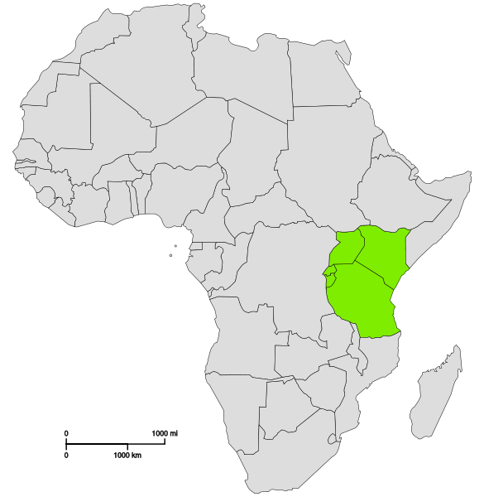
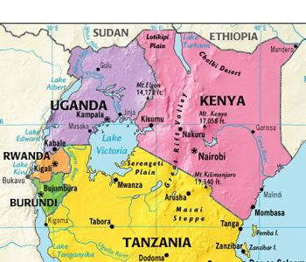
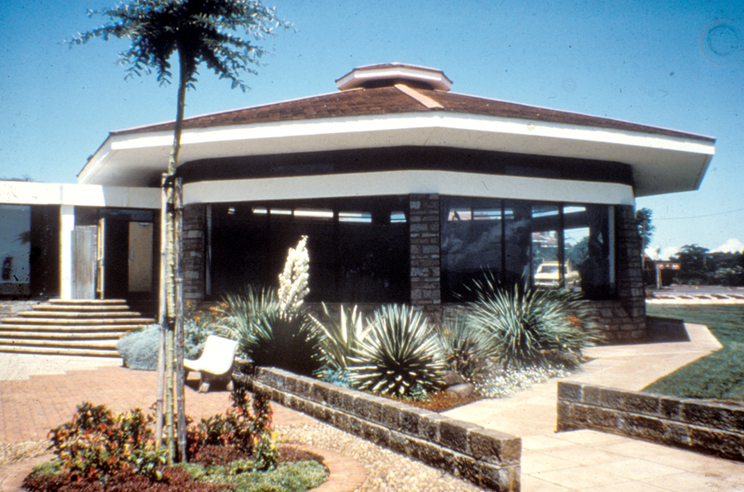
International Laboratory
for Research
on Animal Diseases
(now ILRI)
Notes:
World changing with rapid international travel and worldwide communication- what we do is of interest to many worldwide and what happens affects us. We need to respond to this change. If not – missed opportunities. If we do …..well that’s what I would like to talk about.
Global – often describes a more holistic or “boundary-less” worldview, and involves operating in many different regions. This view takes a more holistic, interdependent, and interconnected approach. -

Slide 12
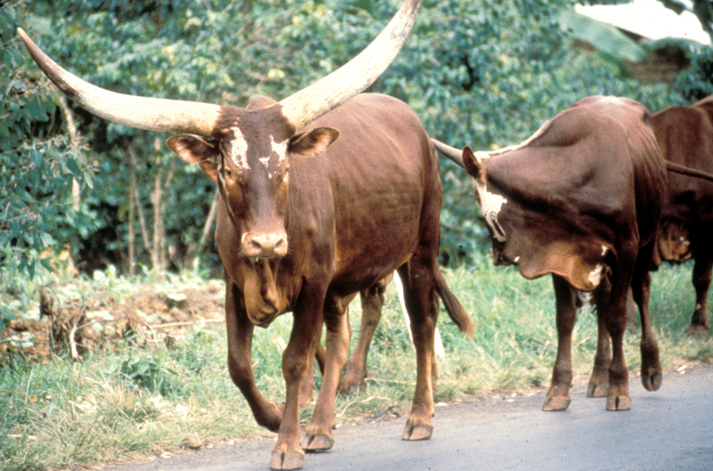
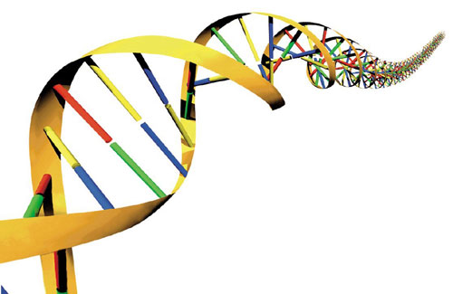
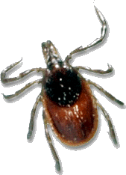
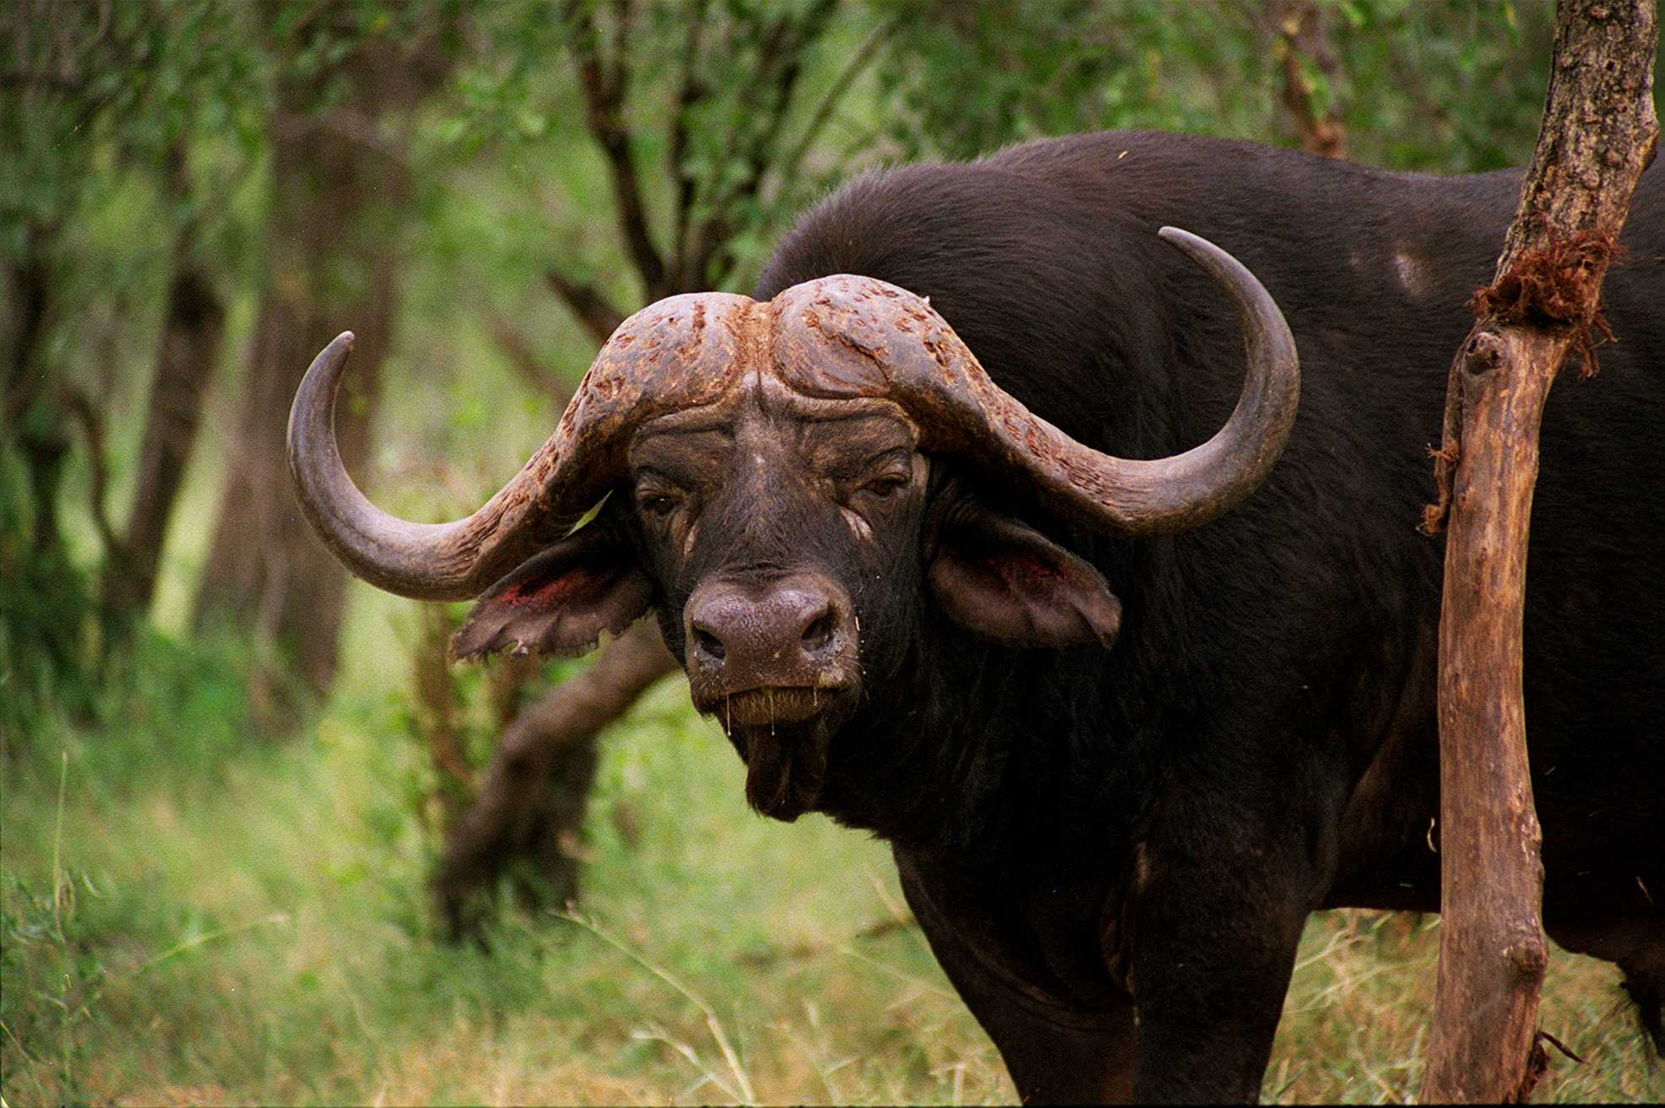
GOAL:
Develop a Vaccine to East Coast Fever

Slide 13

Team
Research
Immunologist
Parasitologist
Molecular
Biologist
Tissue
Culturist
Cell
Biologist
Epidemiologist

Slide 14
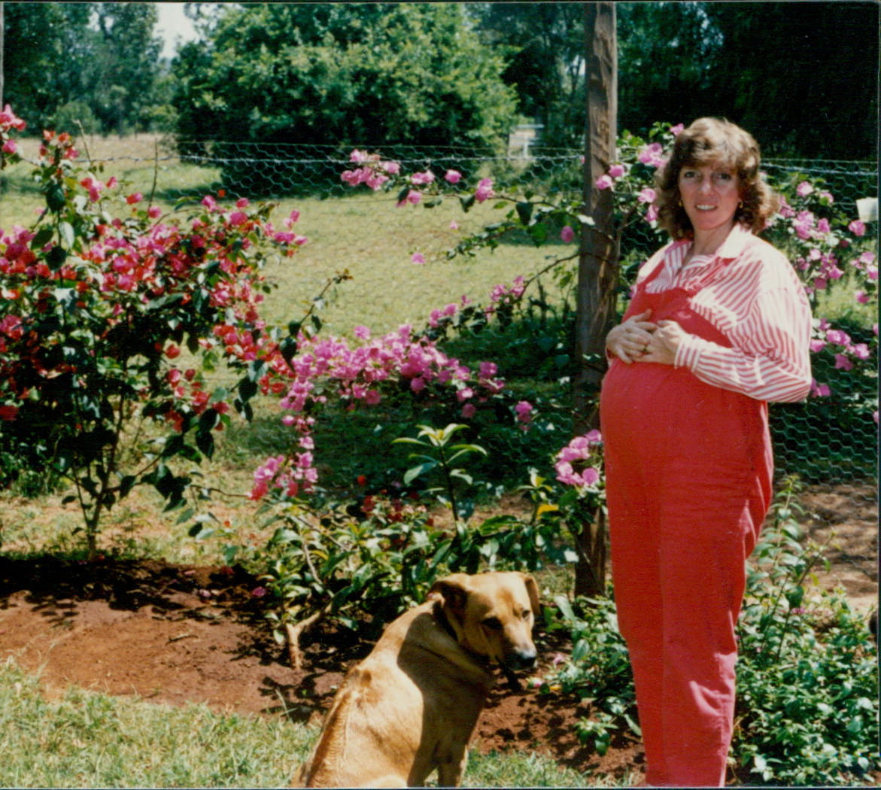
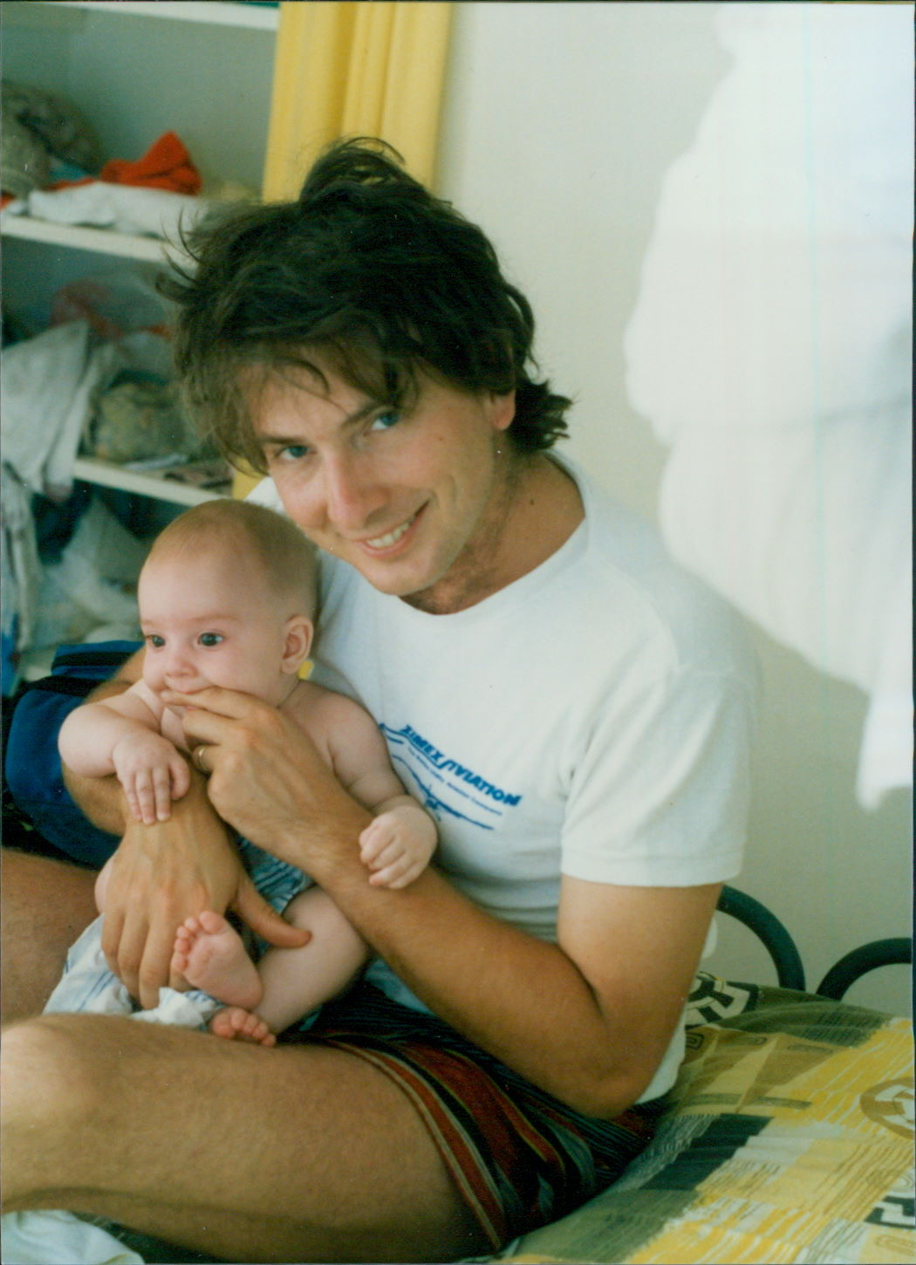
THIS IS FOR ME!!
TRANSFORMATIONAL!

Slide 15

Out of Africa
To California

Slide 16
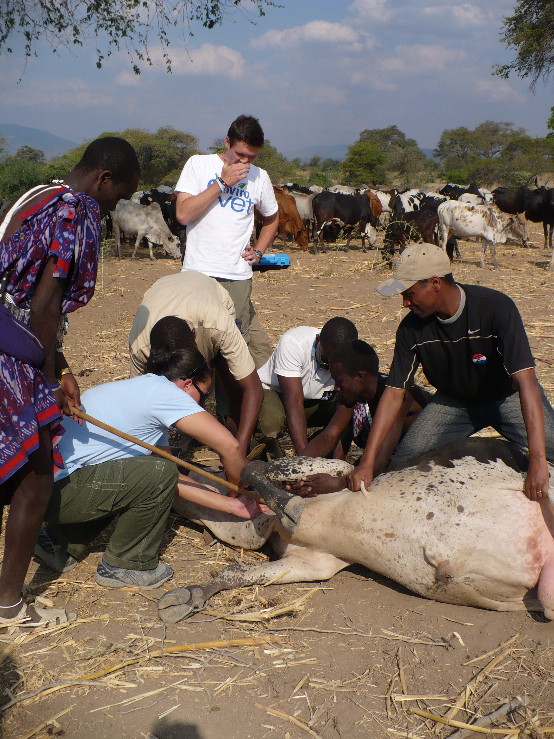
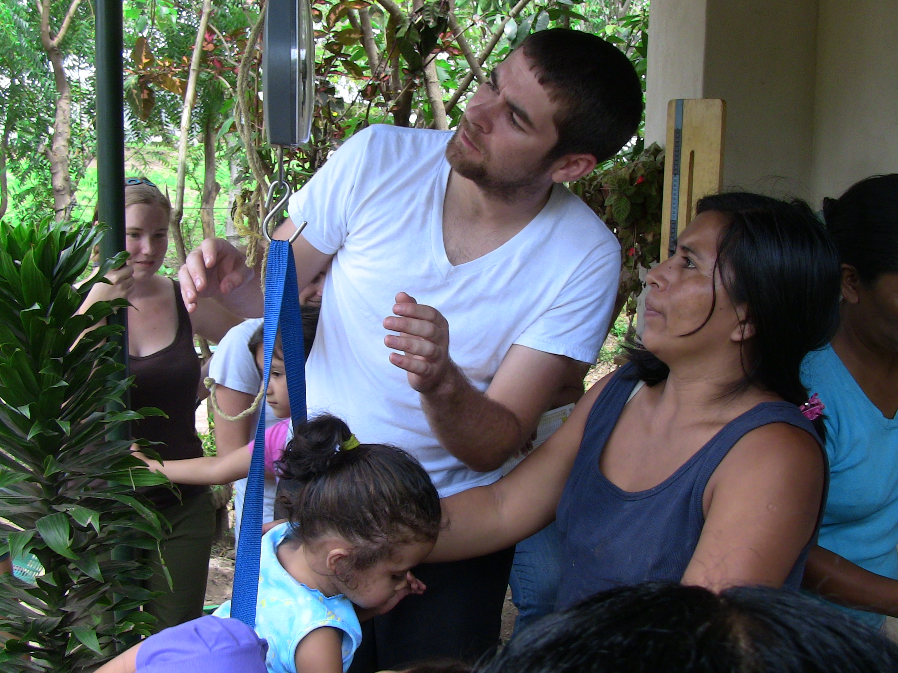
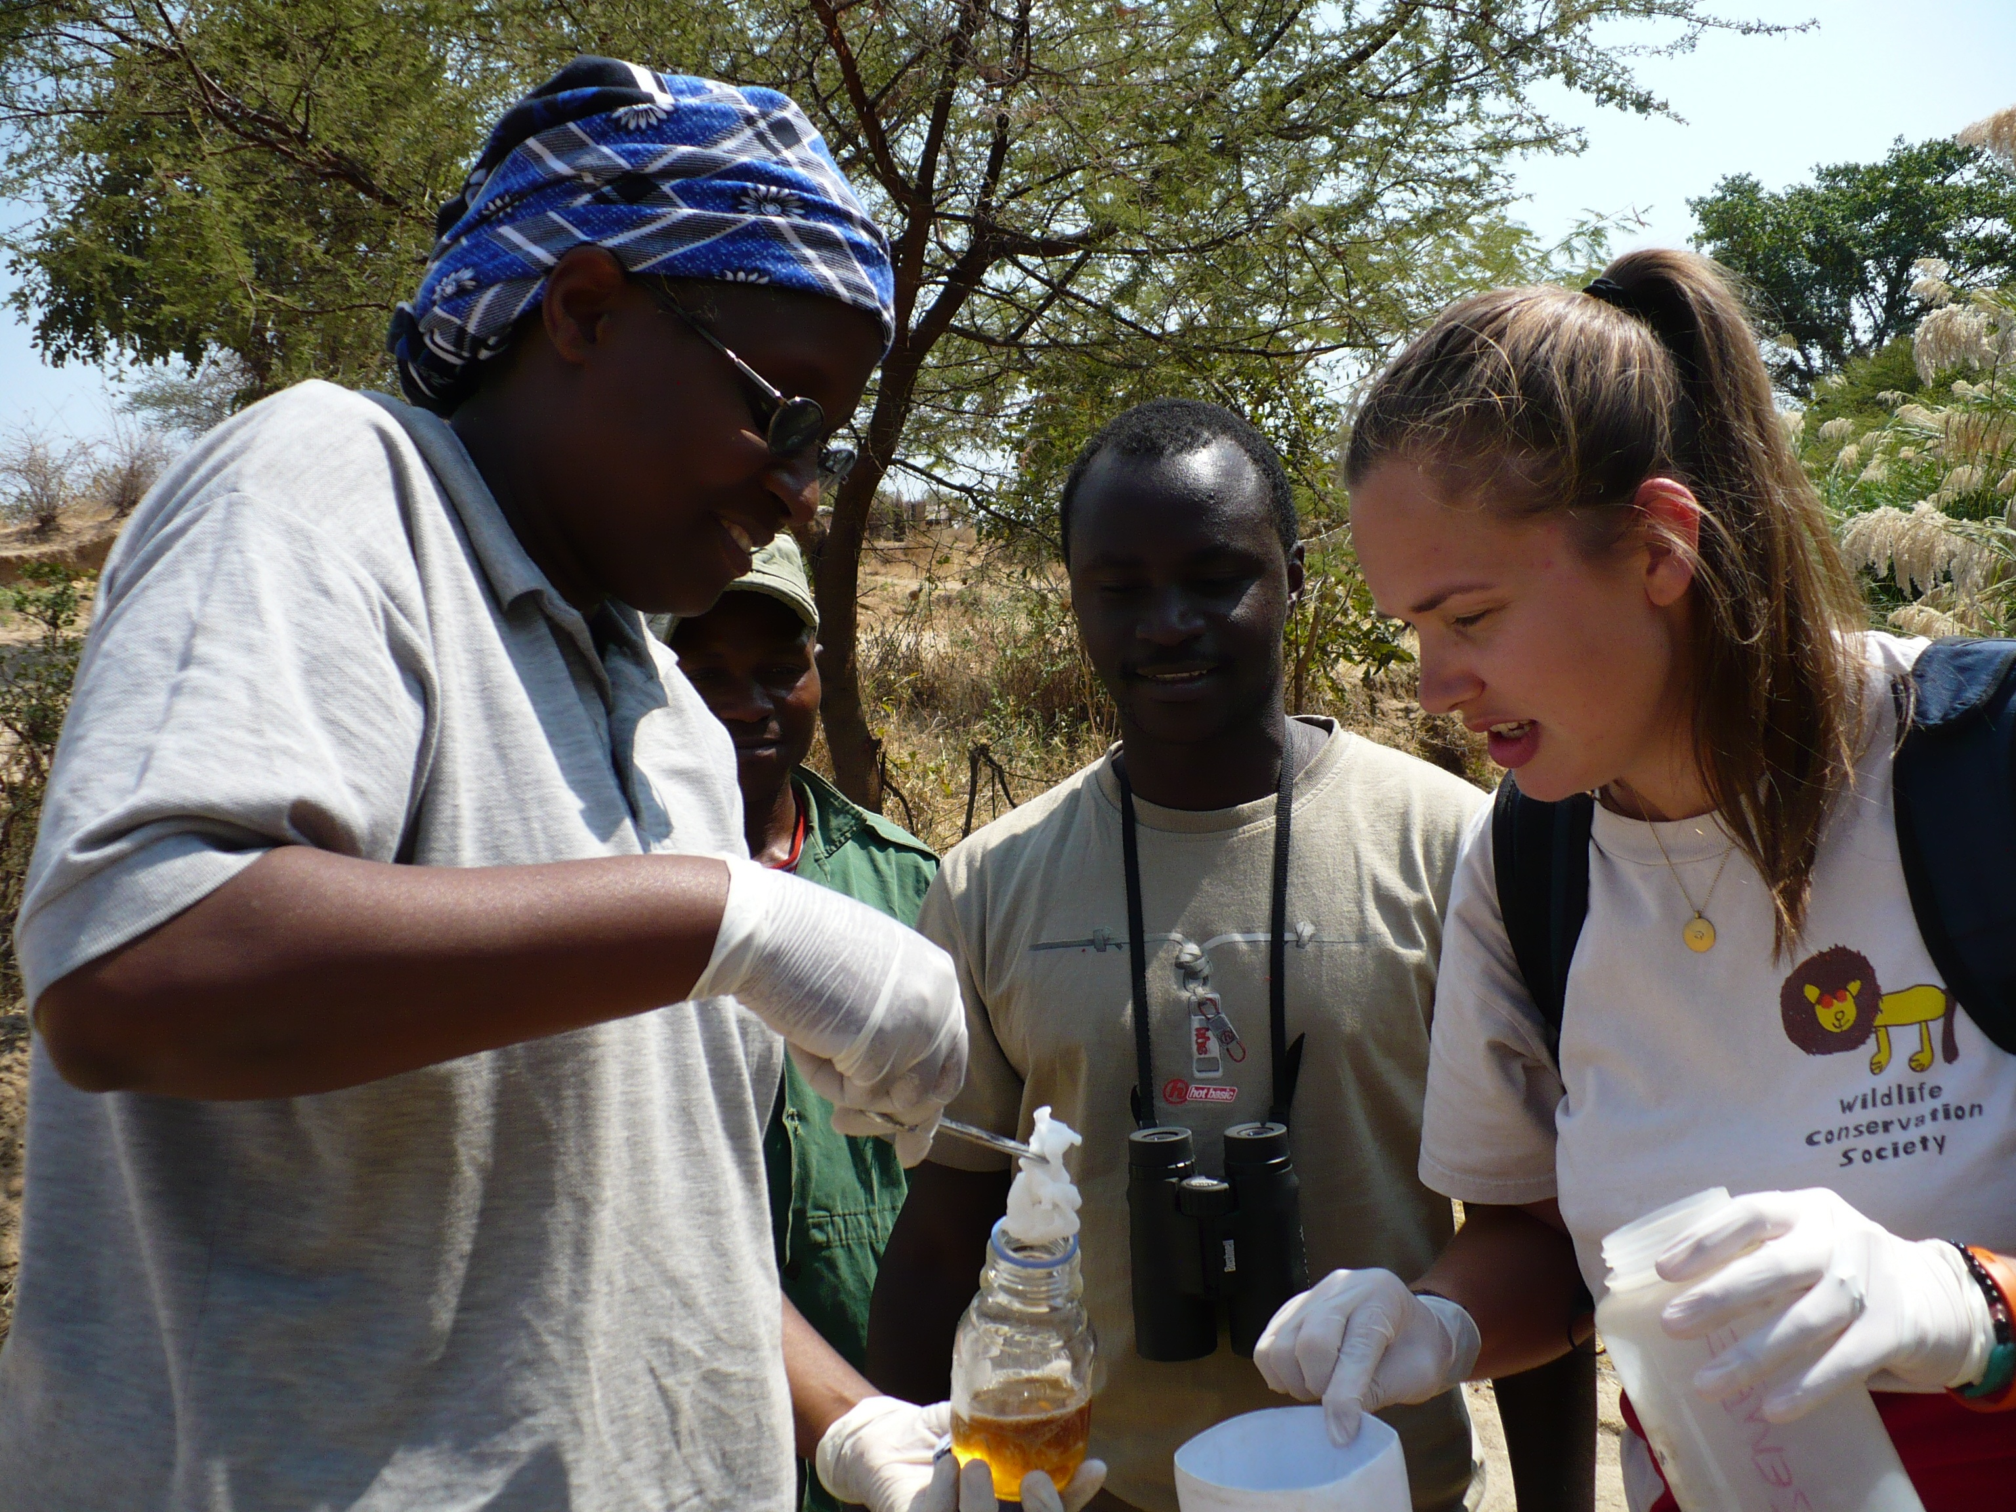
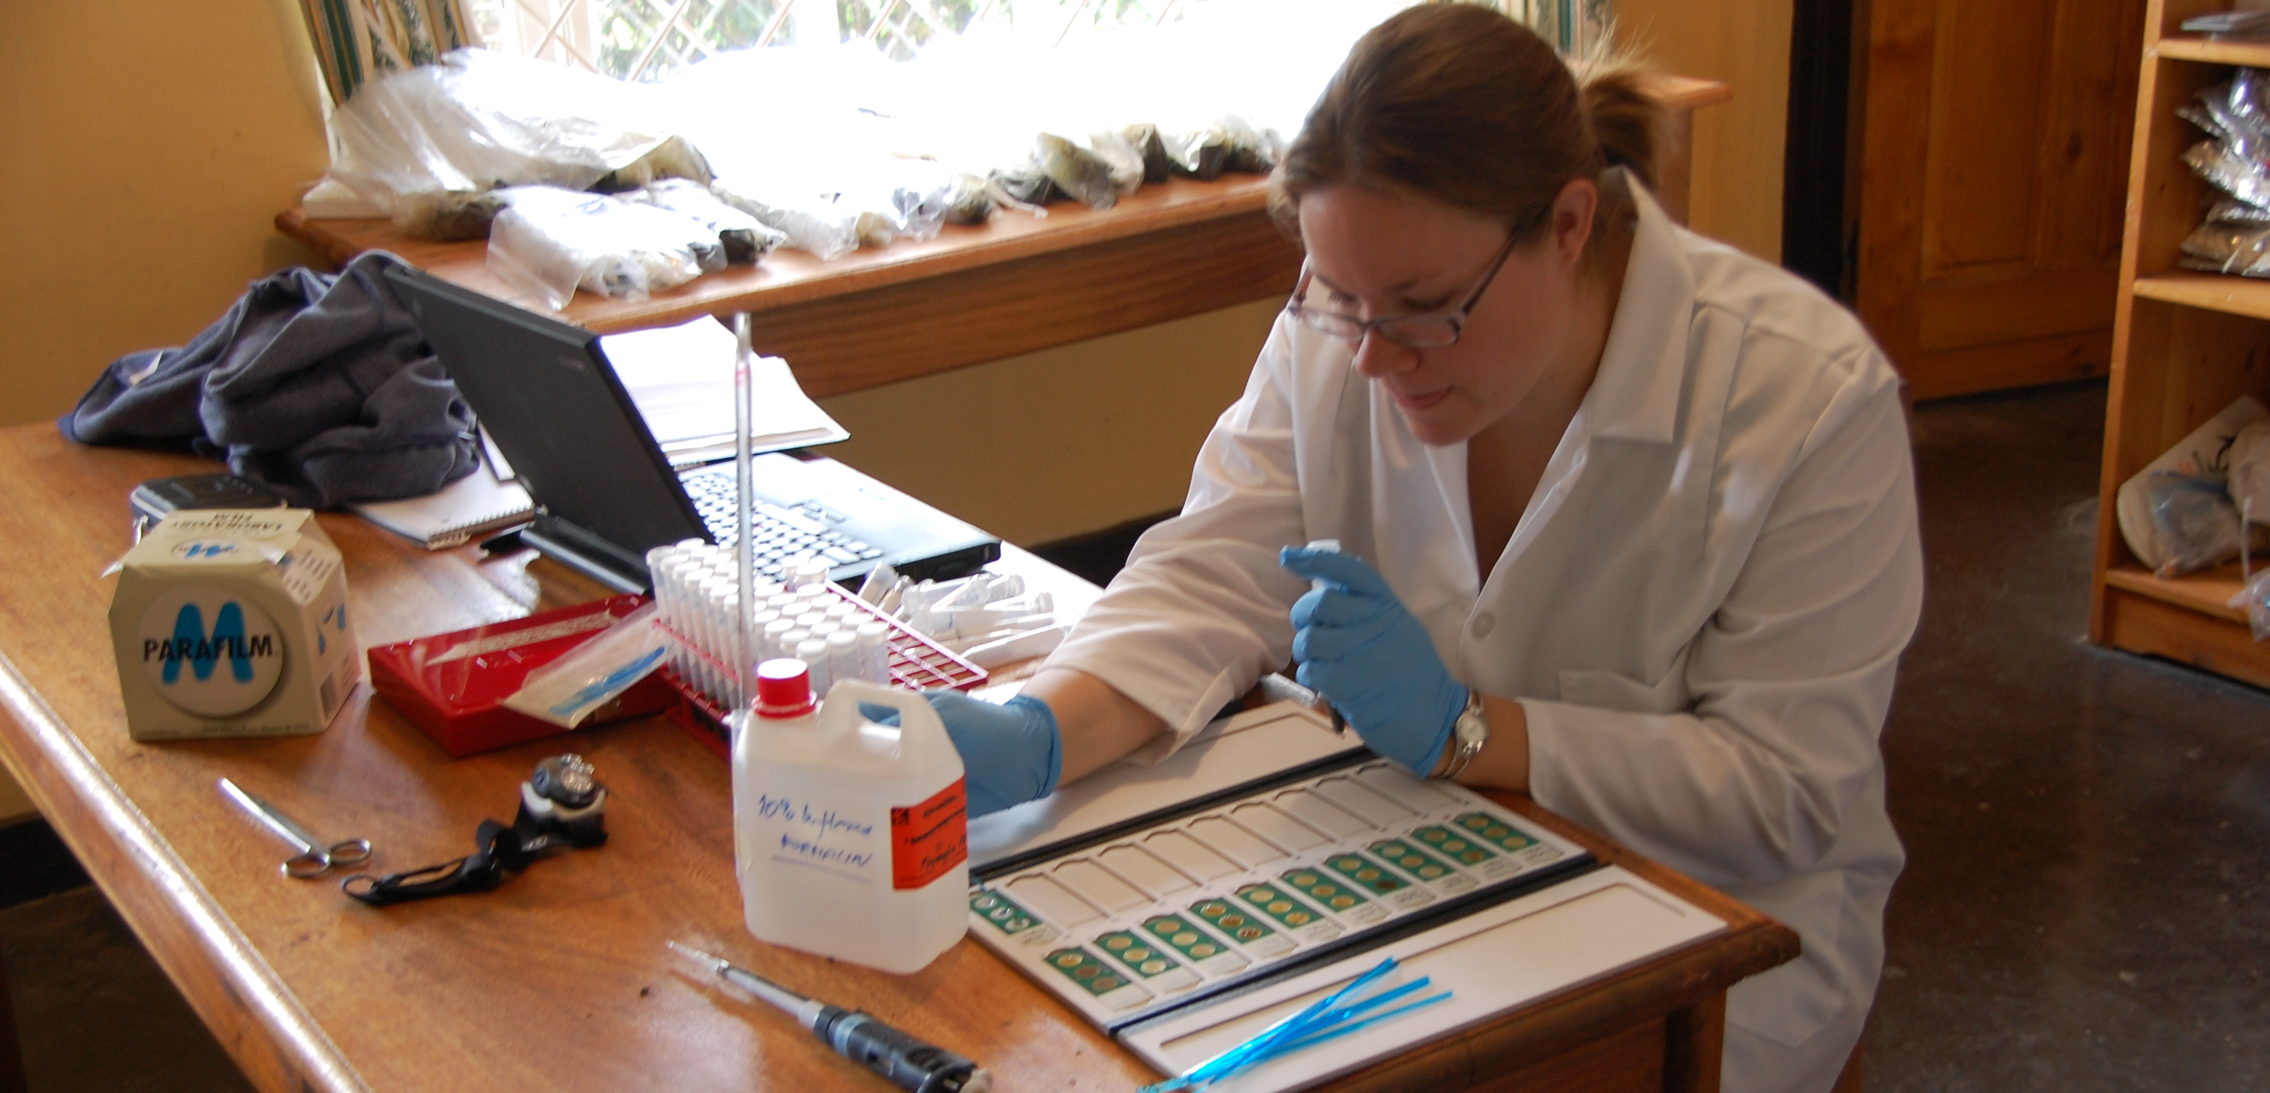
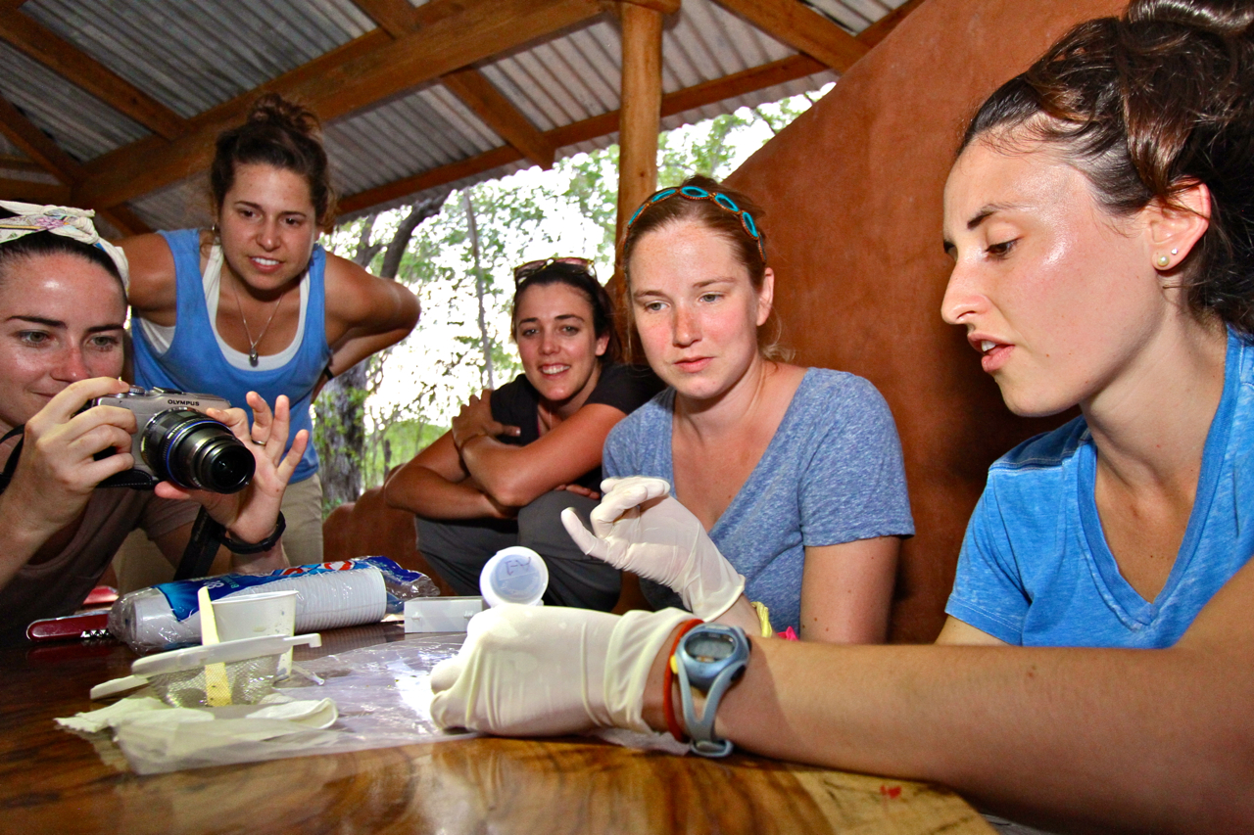
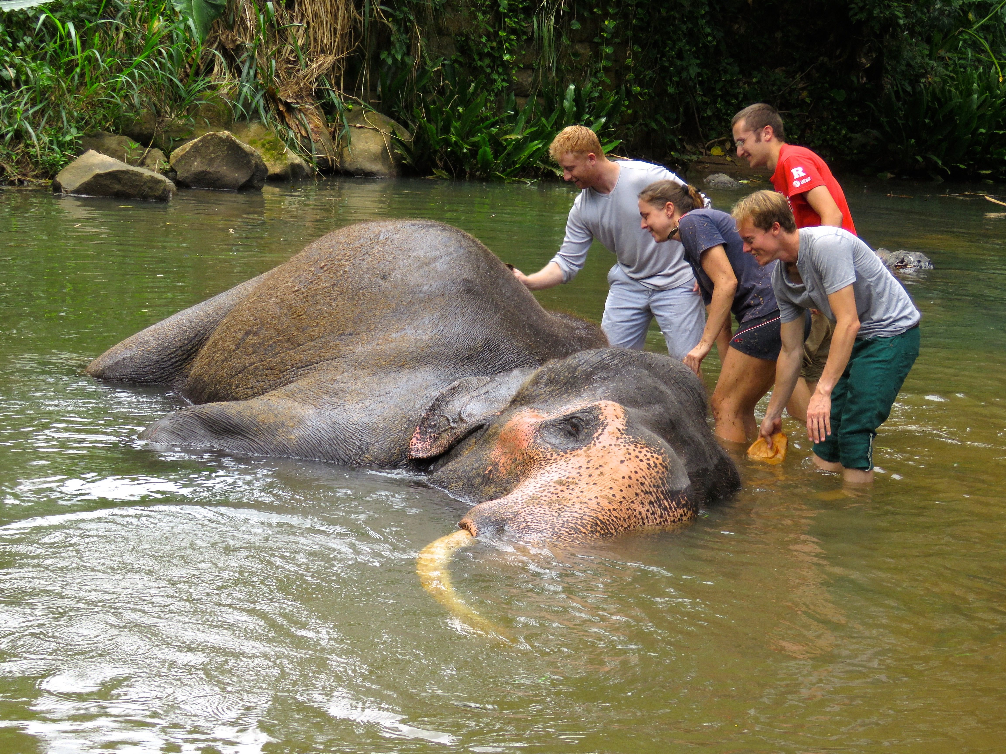
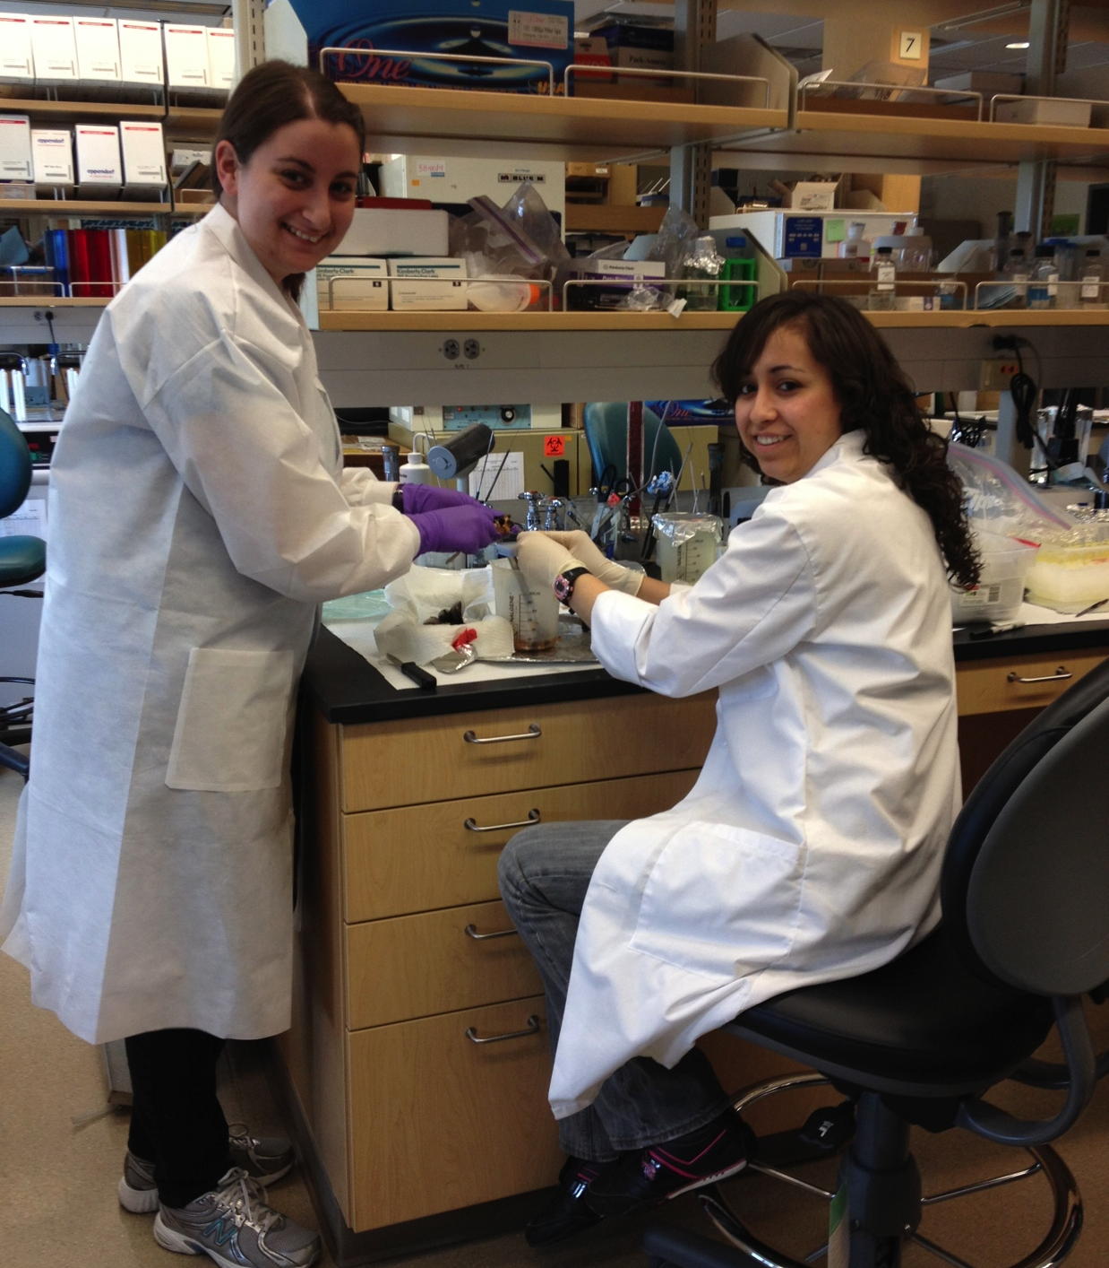
University of California, Davis
Work with Students
Notes:
Trepidation – Student? Scary
No teaching, grants or what

Slide 17
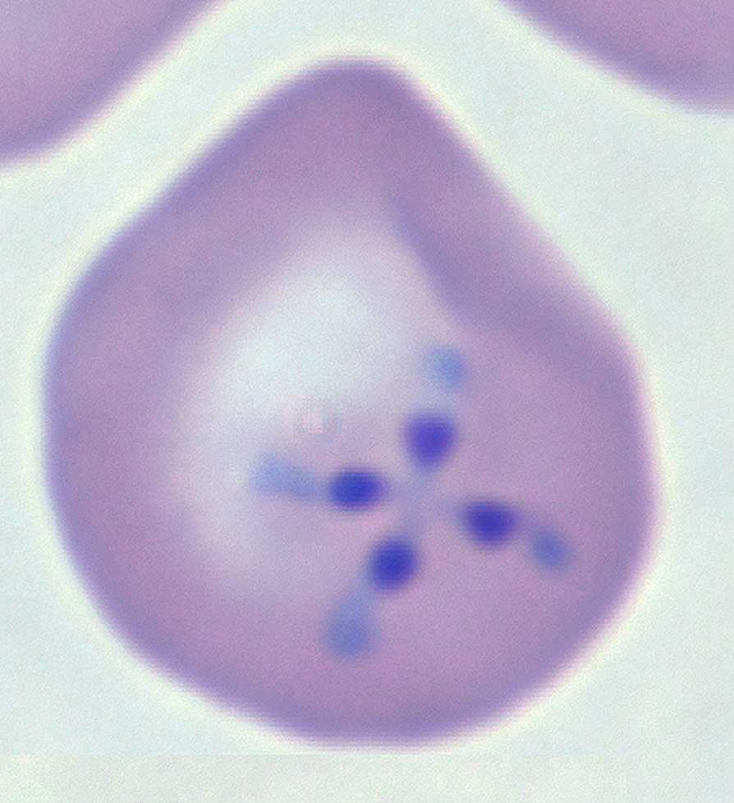
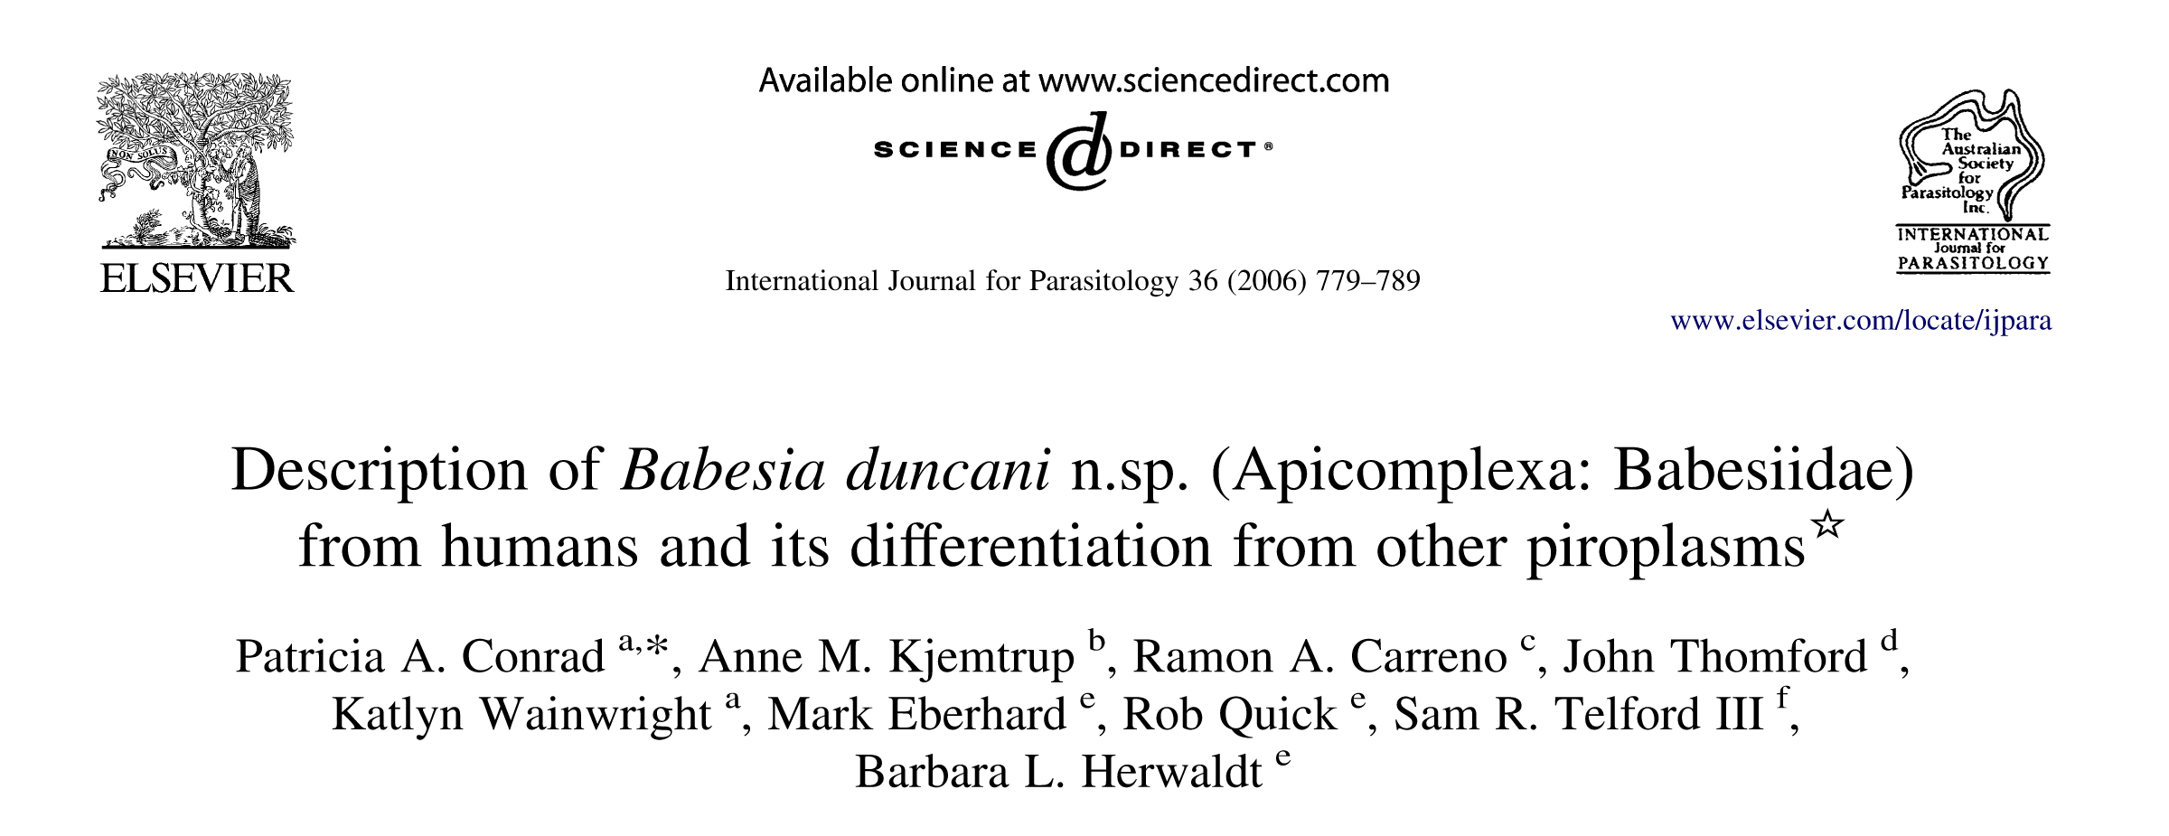
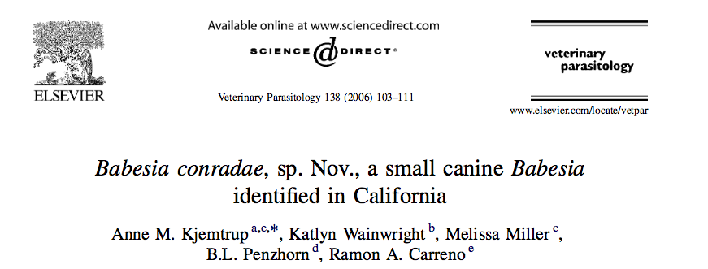
Babesia
Plenty of Problems
and Discoveries

Slide 18




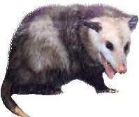
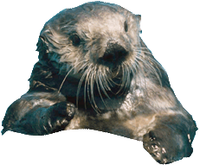
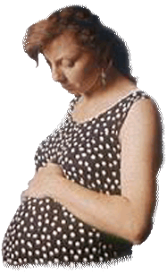
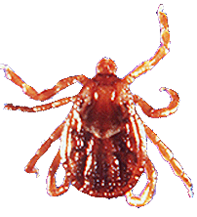






Slide 19
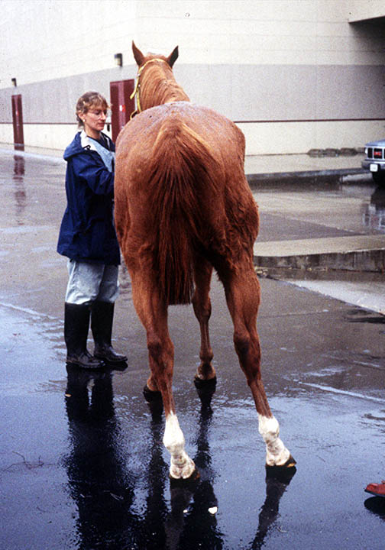
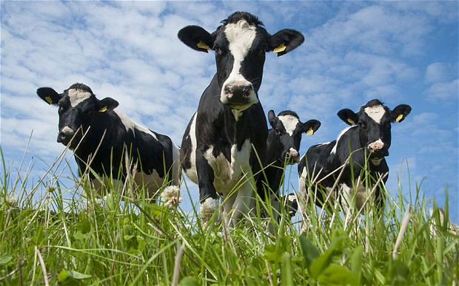
Babesia
Plenty of Problems
and Discoveries
EPM
Neospora -

Slide 20
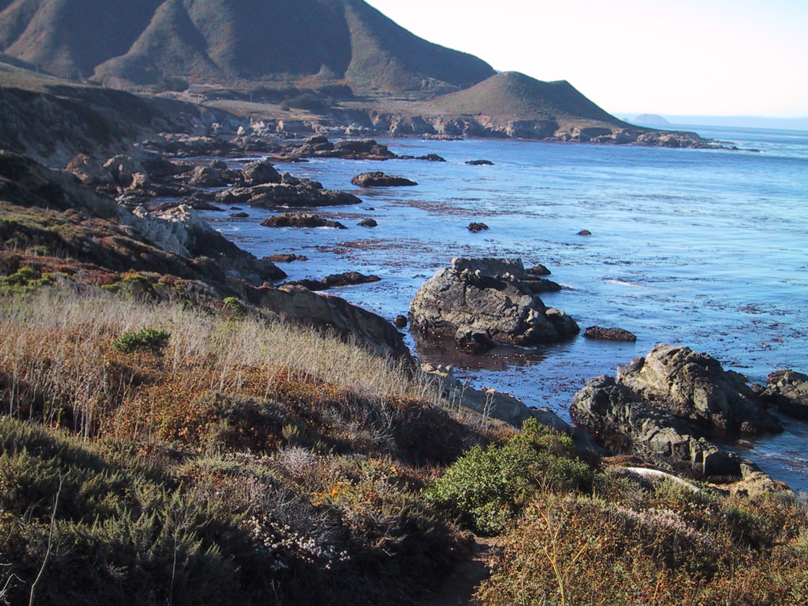
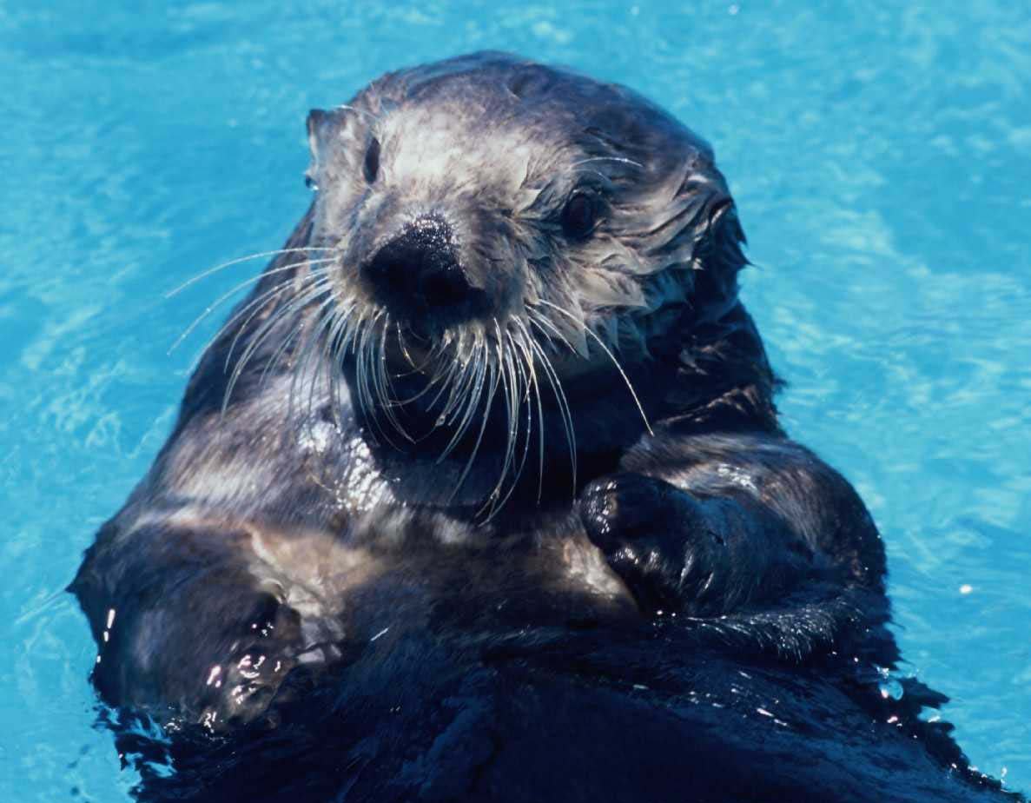

Toxoplasma
Notes:
Wildlife not always the ‘bad guys’ – originator of pathogens Sometimes the vicitim

Slide 21

Toxoplasmosis in Humans
Most no symptoms or flu-like illness
Greatest risk of disease
Pregnancy
Immunosuppression

Slide 22


Giardia
Cryptosporidium

Slide 23




Slide 24




Land to Sea
Land-use &
Climate Change
Notes:
My fascination with interconnections in shared environments continued to expand in California where I’ve worked with an incredible multi-disciplinary team to discover the pathways fecal pathogens of animals and people take to flow from land to sea …..a flow that is impacted by climate and land-use…agriculture, development. Wetlands..
Enough about me…what I really want to tell you about is the University of California

Slide 25








One Health ➔ Teamwork
Coastal
Oceanography
Microbiology/
Parasitology
Epidemiology
Molecular
to
Modeling
Ecology
Pathology
Environmental Engineering
Hydrology
Chemistry

Slide 26



ONE HEALTH
ECOSYSTEM
Holistic
Collaborative
Focused on
integrated solutions
HUMAN
ANIMAL
Notes:
Best captured One Health. Many have heard of this term. Perspective – Approach to health local and global

Slide 27

Mission
Advance the Health of Animals, People, and the Environment

Slide 28







Advancing Health
Biomedical & translational research
Clinical medicine, surgery, oncology, pathology, immunology, ID
Notes:
Areas we have strong reputations and recognition and finding ways to expand our global engagement and leadership will benefit the world.
GLOBAL LENS TO GAIN EVEN GREATER RECOGNITION

Slide 29

Notes:
emerging and epidemic zoonoses usually attract
much interest, endemic zoonotic diseases rarely give rise to collaboration between the medical and
veterinary professions, especially in developing countries.

Slide 30
Global climate & land use changes
& human population growth
Increased contact between wildlife,
livestock, people and pets
Enhanced flow of pathogens
Health risks to humans, wildlife & domestic animals

Slide 31


Emerging Zoonotic Diseases
Animal Amplification
CASES
Human Amplification
TIME

Slide 32
Vectorborne Disease
Notes:
From EPA Report 2016:
Changing Distributions of Vectors and Vector-Borne Diseases
Key Finding 1: Climate change is expected to alter the geographic and seasonal distributions of existing vectors and vector-borne diseases [Likely, High Confidence].
Earlier Tick Activity and Northward Range Expansion
Key Finding 2: Ticks capable of carrying the bacteria that cause Lyme disease and other pathogens will show earlier seasonal activity and a generally northward expansion in response to increasing temperatures associated with climate change [Likely, High Confidence]. Longer seasonal activity and expanding geographic range of these ticks will increase the risk of human exposure to ticks [Likely, Medium Confidence].
Changing Mosquito-Borne Disease Dynamics
Key Finding 3: Rising temperatures, changing precipitation patterns, and a higher frequency of some extreme weather events associated with climate change will influence the distribution, abundance, and prevalence of infection in the mosquitoes that transmit West Nile virus and other pathogens by altering habitat availability and mosquito and viral reproduction rates [Very Likely, High Confidence]. Alterations in the distribution, abundance, and infection rate of mosquitoes will influence human exposure to bites from infected mosquitoes, which is expected to alter risk for human disease [Very Likely, Medium Confidence].
Emergence of New Vector-Borne Pathogens
Key Finding 4: Vector-borne pathogens are expected to emerge or reemerge due to the interactions of climate factors with many other drivers, such as changing land-use patterns [Likely, High Confidence]. The impacts to human disease, however, will be limited by the adaptive capacity of human populations, such as vector control practices or personal protective measures [Likely, High Confidence].
The direct effects include an increased frequency of heat waves, rising sea levels that threaten low-lying communities, anticipated extremes in the global hydrologic cycle (droughts, floods, and intense storms), and adverse effects on agricultural production and fisheries due to environmental stressors and changes in land use. Indirectly, climate change is anticipated to threaten health by worsening urban air pollution and increasing rates of infectious (particularly waterborne and vector-borne) disease transmission. Water- and foodborne diseases. Water- and foodborne diseases are likely to become a greater public health problem as climate change accelerates, due to elevated temperatures, increases in extreme rainfall and flooding frequency, and an anticipated deterioration in water quality following wider drought events.
When It Rains, It Pours: Future Climate Extremes and Health Jonathan A. Patz, MD, MPH, Maggie L. Grabow, PhD, MPH, and Vijay S. Limaye, PhD Annals of Global Health
2014
From Chris Barker:
Climate (cyclical events like El Nino, as well as longer-term climate change) does affect Zika virus transmission (but see below). On average, warmer (faster viral replication and mosquito development) and wetter conditions (more immature mosquito habitat) can lead to increased transmission, but it’s not quite that simple because water storage (and associated immature mosquito habitat) can increase during dry periods too. Prediction of arbovirus transmission at control-relevant scales remains a huge challenge.
All of that said about climate, it is one among a number of other factors, including global travel and trade, human population growth, urbanization, and the evolution of viruses and vectors. I’d place those others higher than climate change on the list of key factors to explain Zika virus’s emergence.

Slide 33


Waterborne Disease
Notes:
WATERBORNE DISEASE
Theoretical, simulation, and empirical data corroborate that increased water vapour, due to higher mean temperatures, triggers more intense precipitation events, even if the precipitation quantity remains constant.92,93 Such events can result in run-off and loading of coastal waters with pathogens, nutrients, and toxic chemicals that may adversely affect aquatic life and public health. This is particularly true in coastal watersheds where human development and population increases have led to urbanisation of coastal areas. Storm surges greatly increase theriskandtheamountofpollutantsenteringrecreational coastal waters.94 Climate variability can negatively impact public health: exposure to southern California coastal waters during an El Niño winter compared with a La Niña winterdoublestheriskofsymptomsrelatedtoinfectious agents.95 Risk of gastroenteritis and respiratory infections due to recreational water use are much higher during the rainy season rather than the dry season.9
Erratic and extreme precipitation events can overwhelm water treatment plants102 and lead to cryptosporidium outbreaks due to oocysts infiltrating drinking-water reservoirs from springs and lakes and persisting in the water distribution system.103,104 A study from England and Wales105 found that 20% of water-borne outbreaks in the past century were associated with a sustained period of low rainfall, compared with 10% associated with heavy rainfall. Droughts or extended dry spells can reduce the volume of river flow possibly increasing the concentration of effluent pathogens, which might pose a problem for the clearance capacity of treatment plants
------------------------
Freshwater ecosystems. Waterborne diseases are particularly sensitive to changes in the global hydro- logic cycle, as both water quantity and water quality play a role in the transmission of these diseases. Outbreaks of waterborne diseases are not random events, and disease outbreaks from most waterborne pathogens are distinctly seasonal and cluster in key watersheds.8 There is strong evidence that links incidence of waterborne outbreaks from pathogens such as Cryptosporidium,59 Escherichia coli 0157:H7,60 and Campylobacter jejuni60 following heavy rainfall events. Storm events of more than 3 inches of rainfall within 24 hours can overwhelm combined sewer systems and lead to an overflow that contaminates recreational and drinking water sources. Overall, there is growing evidence that climate- driven changes in air and water temperatures, rainfall, humidity, and coastal salinity can contribute to the risk for waterborne infections.
When It Rains, It Pours: Future Climate Extremes and Health Jonathan A. Patz, MD, MPH, Maggie L. Grabow, PhD, MPH, and Vijay S. Limaye, PhD Annals of Global Health
2014

Slide 34
Notes:
2016 EPA Report
Increased Exposure to Extreme Events
Key Finding 1: Health impacts associated with climate-related changes in exposure to extreme events include death, injury, or illness; exacerbation of underlying medical conditions; and adverse effects on mental health [High Confidence]. Climate change will increase exposure risk in some regions of the United States due to projected increases in the frequency and/or intensity of drought, wildfires, and flooding related to extreme precipitation and hurricanes [Medium Confidence].
Disruption of Essential Infrastructure
Key Finding 2: Many types of extreme events related to climate change cause disruption of infrastructure, including power, water, transportation, and communication systems, that are essential to maintaining access to health care and emergency response services and safeguarding human health [High Confidence].
Vulnerability to Coastal Flooding
Key Finding 3: Coastal populations with greater vulnerability to health impacts from coastal flooding include persons with disabilities or other access and functional needs, certain populations of color, older adults, pregnant women and children, low-income populations, and some occupational groups [High Confidence]. Climate change will increase exposure risk to coastal flooding due to increases in extreme precipitation and in hurricane intensity and rainfall rates, as well as sea level rise and the resulting increases in storm surge [High Confidence].
Heavy downpours are increasing nationally, especially over the last three to five decades, with the largest increases in the Midwest and Northeast. Increases in the frequency and intensity of extreme precipitation events are projected for all U.S. regions. [High Confidence].
The intensity, frequency, and duration of North Atlantic hurricanes, as well as the frequency of the strongest hurricanes, have all increased since the 1980s [High Confidence]. Hurricane intensity and rainfall are projected to increase as the climate continues to warm [Medium Confidence].
Increasing severity and frequency of flooding have been observed throughout much of the Mississippi and Missouri River Basins. Increased flood frequency and severity are projected in the Northeast and Midwest regions [Low Confidence]. In the Western United States, increasing snowmelt and rain-on-snow events (increased runoff when rain falls onto existing snowpack) will increase flooding in some mountain watersheds [Medium Confidence].
In the next several decades, storm surges and high tides could combine with sea level rise and land subsidence to further increase coastal flooding in many regions. The U.S. East and Gulf Coasts, Hawaii, and the U.S.-affiliated Pacific Islands are particularly at risk.

Slide 35







Ensure food safety, supply
and security
Notes:
livestock & plant agricultural production – from food animals disease surveillance, transboundary disease, welfare, food safety from farm to fork
I see a world where society, stake holders private & public organizations see clearly that they NEED US

Slide 36


SUCCESS
is liking what you have to do

Slide 37
“Challenge what YOU Think
you can do & be surprised what you
DISCOVER !
Notes:
THANK YOU!
Stand-up – to be vet
Right hand- may like research
Left hand – Research is for me!
Tell a little known secret - confession

Slide 38

Questions?
Discussion

