Slide 1
GloCal Alumni Presentation Feberuary, 2019
Damalie Nakanjako
Professor of Medicine
Deputy Dean, School of
Medicine
Scientific Director
Translational lab at Makerere
University’s Infectious
Diseases Institute
Makerere University College
of Health Sciences, Kampala,
Uganda

Slide 2
Outline
Training
Research experience in HIV care and treatment
Key challenges/opportunities
Future directions
Q&A

Slide 3
Training experience
Degree | Institution | Subject area
MBChB | Makerere University | Medicine & Surgery
MMED | Makerere University | Internal Medicine FIC funding- AITRP (CWRU)
Five-year Sewankambo Clinical Research Fellowship | Makerere University’s Infectious Diseases Institute, Gilead-funded opportunity | HIV treatment and co-infections Immune recovery clinical data that led to subsequent lab studies
PhD | University of Antwerp | Biomedical Sciences

Slide 4
HIV situation in Uganda
HIV prevalence was 8% among women and 6% among men, Knowledge of HIV sero-status at 66% for women and 45% for men
HAART coverage – 39% at 350 cells/µL
2017: 1.3M living with HIV, Prevalence 5.9% (from 31% in 1990),
73% of adults receiving ART, 50,000 new infections, 26,000 AIDS related deaths

Slide 5
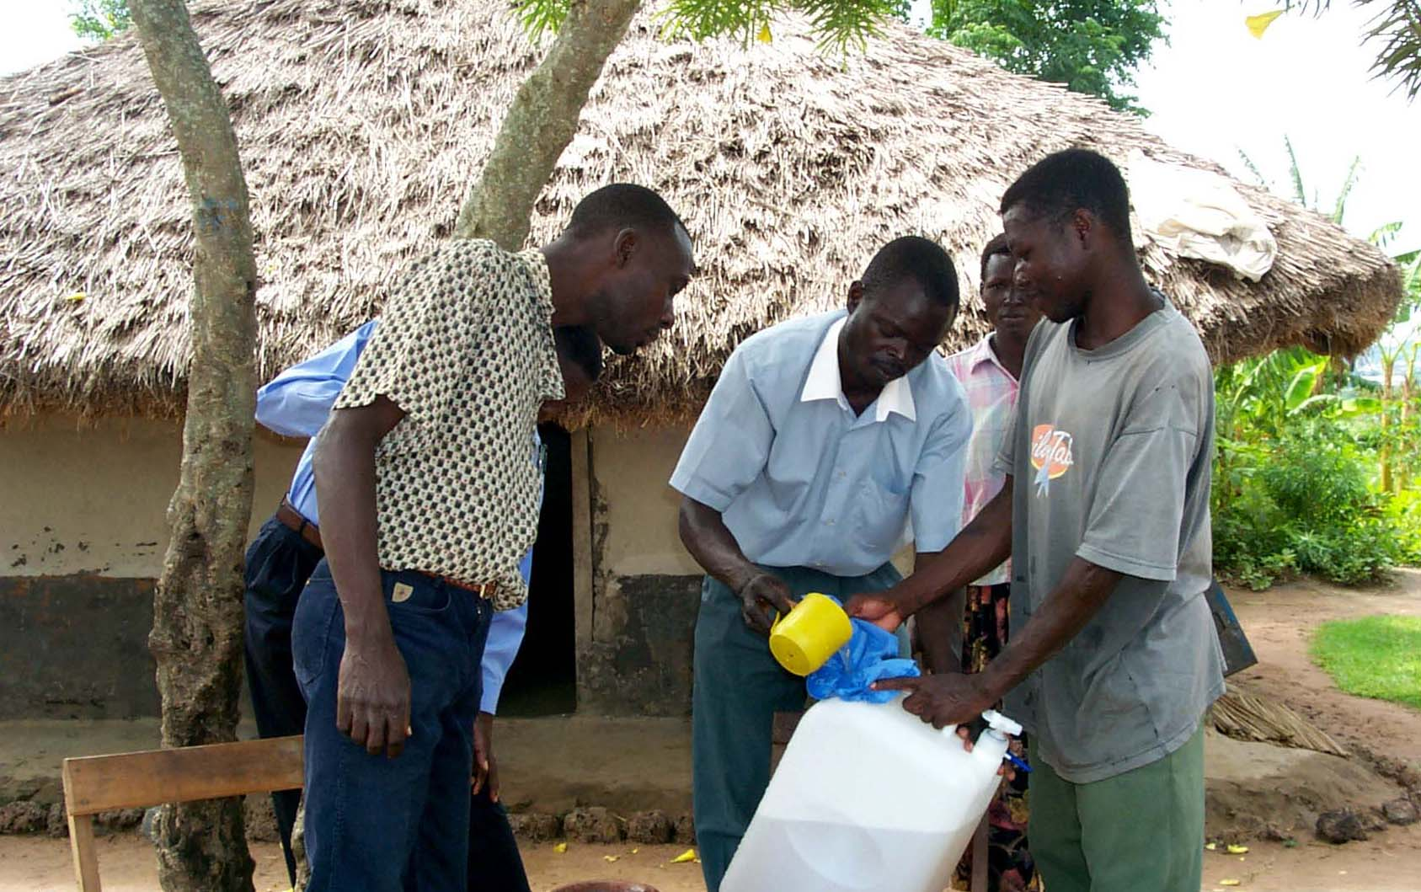
Engagement in community studies
Randomized Clinical trial of simple interventions for HIV care in rural Eastern Uganda
Safe water system PLHIV for 6 months, Weekly field visits, then cotrimoxazole prophylaxis for 1.5 years
-

Slide 6
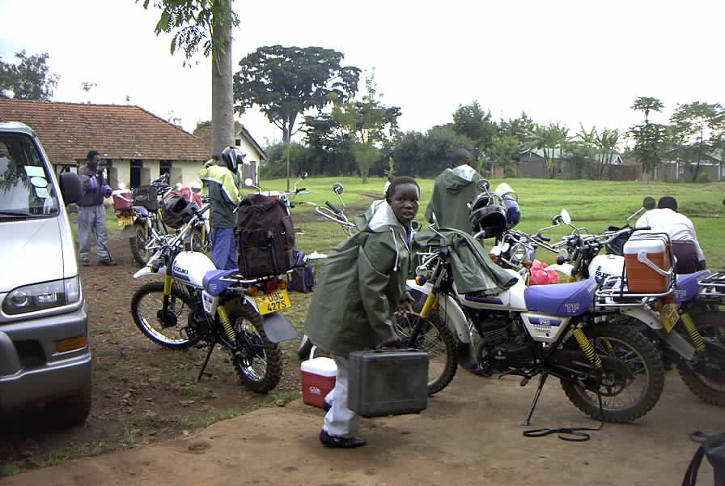
RCT – Field activities
A home based Safe Water System reduced diarrhoea frequency & severity among PLHIV
CTX prophylaxis reduced morbidity & mortality
CTX & SWS readily available & beneficial to PLHIV

Slide 7
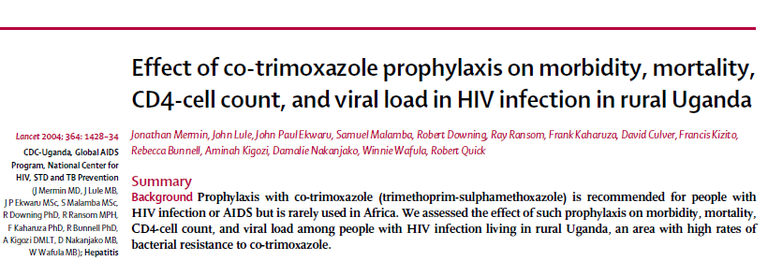

Slide 8
Routine HIV testing in the medical emergency setting at Mulago hospital
National referral
Teaching hospital
>700,000 patients annually
50-70% of admissions
HIV-related
No in–patient HIV testing and ART services in 2003
Mulago hospital medical ward
Nakanjako et al. AIDS Behav. 2007 Sep;11(5):753-8.

Slide 9
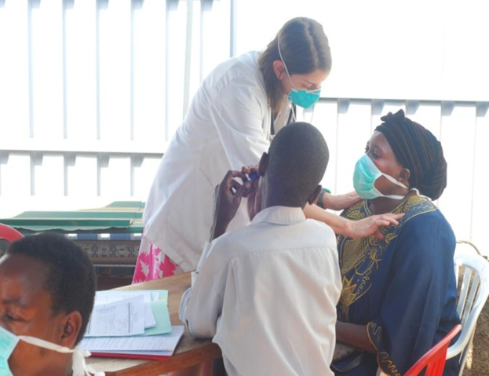
Clinical Studies
Provider initiated HIV testing- highly acceptable
Routine TB screening of TB-HIV co-infections in ART treatment programs
Nakanjako et al. Int J Tuberc Lung Dis. 2010 Dec;14(12):1621-8

Slide 10
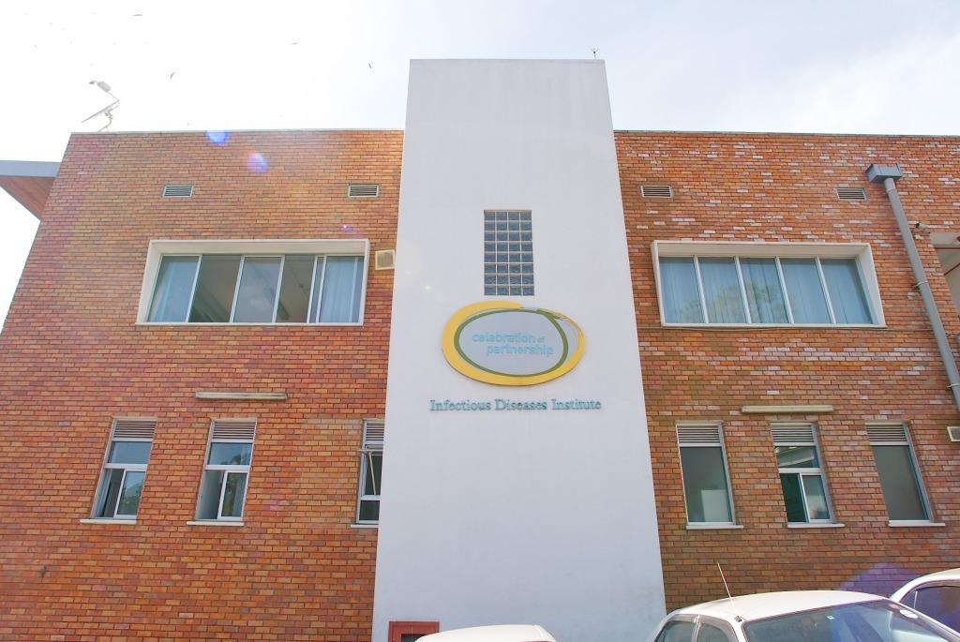
HIV treatment studies at IDI, Makerere University
Regional centre of excellence in HIV care, research & training
HIV/AIDS care >20,000
Up to 7,000 on ART
Over 70,000 IDI- supported
Research cohort research platform of 559 on ART for > 13 years
Infectious Diseases Institute (IDI), Makerere University College of Health Sciences

Slide 11
Translational studies to answer clinical questions

Slide 12
Research Experience
Grant/Funder | Institution
Post-doc (GloCal) | IDI Makerere in Collaboration with Gladstone Institute of Vaccinology and Immunology (GIVI) -Warner C. Greene Additional GloCal year to support mentorship activities
Post-doc (MUII- Wellcome Trust funded) | Infectious Diseases Institute-Makerere Uganda Virus Research Institute VGTI- Florida- Rafick Sekaly, now at CWRU University of Oxford (Sarah Rowland Jones)
International Mentored research CFAR award | UCSF- GIVI Warner C. Greene’s Lab in collaboration with Infectious Diseases Institute
Grand Challenge Canada | Randomised Cross-over trial on atorvastatin as adjunct therapy in ART-treated adults

Slide 13
Research Experience
Grant/Funder | Institution
NIH Subaward HIV prevention in Fisherfolk | CFAR University of Washington
NIH Subaward Parenteral disclosure of HIV status to children with HIV | CFAR University of Washington
NIH Subaward Psychosocial interventions to improve uptake of PMTCT | CFAR University of Washington

Slide 14
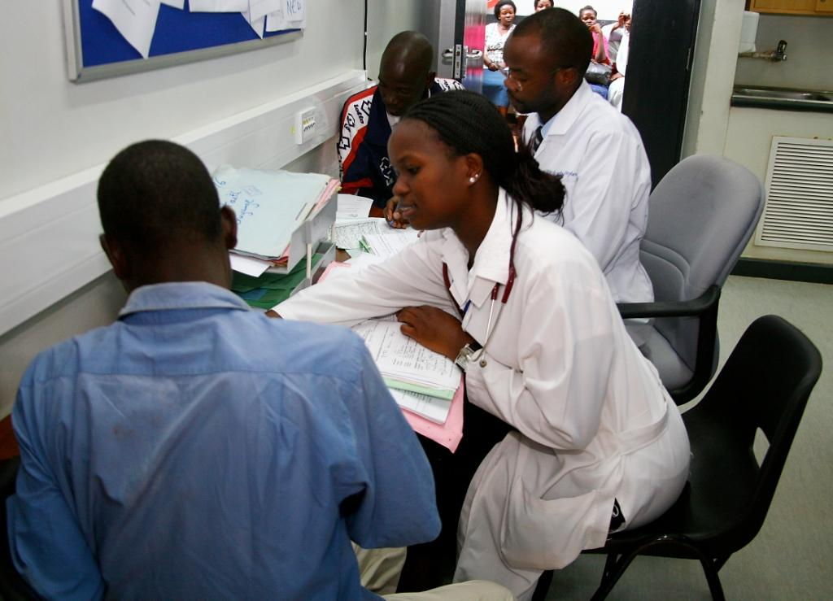
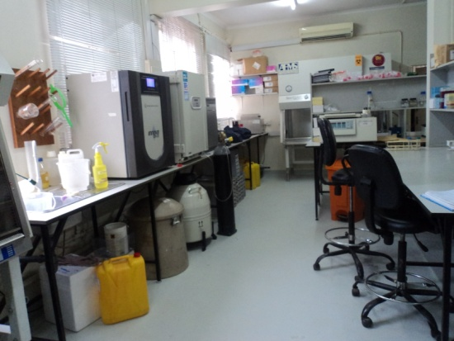
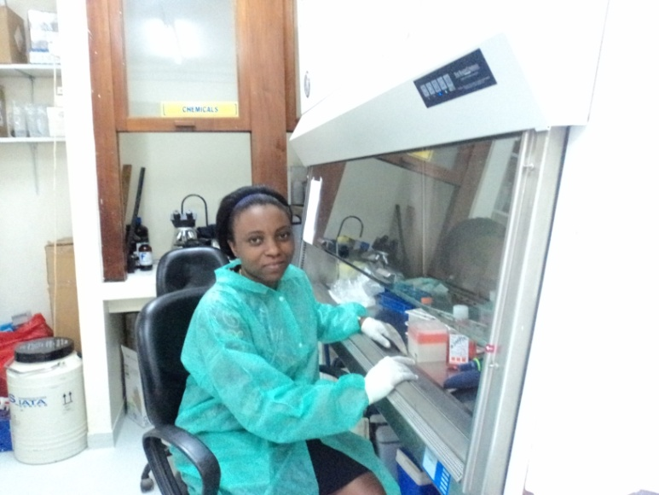
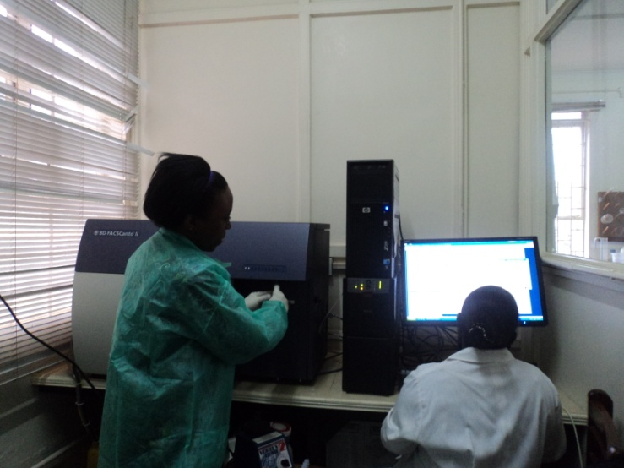

Slide 15
Challenges/Opportunities
Limited funding for research in LMIC
Competitive collaborative research with high quality outputs for sustainable research groups
Not enough time to do everything
Individual Career development plan guides prioritization
Balancing career and family
Understand high and low demand seasons and take advantage

Slide 16
Future directions
Collaborative research to improve patient care
Multidisciplinary approach & translational science
Translation of research to policy
Support health systems strengthening
Mentorship of the next generation of scientists, clinicians, research leaders in the pipeline

Slide 17
Acknowledgements
Collaborators
Warner Greene (GIVI)
Rafick Sekaly (VGTI)
Moses Joloba (MakCHS immunology lab)
Pietro Pala (MRC)
Robert Colebunders (UA/ITM)
All my study participants
Colleagues
All attendees today
MUII team
Allison Elliot, Pontiano Kaleebu, & fellows
IDI Executive & Research leadership
Keith Mcadam, Alex Coutinho, Philippa Easterbrook, Yukari Manabe, Andrew Kambugu
Dept of Medicine Team
Harriet Mayanja-Kizza, Moses Kamya, Elly Katabira, Nelson Sewankambo

