Slide 1
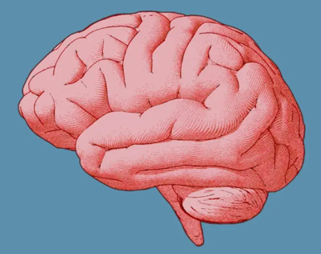
Developing a career in Global Health in Neurology
Monica M. Diaz, MD, MS
Assistant Professor of Neurology
Division of Multiple Sclerosis & Neuroimmunology
University of North Carolina at Chapel Hill School of Medicine

Slide 2
Outline
Introduction
What is global neurology?
Burden of neurological illness worldwide
My path in a global health in neurology career
Collaborations and Mentoring
Lessons Learned
Questions?

Slide 3
Introduction
Monica Maria Diaz, MD, MS
Born and raised in Miami, Florida
First-generation American, family immigrated from Cuba in the 1980’s
Bilingual English/Spanish- grew up speaking Spanish at home, English at school/with friends.
First person to go to college in my family
What got me interested in Medicine and in Neurology?
Grandmother with early-onset Alzheimer’s disease
Grandfather with Parkinson’s disease
I always wanted to be a doctor since high school --> majored in Neuroscience in university

Slide 4
Education Overview
College: University of Miami (Miami, FL); 4 years- graduated 2008
Medical School: State University of New York-Downstate College of Medicine (Brooklyn, NY); 4 years- graduated 2014
Neurology residency: Yale University (New Haven, CT); graduated 2018
Neurology residency is 4 years total: 1 year IM + 3 years Neurology
Neuroimmunology/MS/Neuroinfectious fellowship: University of California, San Diego (San Diego, CA); 1 year- graduated 2019
Master’s in Clinical Research: Medical University of South Carolina (online); 2 years- graduated 2021
Complete simultaneously with both fellowships
GloCal global health fellowship: NIH Fogarty GloCal (Lima, Peru); completed 2020
Faculty position in Department of Neurology at UNC: started Jan 1, 2021
Protected research time x 2 years while applying for K23
Opportunity to travel abroad while on academic time 6 months per year

Slide 5
What is global neurology?
Global Health: “study, research and practice that places a priority on improving health and achieving equity in health for all people worldwide”
Global Neurology: application of these principles to the practice of neurology worldwide
Common misconception: neurology is too specialized for global health; most pressing neurological issues are better addressed by general practitioners or pediatricians.
Growing interest in global neurology among neurology trainees & neurologists
Koplan JP, et al. Towards a common definition of global health. Lancet 2009.
Mathers C, et al. World Health Organization; 2009.

Slide 6
Why Global Neurology?
Global Burden of Disease Study 2016
Neurological disorders are the leading cause of disability and 2nd leading cause of mortality globally
75% of the global burden of neurological disease is in low-and middle-income countries (LMIC)
Including:
80% of all epilepsy cases in LMIC
85% of all strokes occur in LMIC
Global Burden of Disease Study 2016 Neurology Collaborators. Lancet Neurol. 2019; 18:459-480 Report on Epilepsy in Latin America and the Caribbean – Pan American Health Organization 2013
Notes:
scarce supplies, stigma, insufficient medical personnel)

Slide 7
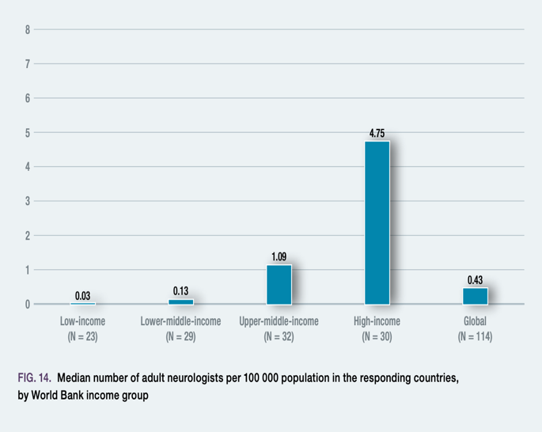
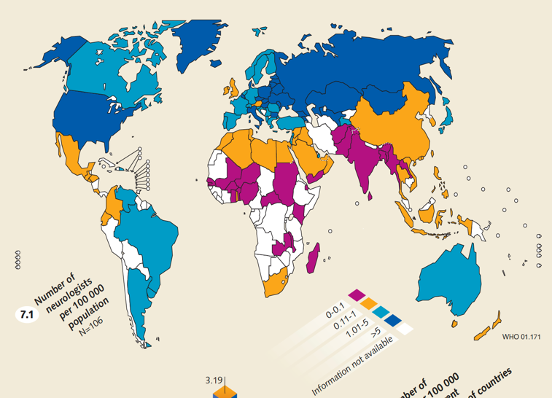
Burden of neurological disease is greater than the number of neurologists in LMIC
Atlas Country Resources for Neurological Disorders, 2004.
WHO Atlas of Country Resources for Neurological Disorders 2017

Slide 8
Carving the path to a global neurology career: My experience

Slide 9
Carving the path to a global neurology career: My experience
PGY-3 year in residency: Johnson & Johnson Global Health Scholars Program
Residency Global Neurology track
6-8 weeks in LMIC in hospital x 2 years
Provide clinical care to underserved regions
2 great mentors (1 U.S.-based, 1 LMIC-based)

Slide 10
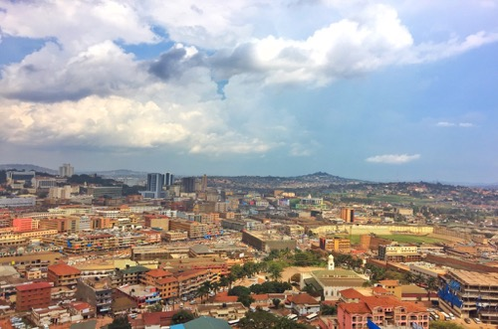
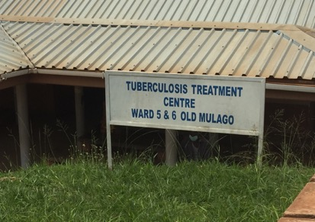
8 weeks in Kampala, Uganda in 3rd & 4th years of Neurology Residency

Slide 11
Neurology Wards at Mulago Hospital
MRIs-
Costs ~$500 for MRI Brain w wo contrast
EEGs-
4 EEG machines at Mulago – however are not functioning
No personnel trained in reading EEGs
Common patient care issues:
Patients often were in ER for 3-4 days prior to being admitted to neurology ward
Difficulty affording diagnostic tests
Labs and CSF takes 3-4 days to results
43 dialects spoken in Uganda → language barrier often present
Notes:
- Could not afford the medication OR

Slide 12
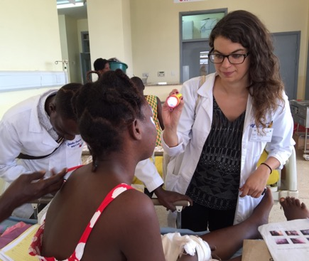
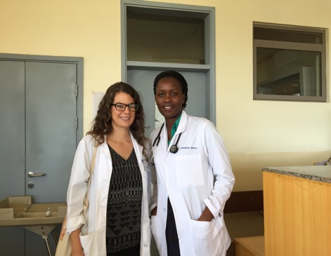
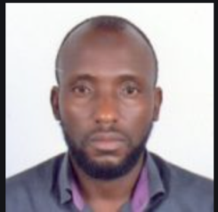
Opportunities for collaboration, mentorship and learning
Mentor in Uganda:
Dr. Abdu Musubire

Slide 13
Opportunities for continued collaboration after rotation finished…
Ugandan perspective in U.S. hospital:
“I saw that the focus is not only on high-quality patient care but also patient satisfaction
“There is a need to train more specialized doctors to build a critical mass of interest in neurology and work on accreditation issues in neurology in Uganda.”
U.S. perspective in Ugandan hospital:
“My experience at Mulago Hospital was invaluable as it helped not only to refine my clinical skills as a neurologist, but also helped me to see neurology from a humble perspective.”

Slide 14
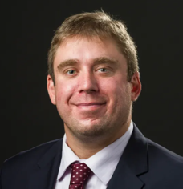
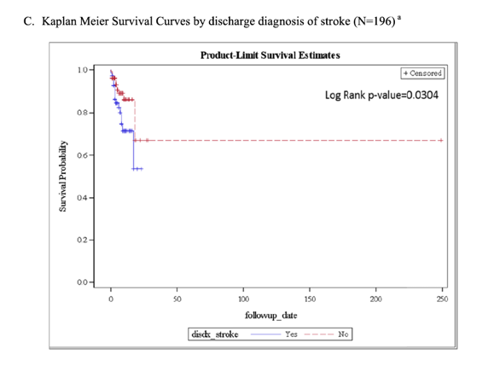
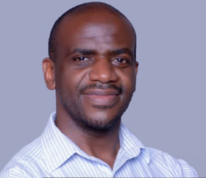
Opportunities to continue to collaborate…
Prospective study of 335 patients admitted to neurology ward at Mulago Hospital
Most common neurological diagnoses:
Stroke (27%)
Head trauma (20%)
Nearly 20% died during hospitalization
Worse survival in:
Stroke (HR=2.69 [1.20-6.04]
Head trauma (HR=3.39 [1.27-9.07]
Dr. Jason Sico (Yale)
Dr. Ivan Kimuli (Makerere)

Slide 15
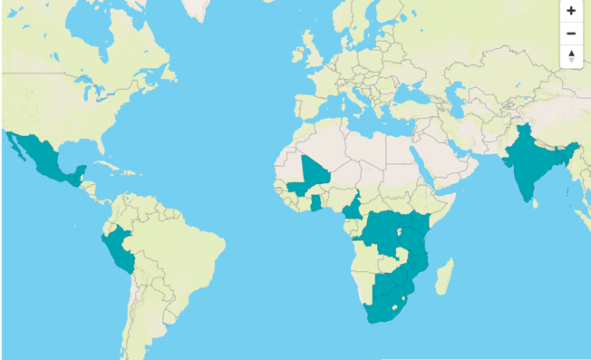
Carving the path to a global neurology career
Supports a 12-month, mentored research fellowship for investigators in HIC and LMIC
Many training sites available

Slide 16
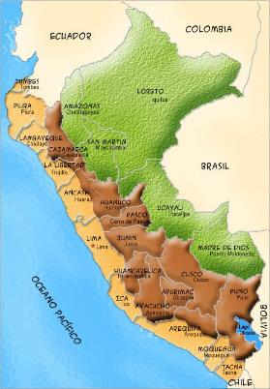
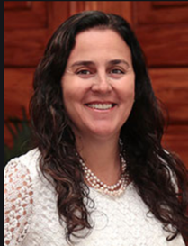
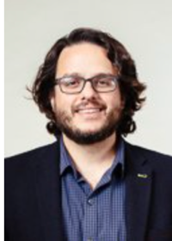
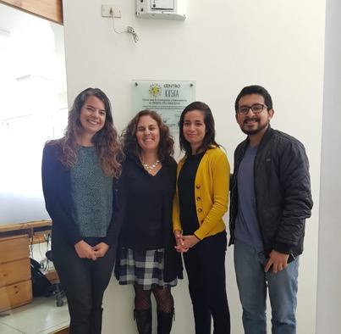
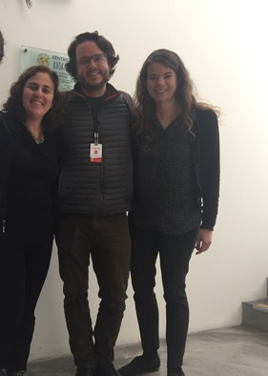
Fellowship Mentors:
Dr. Patricia Garcia Dr. Serggio Lanata
Cayetano Heredia UCSF
Dr. Ronald Ellis: US Mentor (UCSD)
Peru

Slide 17
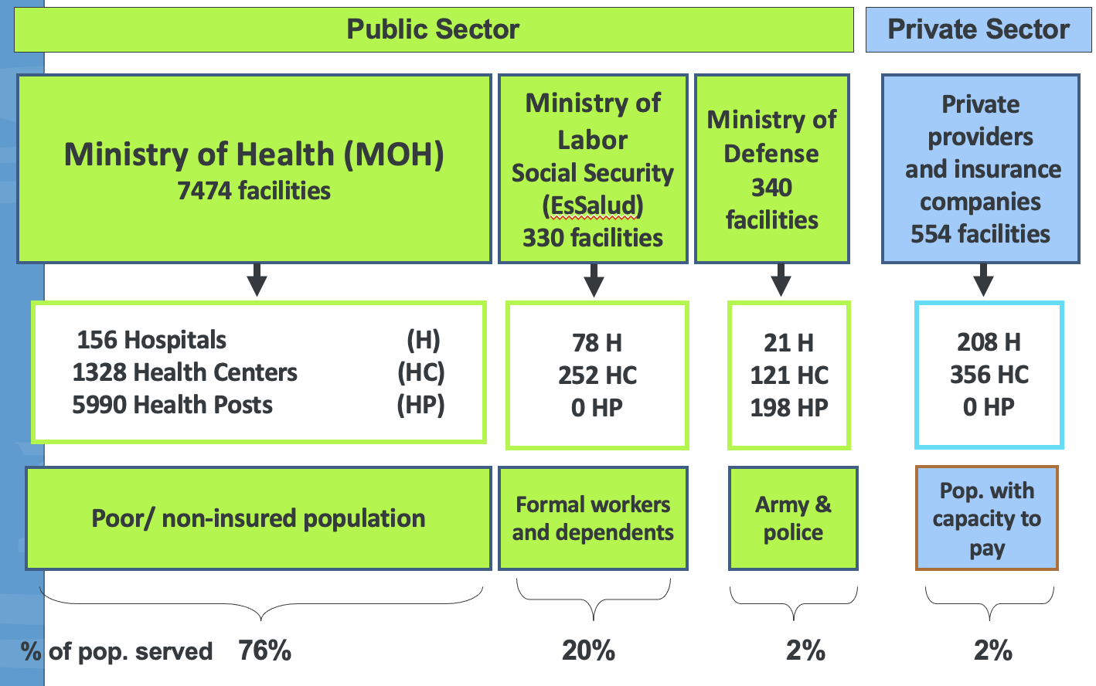
Health system in Peru
Notes:
98% public

Slide 18
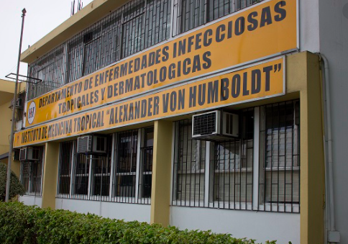
Hospital Cayetano Heredia
Lima, Peru
Ministry of Health public tertiary referral hospital
The largest neurology department in Peru
One CT scanner, no MRI scanner, one EEG machine; many medications not available in-hospital

Slide 19
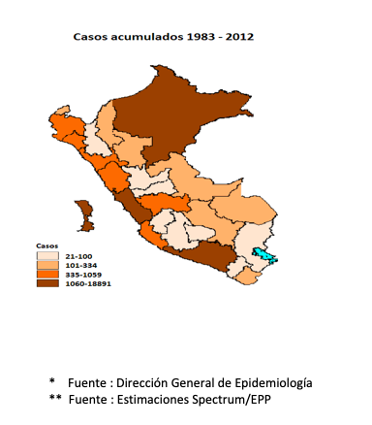
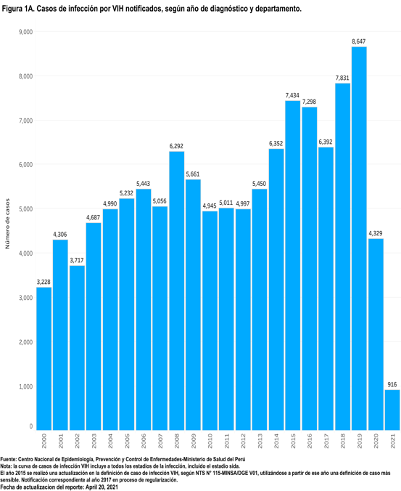
HIV Research in Peru
More than 150,000 reported HIV cases
23% are over age 40
50% of the HIV population in Peru live in Lima
Prevalence of HIV-associated comorbidities is unknown in Peru (and much of Latin America)
Source: Reporte de MINSA Peru, 2018
Notes:
Since 1983, there have been more than 120,000 reported cases of HIV in Peru, 23% of which are over the age of 40.
About half the HIV population lives in Lima.
Most people are diagnosed relatively young, with the median age of diagnosis at 27. And the ratio of men: women is 3.7 to 1.
Women tend to be diagnosed later in life, ages 30-50 years.
Despite this prevalence of HIV in Lima, the prevalence of HAND is unknown in this population.
Espanol:
Han habido mas de 120,000 casos reportados de VIH en Peru
Aunque la edad promedia de estos casos tienen 27 años,
El 23% de estos casos tienen mayores de 40 años.
Y ademas de eso, la mitad de la población con VIH del Peru viven aqui en Lima.
Aunque la VIH es bastante prevalente aqui en Lima, se desconoce la prevalencie de demencia o trasntornos cognitivos que pueden afectar esta poblacion

Slide 20
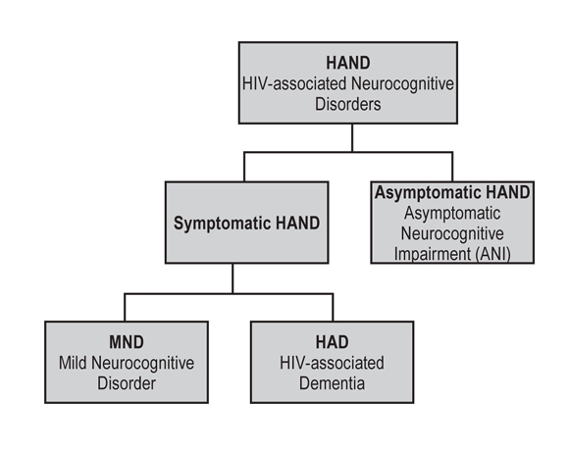
Neurocognitive Impairment (NCI) in HIV
The prevalence of and risk factors associated with HIV-NCI in Peru remains unknown
Source: 1. Kelly CM et al (2014); 2. Van Wijk C (2013); 3. Atashili J, et al (2013); 4. Lawler K, et al (2010); 5. Zamudio-Rodriguez A, et al (2018); Fernandes Filho SM, et al (2012).; Figure credit: Valcour V et al, 2013.
Notes:
One of the most common comorbidities that are seen in older people with HIV is neurocognitive impairment.
Neurocognitive impairment in HIV is divided into 3 types.. An Asymptomatic type without any functional deficits, mild neurocognitive disorder with mild functional deficits and dementia.
The worldwide prevalence of cognitive impairment in HIV varies widely, from about 15% to 60% in developing countries, and very similar rates in developed countries.
The prevalence varies in Latin America as well. However, many of these studies used different cognitive screening tools in heterogeneous pouplations, likely accounting for these variable reported prevalences.
To-date, there has been no study on cognitive impairment in HIV in Peru, and we don’t know what risk factors may worsen or put someone at risk for cognitive impairment in this unique pouplation.

Slide 21
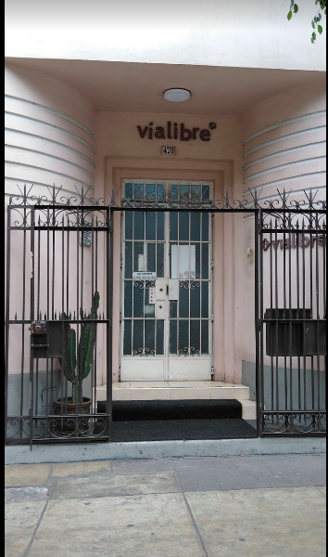
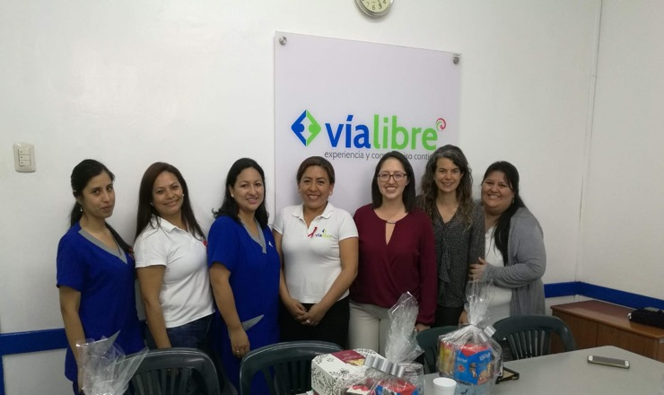
HIV-associated neurocognitive disorder in older Peruvians
Prospective study enrolled 144 HIV+ Peruvian patients >=age 40
Objectives:
1) determine the prevalence of cognitive impairment
2) risk factors for cognitive impairment

Slide 22
HIV-associated neurocognitive disorder in older Peruvians
Neurocognitive Domain Impairment among persons with HIV (N=144)
28% of cohort had global cognitive impairment (similar to reports from other LMIC)
Prior HIV-related co-infection (either syphilis or tuberculosis) increased risk of NCI (OR 2.8; 95%CI 1.2, 6.4)

Slide 23
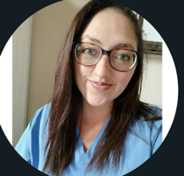
Dr. Garcia Dr. Lanata
UPCH UCSF
Future Directions:
Applied for K23 to National Institute of Mental Health (NIMH) using preliminary data from GloCal fellowship study
Provides 75% research time for 4 years; $50,000 per year of research funding
Submitted Jan 7, 2022 – awaiting response
Dr. Marcela Gil-Zacarias

Slide 24
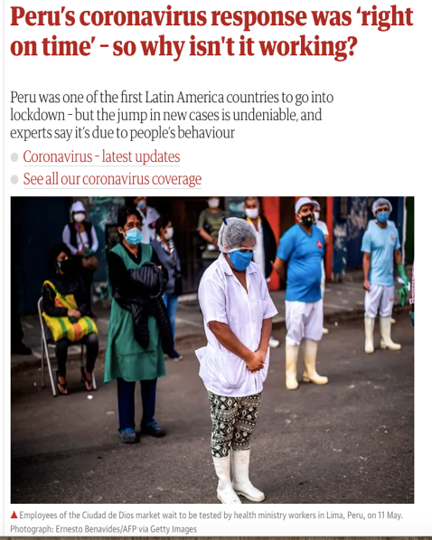
Impact of COVID-19 in Peru
Last patient enrolled into the study on March 14, 2020
Peru implemented a nationwide lock-down and quarantine on March 16, 2020

Slide 25
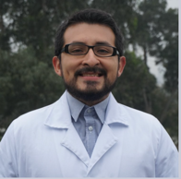
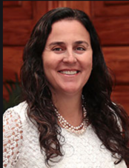
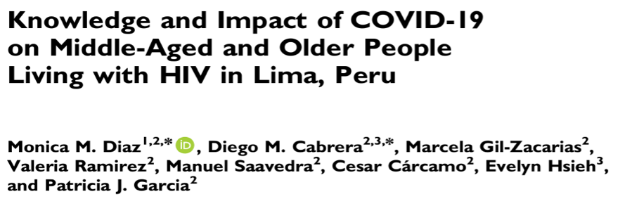
Impact of COVID-19 on people with HIV in Peru
Dr. Diego Cabrera
Dr. Patricia
Garcia

Slide 26
COVID socioeconomic & health impact on persons with HIV in Lima, Peru (July-Aug 2020)
52% of PWH lost their jobs (Men: 46%, Women: 63%, p = 0.003)
Of those who were employed prior to pandemic:
37% → had to continue to work and expose themselves to the public
Increase in anxiety (64%), stress (77%)
Presented findings during Peru CDC webinar in 2020.

Slide 27
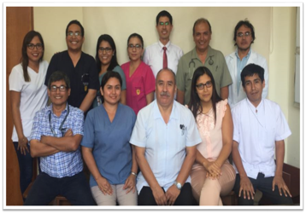
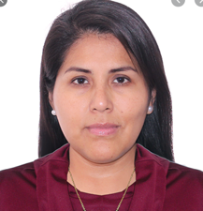
Neurological complications of COVID-19
Introduced to Dr. Ana Ramos through a Peruvian colleague in my Master’s program (coincidence!) → led to relationship with UPCH Neurology department.
Dept of Neurology, Cayetano Heredia Hospital
Dr. Ana Ramos

Slide 28
Stroke in the setting of COVID-19 infection among patients attending a public hospital in Lima, Peru
Presented at AAN Annual meeting 2021

Slide 29
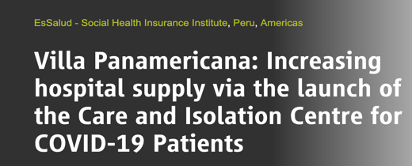
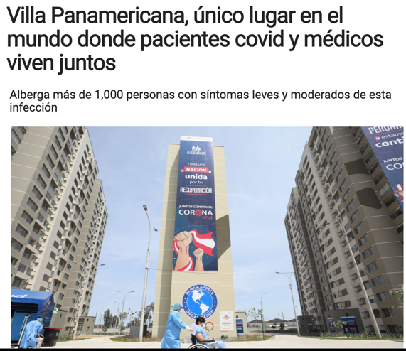
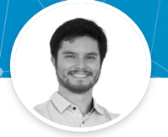
Neurological manifestations of mild-to-moderate COVID-19 in Lima, Peru (July - Sept 2020)
Dr. Marco Carcamo Garcia
My mentor, Dr. Patricia Garcia, let me know there were several doctors working in COVID wards interested in investigating neurological symptoms of COVID-19.

Slide 30
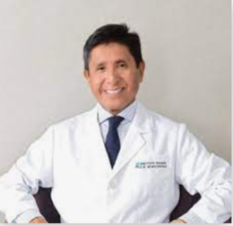
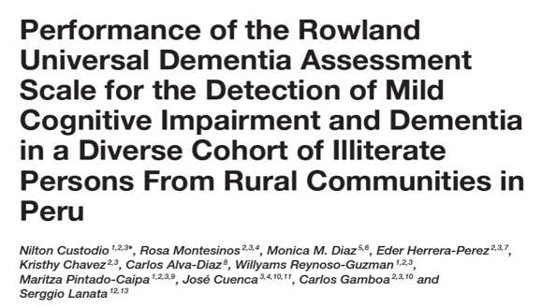
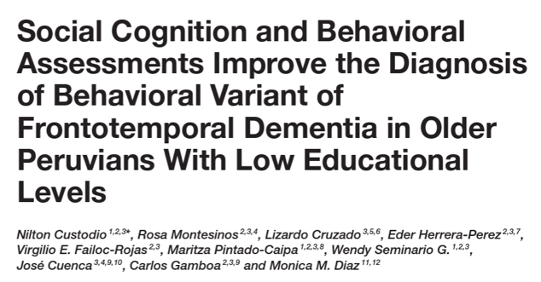
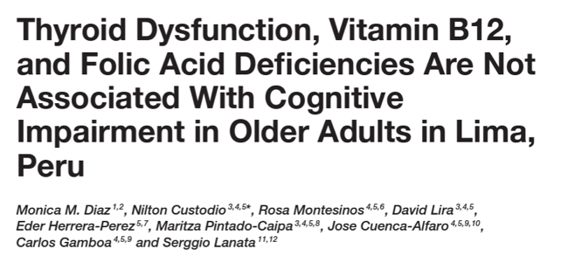
Burden of Dementia in Peru
Introduced to Dr. Nilton Custodio’s group (long-standing dementia expert in Peru) by GloCal trans mentor (Dr. Lanata)
Collaborated on several studies with Dr. Custodio’s group
Dr. Nilton Custodio
Peruvian Neurological Institute

Slide 31
“A vulnerability index for cognitive impairment risk in Latin America”
New grant funded through Alzheimer’s Association International Grant
Lead PI (10% effort yearly) x 3 years
Objectives:
Epidemiology of mild cognitive impairment and dementia in two districts of Lima, Peru (one socioeconomically vulnerable and one affluent)
Assess dementia risk factors (social, behavioral and environmental)
First large-scale door-to-door study assessing modifiable dementia risk factors in Latin America.
Dr. Nilton Custodio
Peruvian Neurological Institute
Dr. Serggio Lanata
UCSF
Notes:
In collaboration with colleagues from the Peruvian Neurological Institute in Lima, Peru and UCSF Memory & Aging Center, the study seeks to evaluate the epidemiology of neurocognitive disorders in two districts of Lima, Peru (one socioeconomically vulnerable and one affluent), assessing individual-level data pertaining to social, behavioral and environmental determinants of brain health. This would be the first large-scale door-to-door study seeking to expand our understanding of cognitive resilience and potentially modifiable neurocognitive disorder risk factors in Latin America.

Slide 32
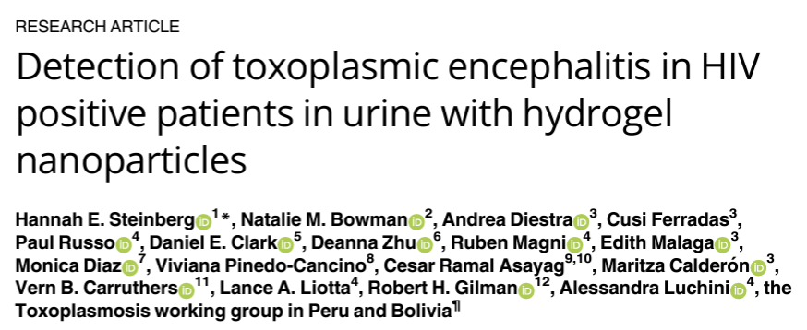
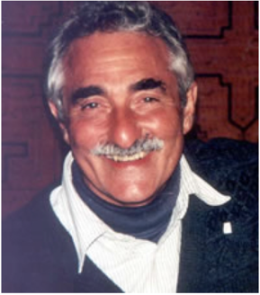
Other collaborations…
Introduced to Dr. Bob Gilman through former Fogarty fellow in Peru
Dr. Gilman looking for neurologist who can interpret CT scans of brain for study → added as Co-Investigator to NIH R01 (“Neurological Syndromes of HIV in Peru & Bolivia)
Working for free, but trade-off is co-authorship

Slide 33
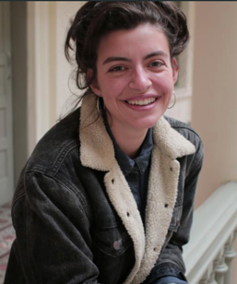
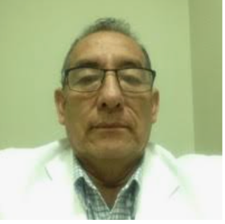
Alzheimer’s and neurodegenerative biomarkers in tears
Dr. Gilman looking for a neurologist as collaborator on grant
Study on “Utility of Alzheimer’s disease biomarkers in tears to predict Alzheimer’s dementia”
Using preliminary data from study, applied for:
Alzheimer’s supplement to existing R01 grant to NIH (pending funding)
R21 grant to NIH: Non-invasive Tear Biomarkers for detecting AD in Peru (not funded, scored ‘okay’, plan to re-submit in November 2022)
Dr. Robert Gilman
Johns Hopkins
Maisie Bailey
MS1, OHSU
Dr. Danilo Sanchez Coronel
Director, Neurodegenerative Diseases
Instituto Nacional de Ciencias Neurologicas

Slide 34
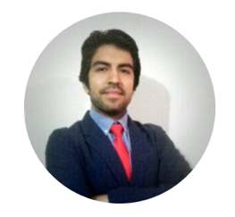
Characterization of non-traumatic spinal cord disorders in Lima, Peru
Mentoring
U.S. mentor on Fogarty fellowship application- applied this year, waiting on status.
Characterize the the population with non-traumatic spinal cord disorders living across 4 hospitals of Lima, Peru.
Regardless of application outcome, we are submitting IRB protocols and plan to start study
Tip: retrospective study can often be self-funded
May need small funding to pay for RA time, but not costly
Dr. Cristoper Alarcon Ruiz
Post-medical graduate
Universidad Científica del Sur (Lima,Peru)
Notes:
We have not yet received UPCH residents at UNC but we are already establishing research efforts with young investigators from Peru.

Slide 35
Systematic Review of Transverse Myelitis in Low-and-Middle Income countries
Mentoring
Mentoring MD/MPH student at UNC on thesis
Interested in applying to neurology for residency; interested in global health
Objective:
To publish a systematic review describing all literature on transverse myelitis (TM) and non-traumatic spinal cord disorders (NTSCD) in low-and-middle income countries.
Meta-analysis of prevalence and etiologies of TM & NTSCD in low-and-middle income countries
MPH thesis:
Plan to submit manuscript to peer-reviewed journal after Faris defends his thesis.

Slide 36
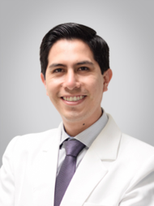
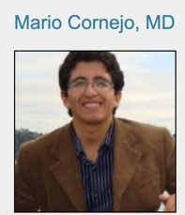
Creating a Global Health in Neurology Rotation for Neurology Residents
4 week rotation at UPCH or UNC
UNC Resident will rotate in:
Neuroinfectious diseases in the infectious disease department (Tropicales)
Neurological emergencies in ICU
Stroke in ER at Hospital Cayetano Heredia
Option to rotate in the Neurogenetics clinic at Hospital Mogrovejo (INCN)
UPCH resident rotates on neurology consult and stroke service at UNC x 4 weeks
Dr. Jimmy Palacios
(Stroke)
Dr. Ana Ramos
(Neuro-ID/Neuroimmunology)
Dr. Omar Heredia
(NeuroICU)
(Neurogenetics, INCN)

Slide 37
Other Activities:
Notes:
Grand Round topic will be chosen by the Peruvian attending mentor. For PGY-2 and PGY-3 a patient’s case will be discussed and for PGY-4 a topic of the resident interest will be presented.

Slide 38
Lessons learned…
Always try to find opportunities to collaborate
Don’t be afraid to reach out, people are usually willing to collaborate
Established collaborations with several research groups by asking:
UPCH, Instituto Peruano de Neurociencias, Instituto Nacional de Ciencias Neurologicas
Know when to say NO to opportunities that may not help your career
Publications: Some investigators have collected the data and don’t have the time to analyze and write up → may be a good publishing and collaboration opportunity
Need uninterrupted time to write
Time management is important

Slide 39
Lessons learned…
Grant Funding:
Apply to foundation grants (Doris Duke, Bill & Melinda Gates, Grand Challenges)
Foundation grants by specialty (American Academy of Neurology, Alzheimer’s Association, Center for AIDS Research, MS Society, American Encephalitis Society)
U.S.-based Institutional funds (UNC pilot funding)
Some may not cover work performed outside of U.S., so need to read the guidelines
NIH funding:
K01 or K23 for US based trainees (happy to talk about my experience)
K43 for LMIC trainees
If no funding, could start retrospective study while applying for funding.
Securing time abroad:
Negotiating job offers is important
Institution that sees importance of global health
Find your niche! (Become the go-to person for _____)

Slide 40
Acknowledgements
U.S. Mentors
Jason Sico (Yale)
Ana-Claire Meyer (Hopkins)
Robert Gilman (Hopkins)
Ronald Ellis (UCSD)
Serggio Lanata (UCSF)
LMIC Mentors
Abdu Musubire (Makerere, Uganda)
Patricia Garcia (UPCH, Peru)
Nilton Custodio (IPN, Peru)
Collaborators
Ana Pilar Ramos (UPCH, Peru)
Jimmy Palacios (UPCH, Peru)
Mireya Cuba (UPCH, Peru)
Maritza Pintado-Caipa (INCN, Peru)
Danilo Sanchez Coronel (INCN, Peru)
Clio Rubinos (UNC, Chapel Hill)
Robinson Cabello (Via Libre, Lima)
Mentees
Marcela Gil Zacarias (UPCH, Peru)
Hanalise Huff (Harvard)
Maisie Bailey (OHSU)
Cristoper Alarcon-Ruiz (Cientifica Sur)
Neurology Department at UPCH
GloCal
Craig Cohen (UCSF)
Stefanie Strathdee (UCSD)
Kimberly Bale (UCSF)

Slide 41
Thank you Questions? Monica.diaz@neurology.unc.edu

