Slide 1
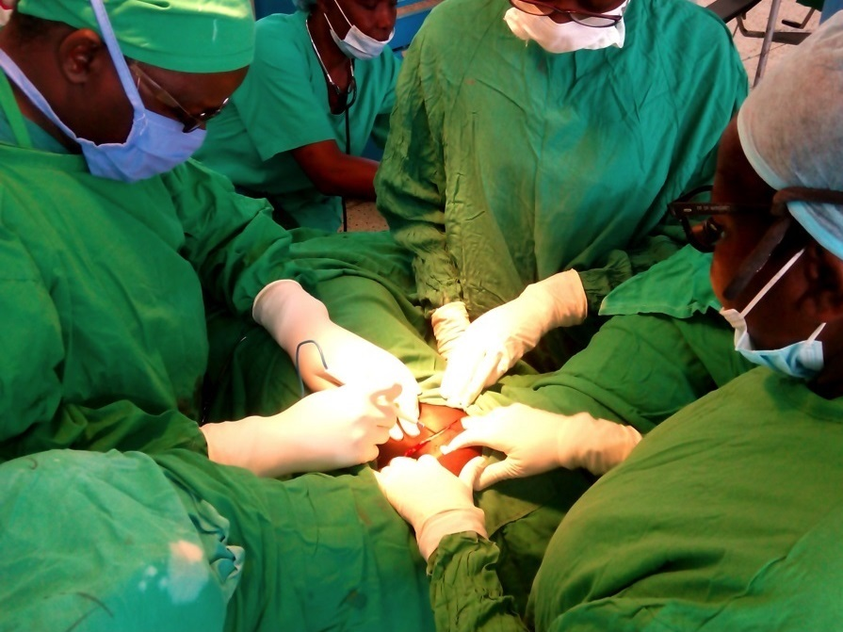
One Path and the Things I Learned
GloCal Fellows Career Development Webinar
April 21, 2021
Catherine Juillard, MD MPH
Department of Surgery
University of California, Los Angeles

Slide 2
Disclosures
NIH 1R21TW010956-01
NIH R21TW010453
American College of Surgeons Faculty Research Fellowship
No conflicts of interest to report

Slide 3
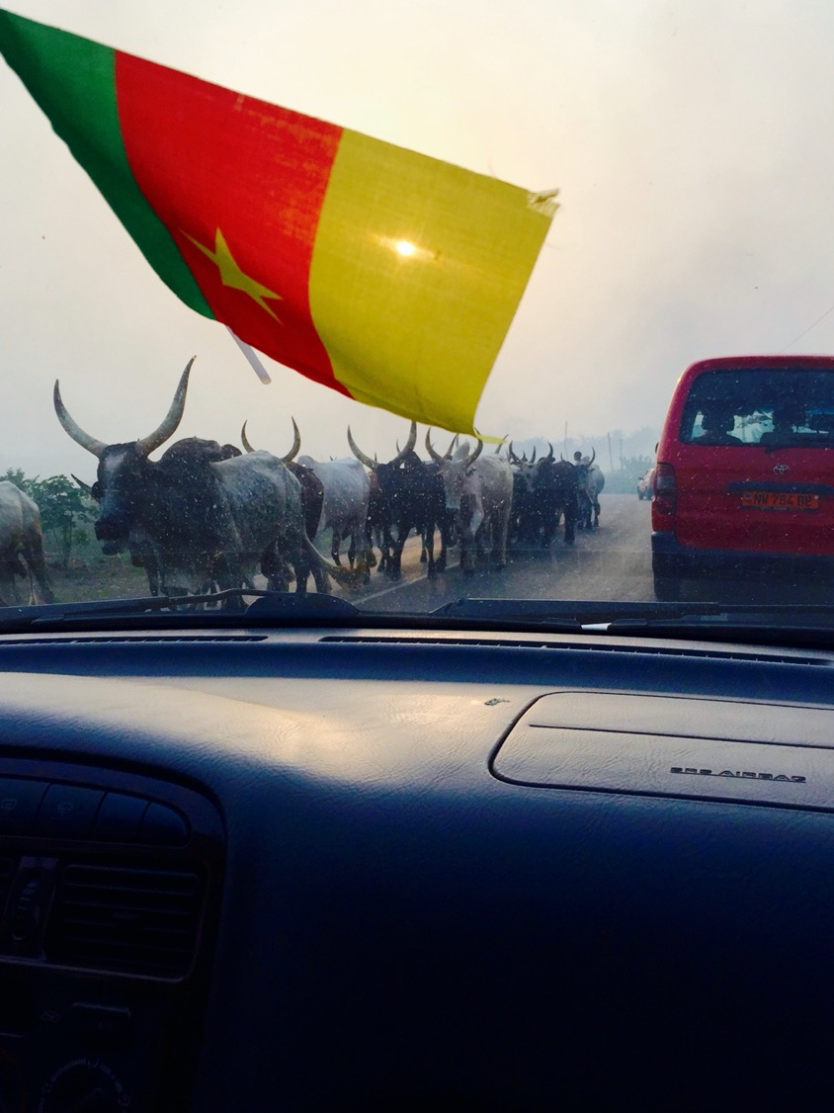
Overview
My path
Important Lessons (for me!)
My advice
Questions!

Slide 4
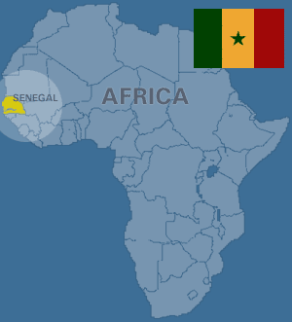
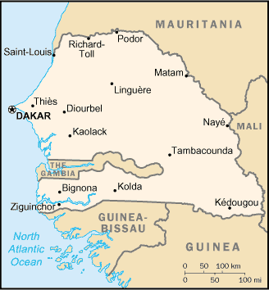
How it all started (for me)…

Slide 5
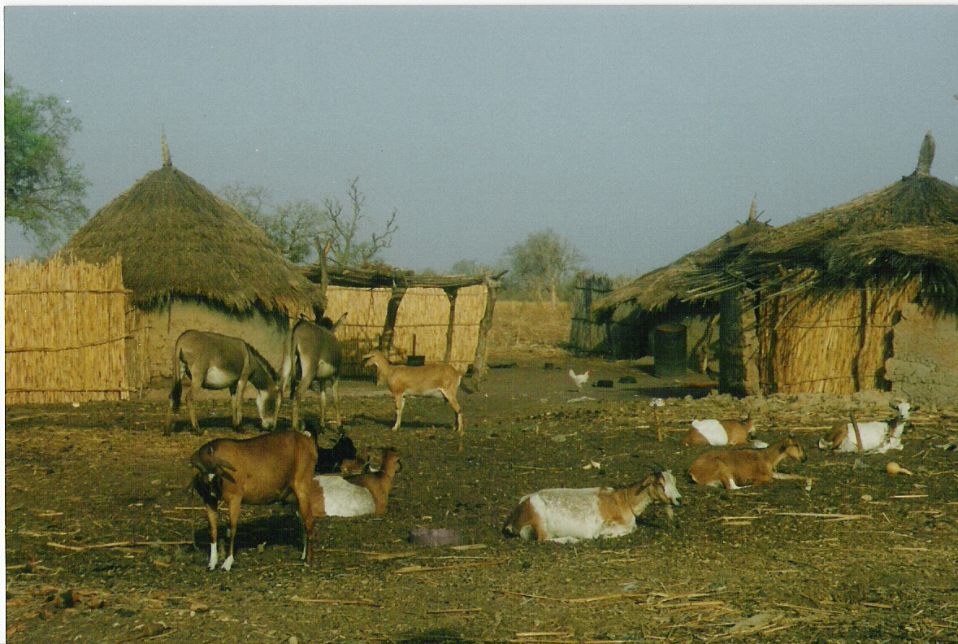
Then I actually got there…

Slide 6
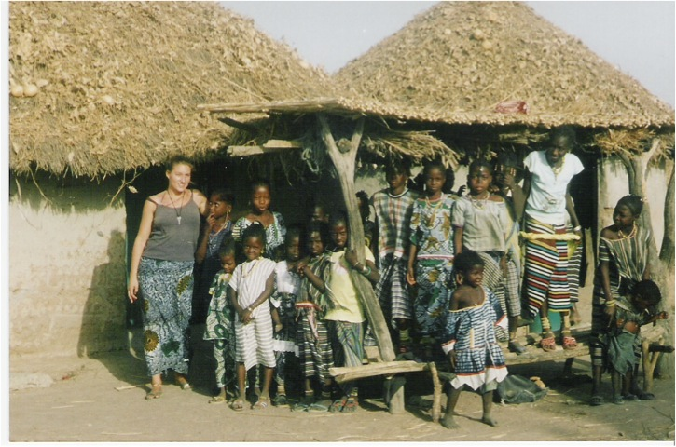
My Hut
(suudu am)

Slide 7
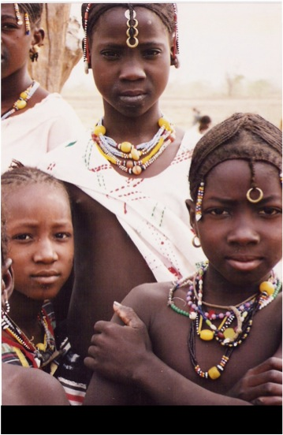

Slide 8
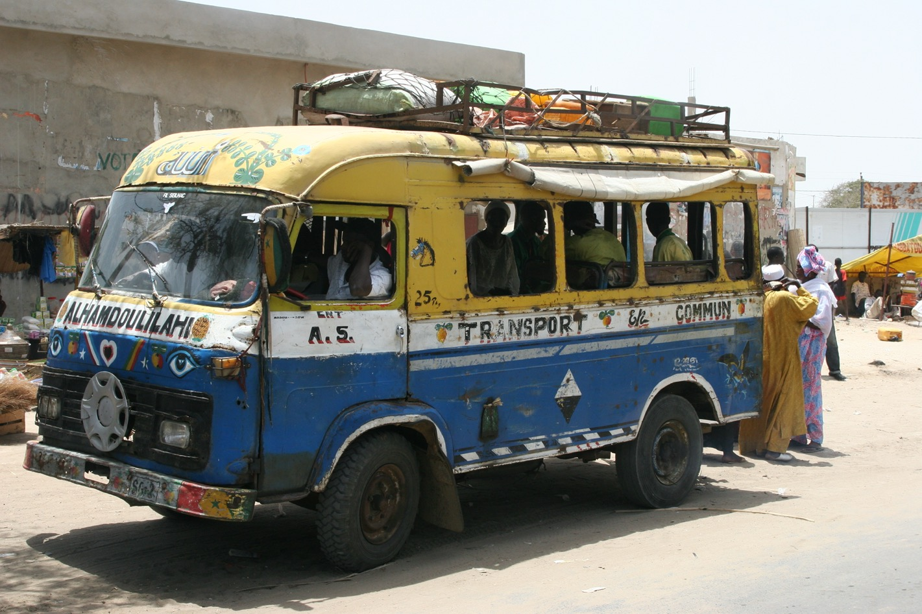

Slide 9
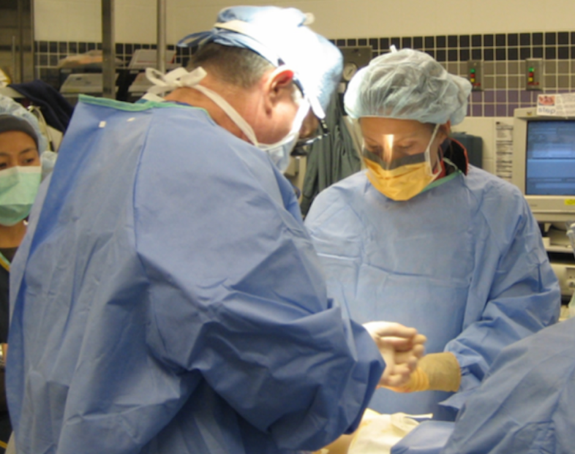
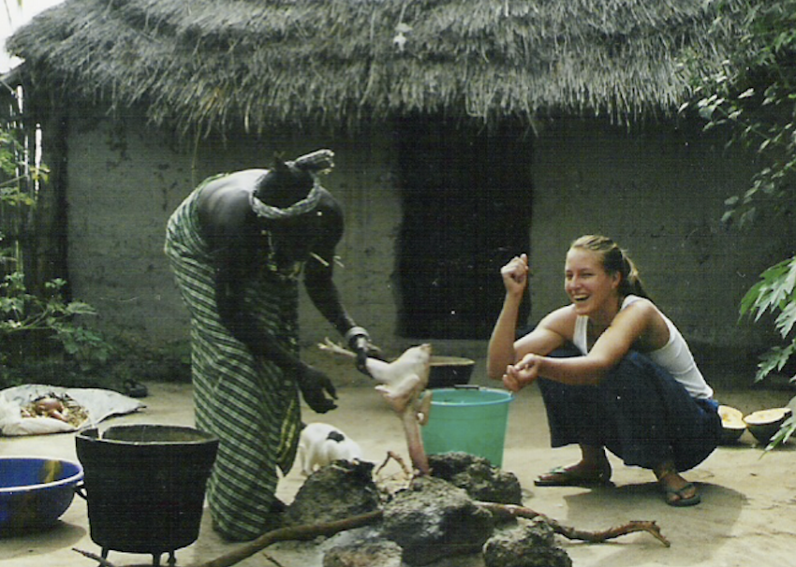
Medical School
(also known as: Catherine is wrong a lot.)
I thought I was going to :
Go into family practice. (wrong)
Work in community health/development. (wrong)
Go back and live in Senegal. (also wrong)
I liked surgery….

Slide 10
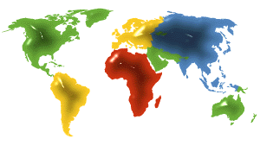
Traditional Model Surgery and International Health
Short-term missions
Transient interventions
Treat individuals

Slide 11
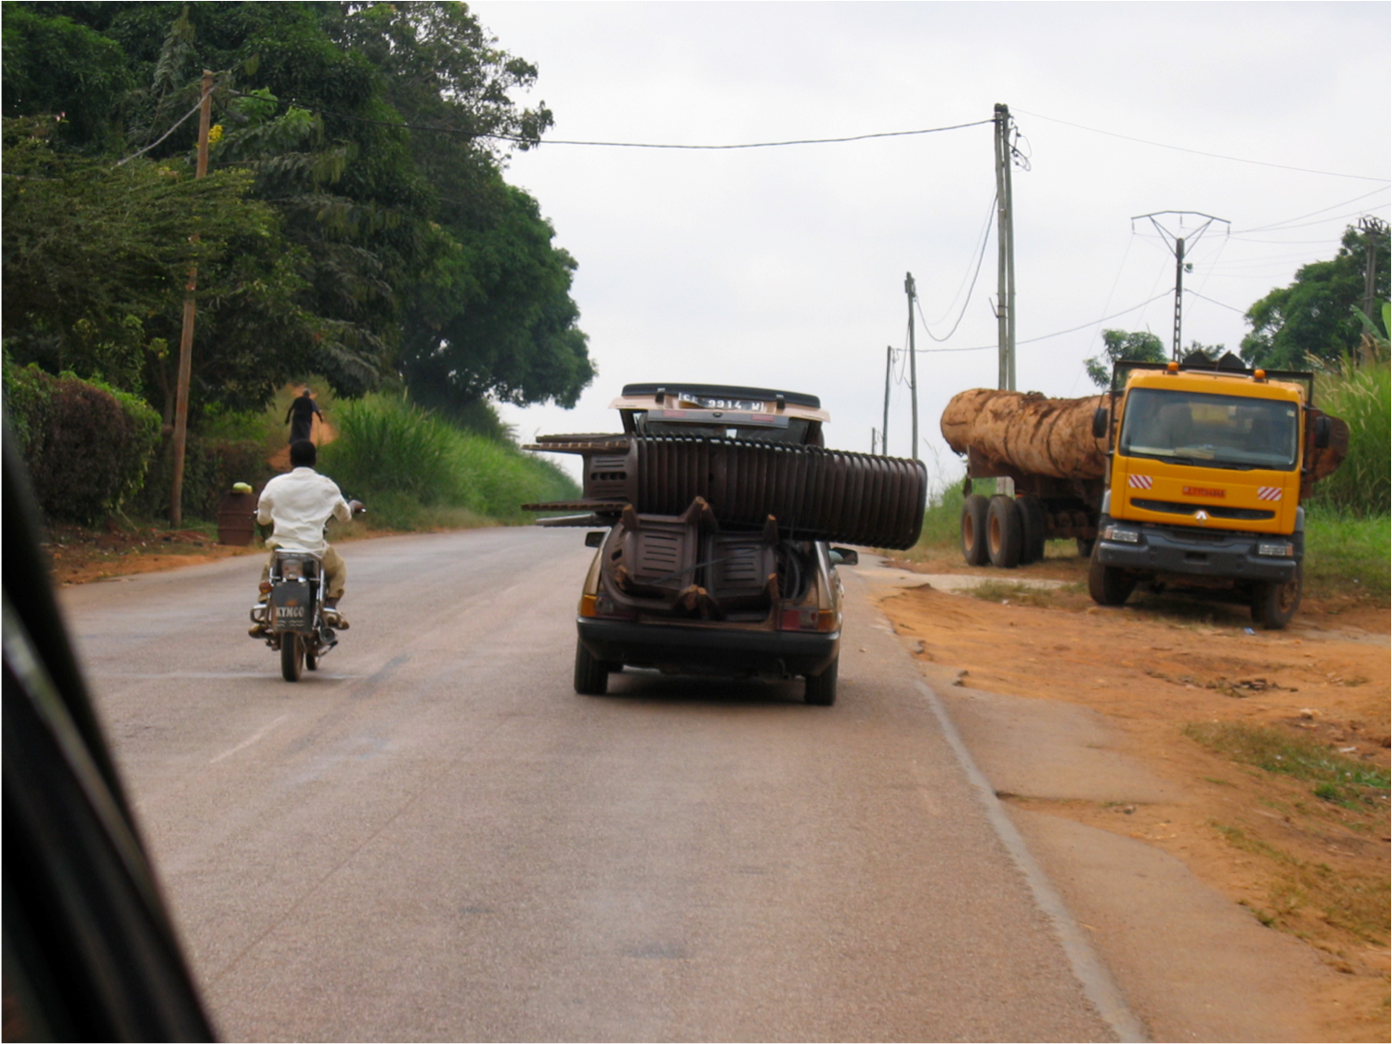
Why is surgery underprioritized?

Slide 12
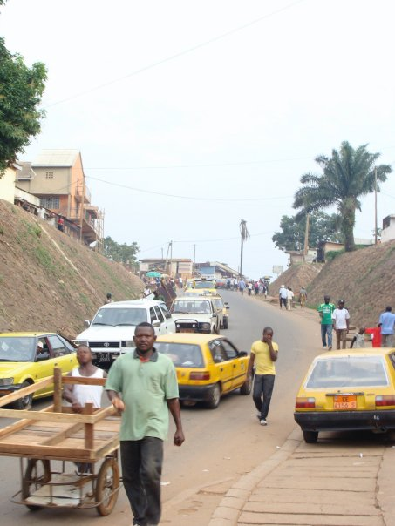
Perceptions of Surgery
Curative
Focus is on the Individual
High-tech, high-skills
Not Cost-effective

Slide 13
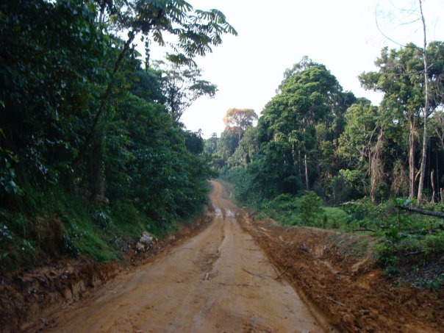
Perceptions of Public Health
Prevention approach
Focuses on Populations
Low-tech
More cost-effective
Equity

Slide 14
Surgical Research Years
MPH
Johns Hopkins
WHO
Geneva
Cameroon
Africa
June 2008 – September 2008
July 2007 – May 2008
October 2008 – June 2009

Slide 15
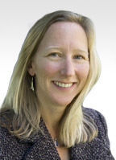
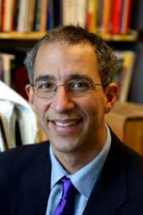
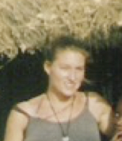
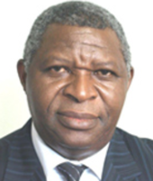
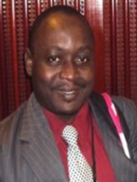
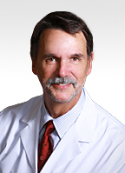
LESSON # 1: Mentorship is a team sport.
Program Director—Institutional Support
Methods Guru (biostats)
Trauma Director: Career Advice!
Injury Research Mentor
Non-traditional thinker
Injury Research Mentor

Slide 16
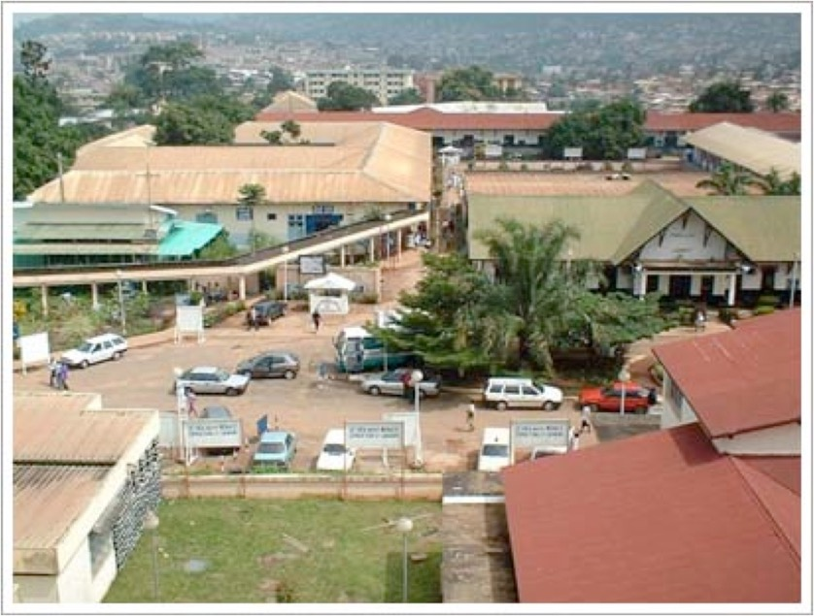
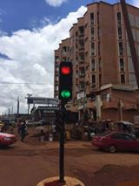
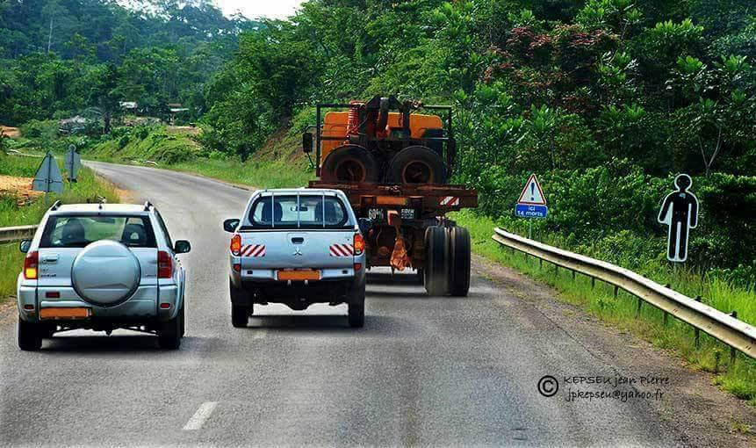
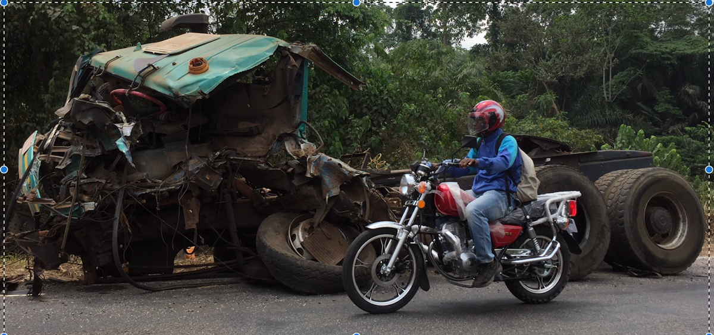
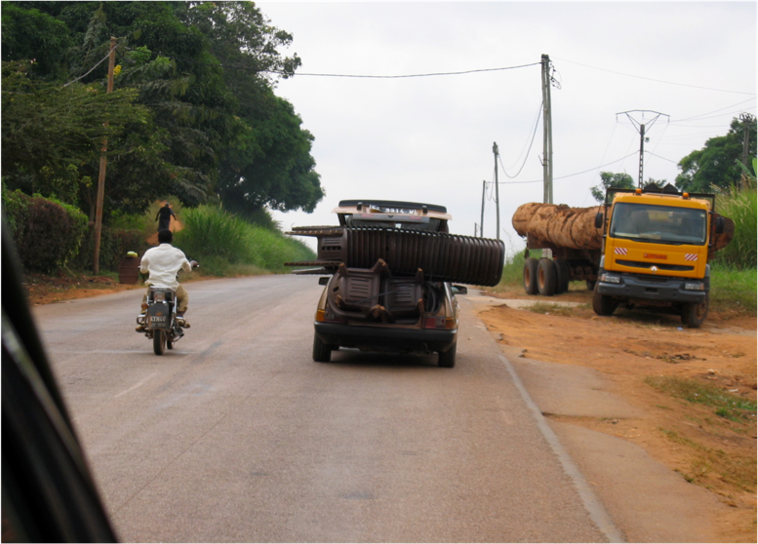

Slide 17
LESSON #2: Partners are the key

Slide 18
Catherine Juillard, MD MPH
Alain Chichom, MD
Melissa Carvalho, MPH
Rasheedat Oke, MBBS MPH
Lidwine
Nsuh, BSc
Dr. George Etoundi, MD
Agbor Mbiarikai MSc
Fanny Dissak Delon, MD PhD
Our Team
Ministry of Public Health
UCLA (PASE)
University of Buea
6 Trauma Registry Research Assistants
3 Mhealth Research Assistants & 4 Physician Examiners
4 Trauma Quality Fellows

Slide 19
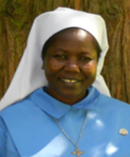
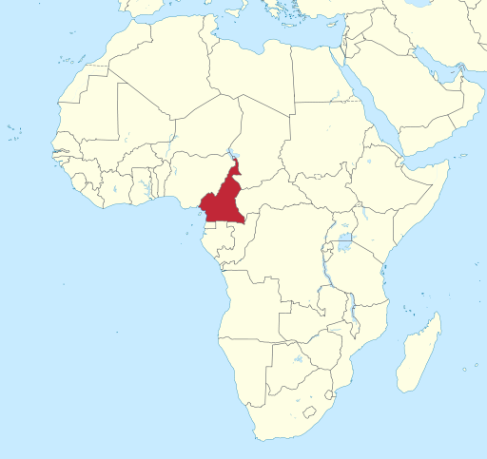
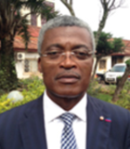
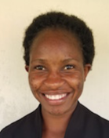
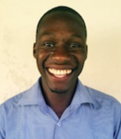
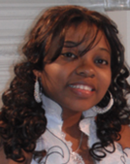
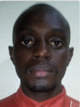
Cameroon Uganda
Martin Monono, MD
WHO Health Systems, Africa Region
Mary Margaret Ajiko, MD
Senior Surgeon
Soroti Regional Referral Hospital
Georges Alain Etoundi Mballa, MD
Director of Disease Control
Ministry of Public Health
Goretty Arikot, BA
Research Assistant
Alain Chichom, MD
Chief of Surgery
University of Buea
Silas Okullu, DN
Research Assistant
Fanny Disak Delon, MD
Study Supervisor
Agbor Mbianyor, MSc
Program Manager

Slide 20
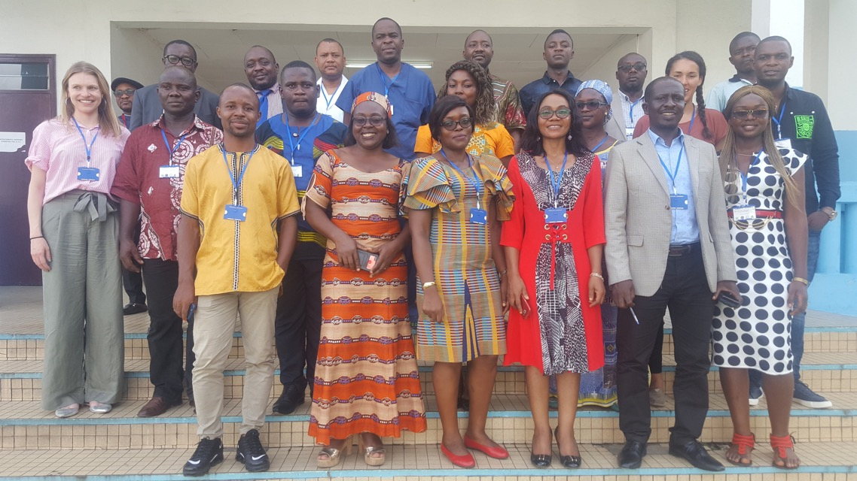
PARTNERS PARTNERS PARTNERS
TRUST
Navigating the roles each partner has, what each brings to the partnership
How that might shift
Finding common ground between funders’ (and other external stakeholders’) priorities and the REAL priorities on the ground
Constant self-evaluation

Slide 21
GloCal Opportunity
HUGE chance to form strong partnerships in other countries.
Build trust and friendship—it’s more fun ☺
Listen and learn
Find like-minded people with big dreams
Potential future partners with complementary skillsets
Mentorship
International-based GloCal Fellows: What can the U.S. cohort (faculty/trainees) do for you? What partnerships can be helpful in the future? What resources will you need?
Grant application support
These opportunities are generally RARE throughout your career—take full advantage of it!

Slide 22
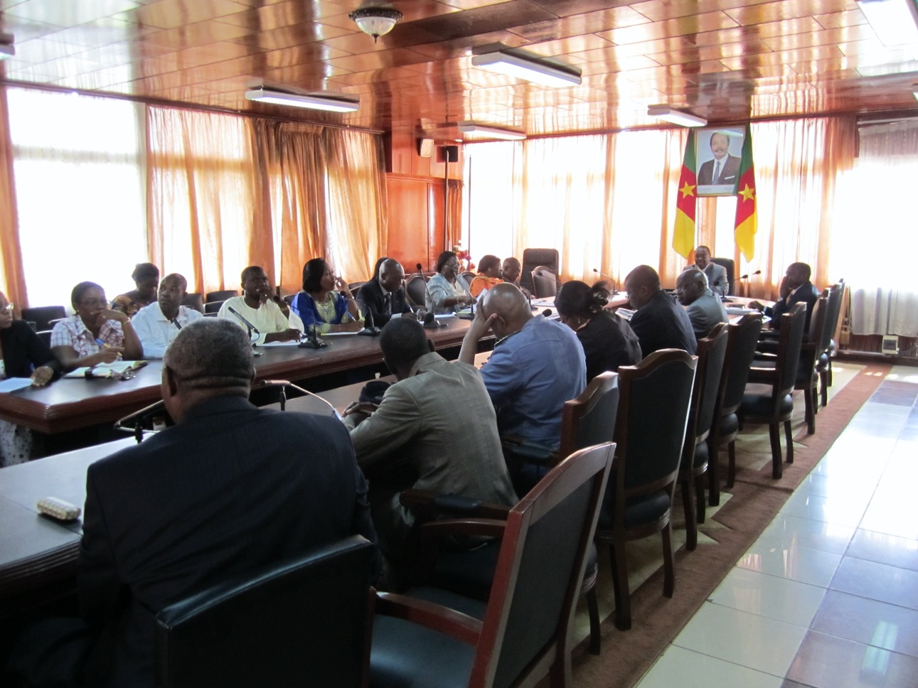
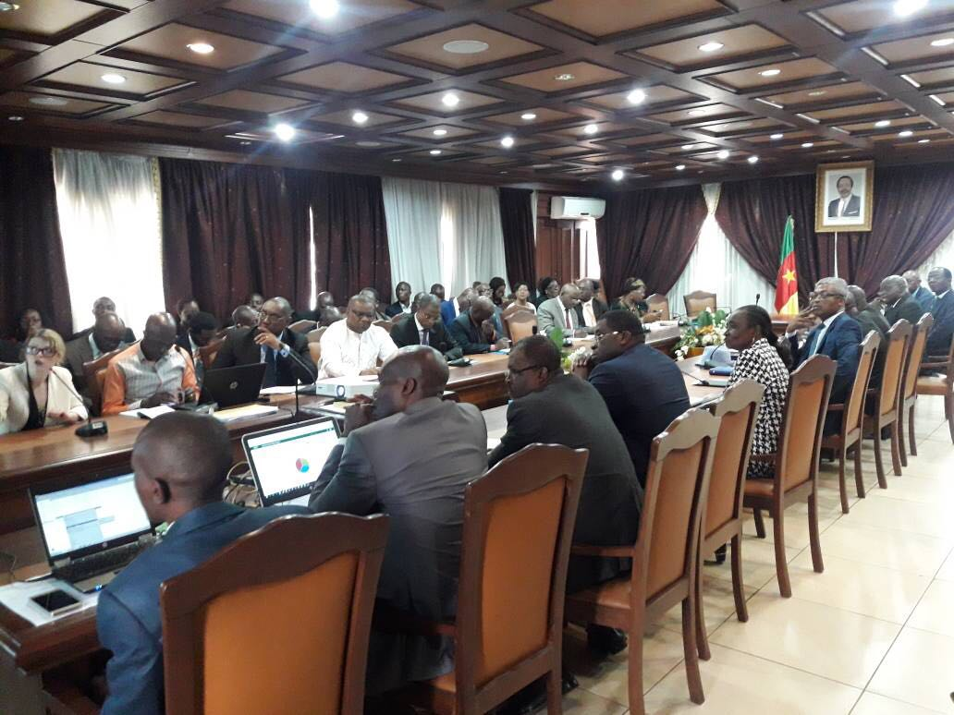
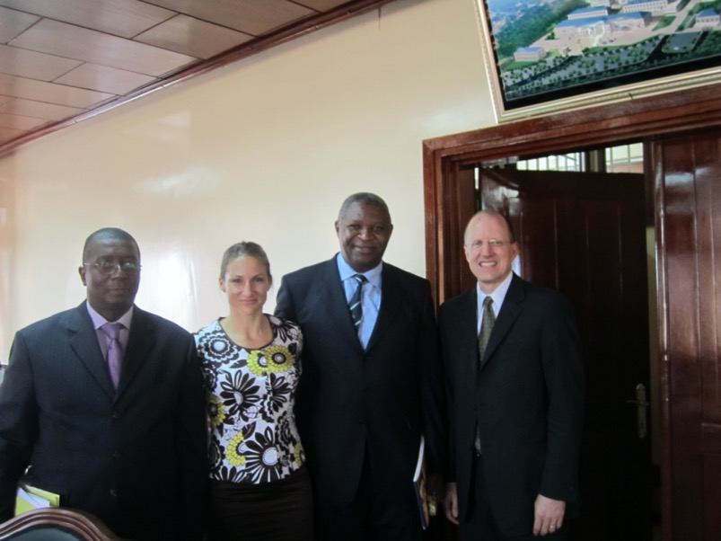

Slide 23
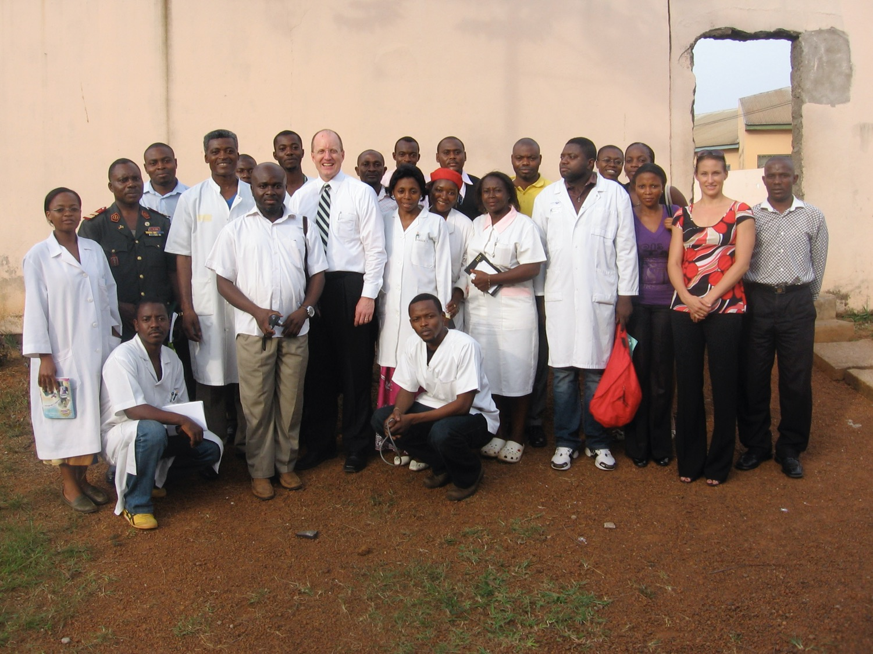

Slide 24
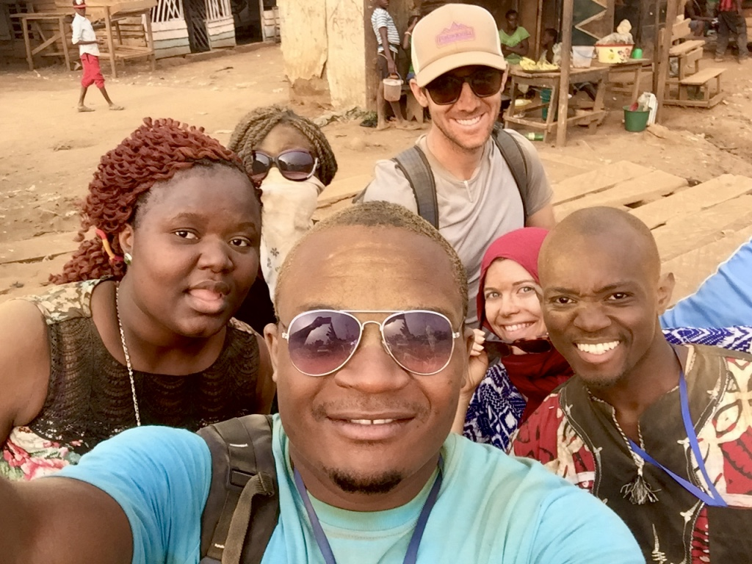
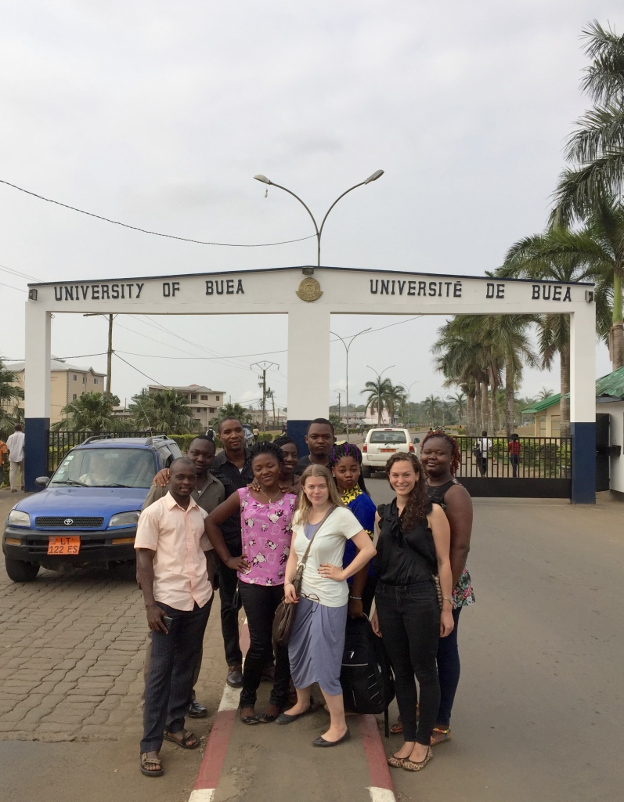
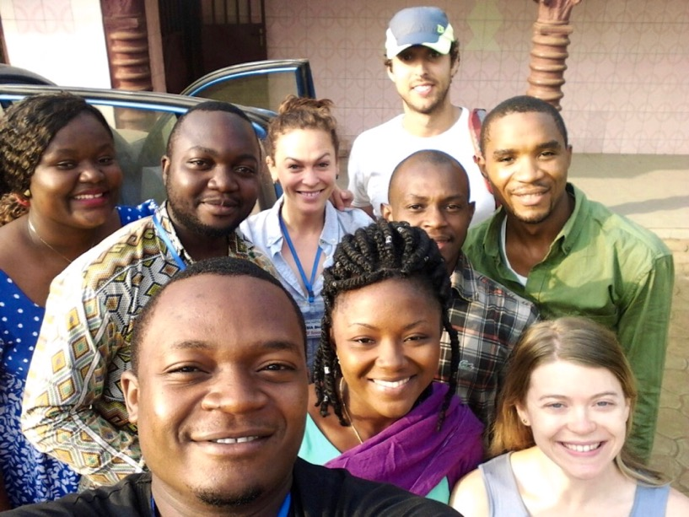

Slide 25
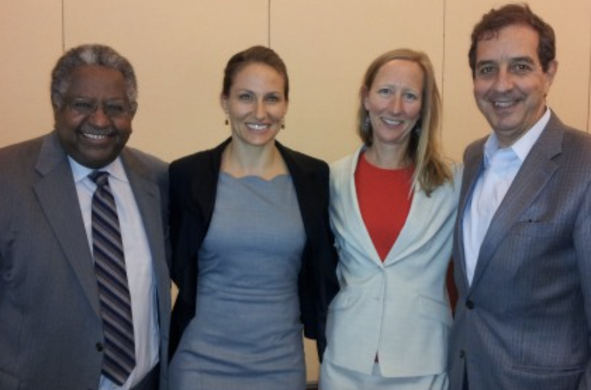
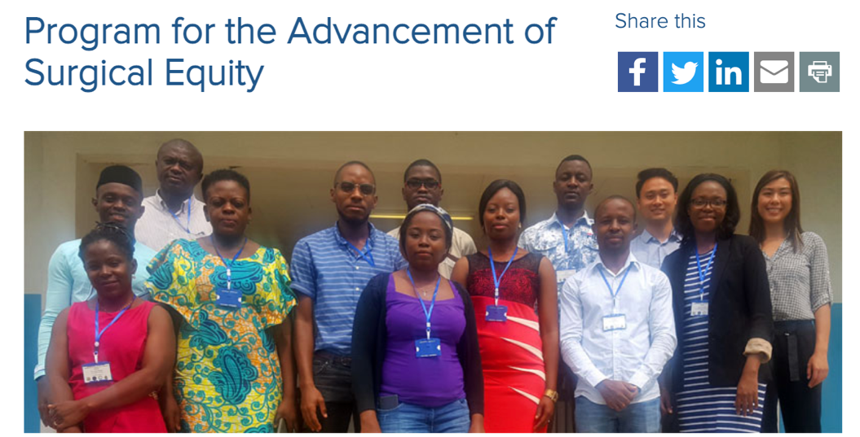
LESSON #3: It’s ok to be different…
I didn’t know enough to know that I was taking a risk.
It WAS a risk… but also a STRENGTH
If it works, you are unique and a pioneer!

Slide 26
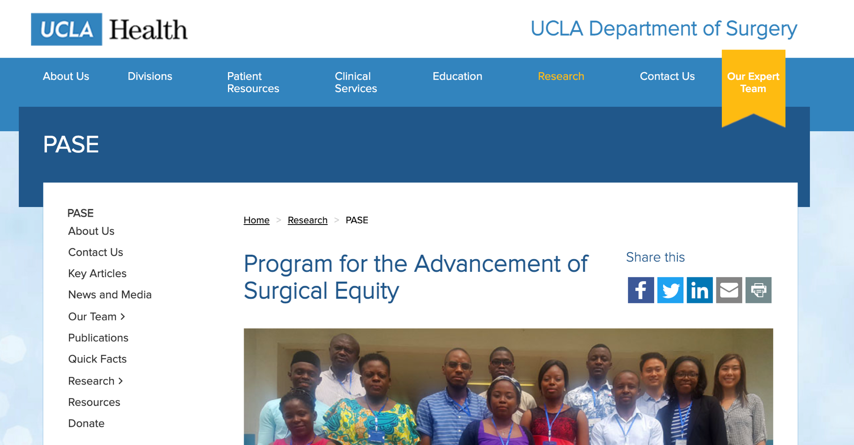
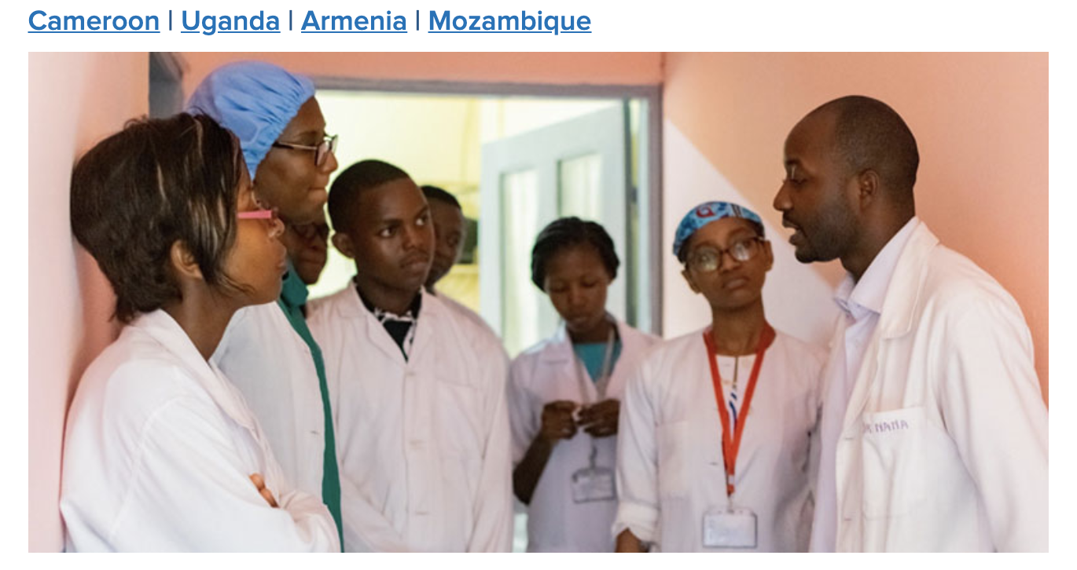

Slide 27
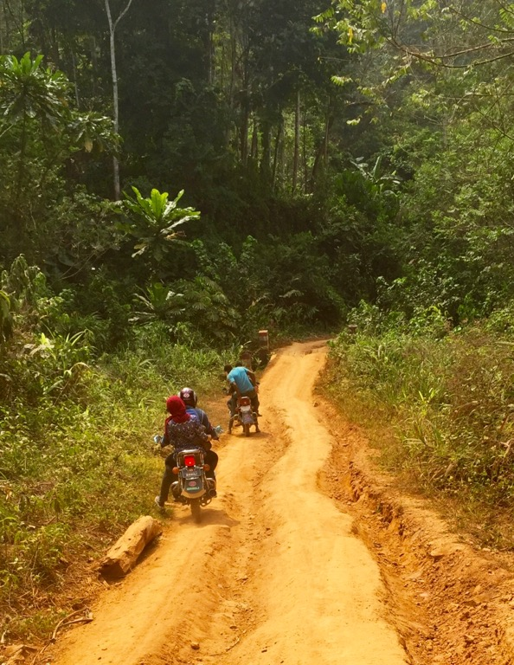
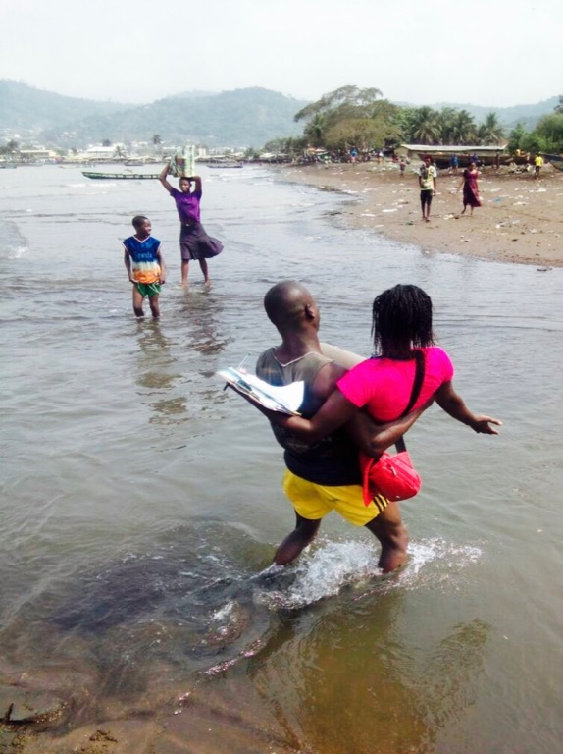
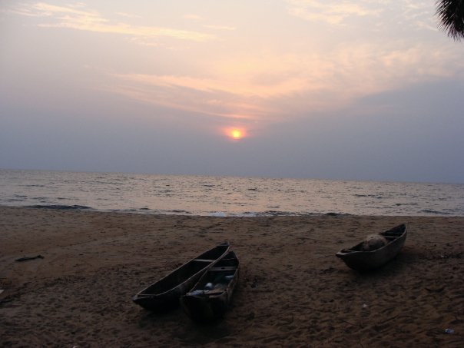
LESSON # 4: Do what you care about!
Make decisions based on your internal compass.
I can weave the past 15 years into a narrative that looks like it tells a nice story, but that’s not what it felt like at the time!
You may not know where you are going, exactly, but if the reasons for your choices are true and consistent, you will get somewhere you belong.

Slide 28
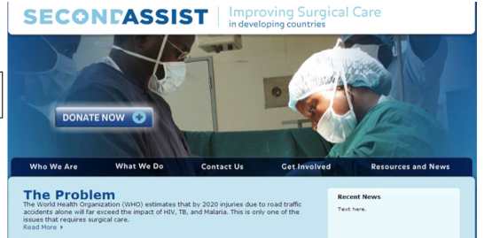
My funding trajectory
NGO (Foundation, Donors)
Departmental (first job)
Professional Society (ACS Junior Faculty Award)
Finally 2 NIH grants

Slide 29
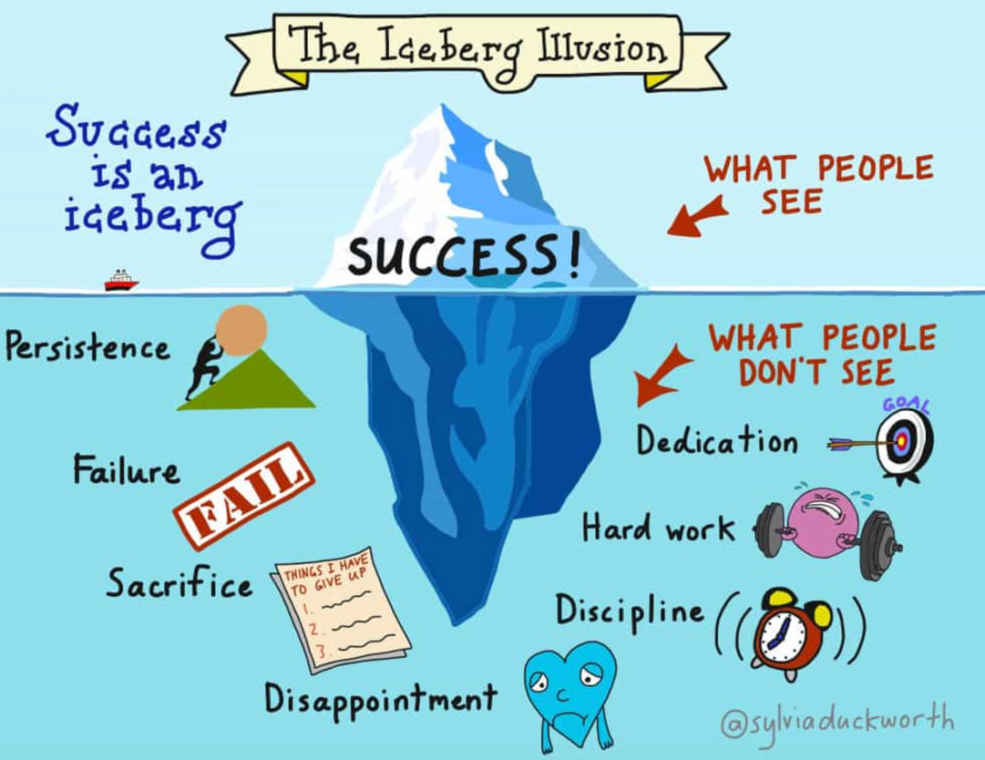
Failed Grants Applications
AAS Roslyn Faculty Award x 2
AAST Scholarship x 2
ACS Faculty Research Scholarship x 2
COVID Surg Grant (Chichom PI) x 1
Conservation Food and Health Foundation x 1
SFGH Hearts Grant x 1
UCSF Deans Diversity Fund x 1
Maghrib Studies Institute Grant x 1
Measure B Proposal (LA County) x 1
MIT Surgical Innovations Grant x 1
NIH D43 x 2
NIH R21 x 4
Roux Prize x 3 (always a runner up!)
SUS Junior Faculty Award x 1
Toyota Grant x 1
UCLA Global Health Seed Grant x 2
VOCA Grant x 1
USISTEF Grant x 1
3 Successful Applications
28 Failed Applications
NIH 1R21TW010956-01
NIH R21TW010453
American College of Surgeons Faculty Research Fellowship

Slide 30
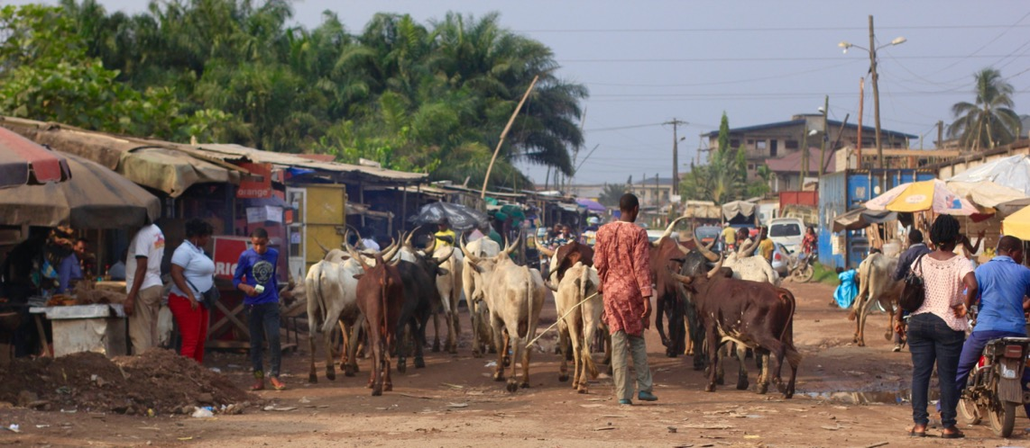
LESSON #5: PERSISTENCE!!!!
You have to be willing to get beat up.
9/10ths of academia is failure.
GET BACK UP!
For every success, there are 10-20 hidden failures.
→be resilient
This times 20 for academia!

Slide 31
Funding—What is out there…
U.S. Federal Academic Funding
NIH
K-awards (career development awards)
R01s
R21s
Development/Donor
World Bank
USAID
DIFID (UK version of USAID)
Other options
DOD, UK, Swedish, African funds available to LMIC investigators

Slide 32
Lesson #6: Find a way to contribute
SKILLS—hard skills. What can you contribute?
As a resident going to Cameroon, I couldn’t help with surgery (I was still in training)
I COULD do a solid multivariate analysis—that allowed me to be very useful to many people who became my partners!

Slide 33
LESSON # 7: Check the boxes….
But don’t lose sight of the real goal!
Papers, funding, presentations, etc. (be practical…)
Still move the needle towards your ULTIMATE goal
Learning/developing skills
Be opportunistic
Develop lasting partnerships
Lay the groundwork for
productive and impactful research
Help colleagues succeed

Slide 34
Imperfect Projects…
Opportunity | What I was thinking | What Happened
Analysis of Hysterectomy Data for Biostats Project | I’d rather have my toenails pulled out one by one
Analysis of Nigerian injury data for MPH Capstone | That’s not Francophone West Africa….
Take a class on Injury Prevention | Safety is for nerds | I became a trauma surgeon

Slide 35
Injury control in Cameroon
Community Based Survey
Trauma Registry
Audit Filters
Trauma QI
Training
Cell Phone
Feasibility
Disability and Economic Impact Surveillance
Severity Scoring
Cell Phone Follow Up Program
Triage Tool
For
Further Care
Injury Surveillance
Trauma QI
Program
Prevention
Prehospital
Hospital
Outpt F/U
Rehab
SES Tracking
Reduced Injury Incidence
+
=
Reduced burden of injury
Improved Trauma Care

Slide 36
Goals in Cameroon
Help build research capacity
Support my partners
Contribute meaningful data
Long term goals:
Give MOPH data they need for prevention policy
Improve trauma care
Help Buea create an Injury Center
Universal Health Care

Slide 37
Lesson #8: Enjoy the Wins

Slide 38
THANK YOU…

