Slide 1



MY RESEARCH CAREER: HIGHLIGHTS AND CHALLENGES
Dr. Moses R. Kamya
Professor, Department of Medicine, Makerere University, Kampala, Uganda
Executive Director, Infectious Diseases Research Collaboration
GloCal Career Development session Thursday, April 21st from 8-9 am Pacific time

Slide 2



Outline
  My academic career
  Networking
  Collaboration in the international setting
  Working across cultures
  Securing grant funding for research
  Peer review and publication process
  Dissemination of research findings
  Balancing professional and personal life

Slide 3
Academic Background
Bachelors of Medicine and Surgery (M.B.Ch.B), Makerere U
Masters of Medicine in Internal Medicine (M.Med Int.Medicine), Makerere U
Masters of Public Health (MPH), UC Berkeley
PhD in Biomedical sciences, University of Antwerp, Belgium

Slide 4

Professional Positions
2009-current: Professor, Department of Medicine, School of Medicine, Makerere U
2008-current: Director, Infectious Diseases Research Collaboration, Uganda
2015-Current: Fellow, Uganda Academy of Sciences
2015-2019: Dean, Makerere University School of Medicine
2009-2015: Chair, Department of Medicine, School of Medicine, Makerere U
2007-2010: Head, Infectious Disease Unit, Mulago Hospital, Kampala, Uganda

Slide 5
Career Path 1
Started at Masters level:
Did STD work and published my first paper: Kamya MR, Nsubuga P, Grant RM, Hellman N. The high prevalence of genital herpes among patients with genital ulcer disease in Uganda. Sex Transm Dis. 1995 Nov-Dec;22(6):351-4. doi: 10.1097/00007435-199511000-00006. PubMed PMID: 8578407.
After 3-month course at CAPS published: Kamya M, McFarland W, Hudes ES, Ssali A, Busuulwa R, Hearst N. Condom use with casual partners by men in Kampala, Uganda. AIDS. 1997 Sep;11 Suppl 1:S61-6. PubMed PMID: 9376103.

Slide 6
Career Path 2
As study coordinator on TB trial:
J.L. Johnson, R.M Kamya, A. Okwera et al. Randomised Controlled Trial of Mycobacterium vaccae Immunotherapy in HIV-Non-Infected Ugandan Adults with Newly-Diagnosed Pulmonary Tuberculosis. The Journal of Infectious Diseases. 2000;181:1304-12
Then started malaria work: first, first paper:
Kamya MR, Dorsey G, Gasasira A, Ndeezi G, Babirye JN, Staedke SG, Rosenthal PJ. The comparative efficacy of chloroquine and sulfadoxine-pyrimethamine for the treatment of uncomplicated falciparum malaria in Kampala, Uganda. Trans R Soc Trop Med Hyg. 2001 Jan-Feb;95(1):50-5. doi: 10.1016/s0035-9203(01)90331-1. PubMed PMID: 11280066.

Slide 7
Career Path 3
Then did both malaria and HIV - focusing on interactions between both diseases:
Kamya MR, Gasasira AF, Yeka A, Bakyaita N, Nsobya SL, Francis D, Rosenthal PJ, Dorsey G, Havlir D. Effect of HIV-1 infection on antimalarial treatment outcomes in Uganda: a population-based study. J Infect Dis. 2006 Jan 1;193(1):9-15. doi: 10.1086/498577. Epub 2005 Nov 18. PubMed PMID: 16323126.
Achan J, Kakuru A, Ikilezi G, Ruel T, Clark TD, Nsanzabana C, Charlebois E, Aweeka F, Dorsey G, Rosenthal PJ, Havlir D, Kamya MR. Antiretroviral agents and prevention of malaria in HIV-infected Ugandan children. N Engl J Med. 2012 Nov 29;367(22):2110-8. doi: 10.1056/NEJMoa1200501. PubMed PMID: 23190222; PubMed Central PMCID: PMC3664297.
Co-authored a book chapter in Cecil Medicine titled “Malaria” Chapter 353.

Slide 8
Current Research Program
We currently have a thriving research collaboration (IDRC Uganda)
  http://idrc-uganda.org
  Doing research on infectious diseases (malaria, HIV, TB )
  Has expanded to non-communicable diseases
  Collaborating partners: Makerere University, Uganda Ministry of Health, UCSF, LSHTM
  Team effort = faster and easier publication
Over the years our research has
  Generated new knowledge in the infectious and non-communicable diseases
  Greatly impacted on national disease control policies.
  Most recent dissemination our research findings was held on 23rd March 2022

Slide 9
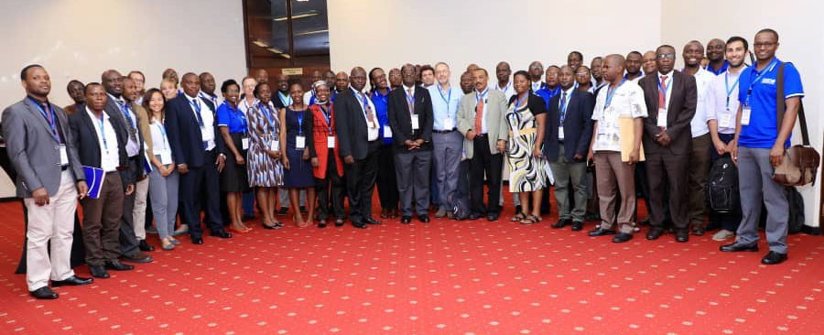
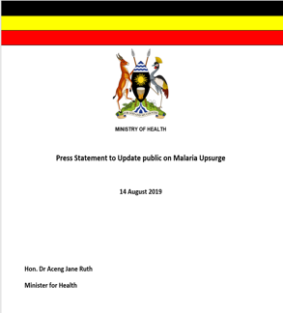
Important that information should Reach Policy Makers using Different Channels in order to Inform Policy
Dissemination channels may include: Policy briefs, Meetings, Seminars, Publications, Reports

Slide 10
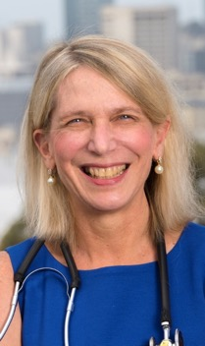
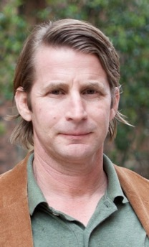
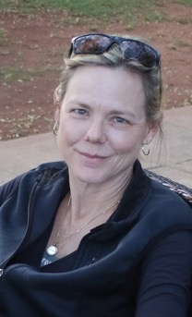
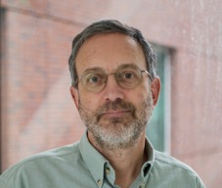
Networking, Collaboration and Working Across Cultures
Prof. Diane Havlir
Prof. Phil Rosenthal
Prof. Grant Dorsey
Prof. Sarah Staedke

Slide 11
Capacity Development – Research Training
Through the years, I have also led some training programs at Makerere University
  MEPI-CVD - R24TW008861
  Implementation Science training program (MakImS) - D43TW010037
  Behavioral and Social Sciences training program (MakBSSR) - D43TW011304
  Malaria Capacity Development Consortium – WT084289MA
  Malaria COHRE - D43TW008077
  Malaria Training in Uganda - D43TW007375
  Uganda HIV/TB COHRE Training Program - U2RTW006900

Slide 12
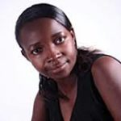
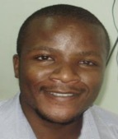
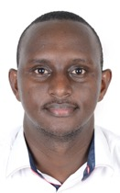
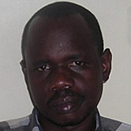
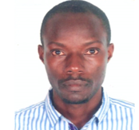
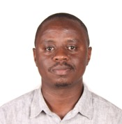
Capacity of Local Scientists Developed under IDRC
Joaniter
Emmanuel
Patience
Isaac
Patrick
Thomas
Epidemiologists
Immunology
Alex
Samuel
Steven
Rek
Yeka
Catherine
Transmission
Drug resistance
Sam
Community Trials
Henry
Maxwell
Simon
Jaffer
Abel
Arthur
Data
Insecticide resistance
Clinical Research

Slide 13
Some of the Successful PhDs I have Supervised
School-based malaria control: Impact of intermittent preventive treatment on malaria morbidity and cognitive function in Ugandan school children – PhD, Makerere University, 2014 by Joaniter Nankabirwa
Non-Enrollment & Non-Adherence to HIV Care in A Community-Based Program, Rakai, South Western Uganda- PhD, Makerere University, 2015 by Gertrude Nakigozi.
Strategies to improve HIV care & treatment outcomes in resource-limited settings – PhD, University of Antwerp, Belgium, 2009 by Damalie Nakanjako.
Correlating anti-tuberculosis drug concentrations with clinical outcomes in TB-HIV co-infected patients – PhD, Makerere University, 2018- by Christine Sekaggya
Population based survey of the prevalence of Asthma among adolescents & adults in Uganda - PhD, University of Gronigen, Nertherlands, 2019- by Bruce Kirenga
Molecular Epidemiological Surveillance of pfhrp2 and pfhrp2 gene deletions in P. falciparum parasite populations – PhD, Makerere University, 2022 by Bosco Agaba Bekiita

Slide 14
Research Funding
WHO small grant (PI Kamya)
RO3 grant (PI Rosenthal)
Successful small grants that created opportunity for bigger grants, stronger collaborations, and more opportunities for funding
Larger grants tend to be multi-disciplinary and required diverse expertise examples PRISM and SEARCH

Slide 15
Lessons for Successful Grant Writing
Time – to write a good piece (planning), up-to date with literature
Peer review (to check quality and flow of the research ideas, editing)
Being responsive to the RFA
Building on prior work
Building a strong team
Leverage existing infrastructure

Slide 16
What’s been Important in my Career
Standing out (at least early in career)
Building lasting relationships
Building research teams
Identifying talent among early career scientists
Collaborations
Integrity
Hard work
The balance is important

Slide 17
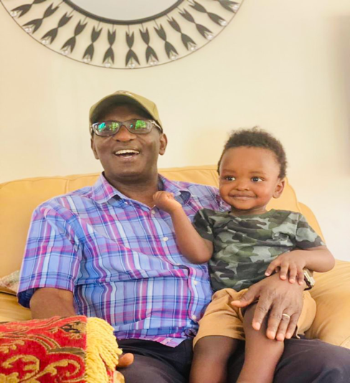
Balancing Professional and Personal Life
The joy of being a grand parent

Slide 18
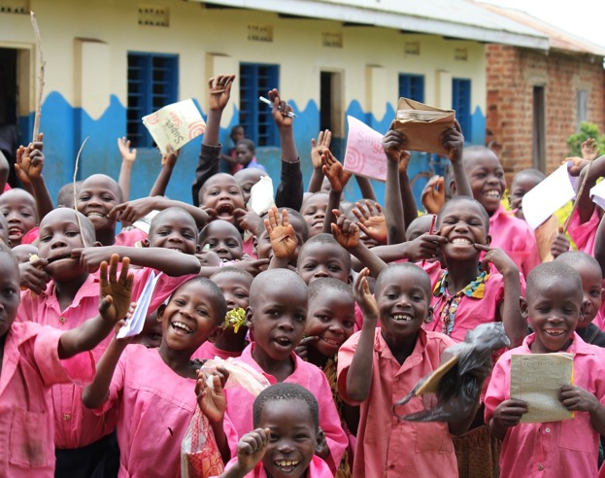
Thank You

