Slide 1
GH Career Trajectory
Kelika A. Konda, PhD, MHS
Associate Professor, UCLA
Associate Researcher, UPCH

Slide 2
Disclosures
• Dr. Konda is a faculty member of the University of California, Los Angeles
• Dr. Konda is a Associate Researcher at Universidad Peruana Cayetano Heredia
• In the past 12 months, Dr. Konda has received:
– Salary from Universidad Peruana Cayetano Heredia and University of California, Los Angeles
kkonda@mednet.ucla.edu
kelikakonda@gmail.com
kelika.konda@upch.pe

Slide 3
Pre-grad
BA in major environmental health and minor political science
In Peru your career is generally defined by your undergraduate major, people are always astounded that I didn’t study medicine
I studied Spanish from middle school onwards, but really became fluent as a Peace corps volunteer in the Dominican Republic
Fluency helps, the more languages the better…
https://www.peacecorps.gov/ (you can do peace corps at any age)

Slide 4
MHS
After Peace Corps I went to Hopkins for my masters in Social and Behavioral Interventions in International Health
Then did my thesis research in Peru – with the same research group I work with today
This is rare, most masters students don’t stick with the same research group for the next 15 years
I was lucky to find a study that had funding for a research assistant at UCLA where I could work in Peru

Slide 5
PhD funding
After working for 2 years as a research assistant, I went back to Hopkins for my PhD, now in ID EPI
I applied for and received an F31 to fund my PhD dissertation https://researchtraining.nih.gov/programs/fellowships/f31
Stipend & educational funding, not much, but a good first foray into the world of NIH grants
All of you, pre- or post-doc already have the experience of receiving an NIH-funded grant, which will help you going forward
The NIH likes to see researchers who have gone through their system, they recognize the steps and sometimes reward those who follow them

Slide 6
Post-Doc in Global Health
I was funded by a T32 grant for a 3-year post-doc
https://researchtraining.nih.gov/programs/training-grants/t32
During the post-doc I was able to work with multiple researchers on a variety of projects that led to funding that I continue to receive
An R34 Project that is now an R01
An R01 that led to 2 additional R01s
I was also able to apply for a K01 award, which helped me to get a faculty appointment at UCLA
And I applied and received NIH student loan forgiveness – very helpful!
https://www.lrp.nih.gov/

Slide 7
GloCal & my K01
I did GloCal in 2013, the same year as the first year of my K01
Both funded me to study gay couples in Peru –slightly different research questions, but the work was complementary
Both provide mentorship and also focused research time, particularly the K01 which gives you a 5 year breather to focus and work
https://researchtraining.nih.gov/programs/career-development
There are multiple types of K awards

Slide 8
NIH Grants
Part of my exposure from my time as a research assistant onwards was participating in NIH grant writing
Starting out just helping with literature reviews, references, and the supporting documents (Budget justification, equipment, facilities and resources, etc etc)
I’m still not a wonderful grant writer – but this experience has helped me tremendously

Slide 9
Branch out from the NIH
I have also worked on WHO, UNAIDS, UNITAID, local government, & industry funded projects
All funders are different, the NIH does not have the monopoly on good science, especially internationally

Slide 10
Other consultancies: deciding when to say no…
Other opportunities arise and you have to decide when to say yes and when to say no
Time and money are part of the equation
But also: exposure, new working groups, new research areas, experiences or research questions

Slide 11
Career trajectory
Academic with a twist
I have an appointment at UCLA as an associate professor & am an associated investigator at UPCH
Few US investigatores live outside of the US, most people who work in GH continue to live in the US
There are downsides – I will never have tenure

Slide 12
Creative ways to fund research projects and salary
When someone writes to you out of the blue for a collaboration, pay attention, it could work really well
Don’t scoff at small money – the tiny $5-10k seed grants can really help!
Being funded 100% by the NIH is tough – not just scientifically, but also the funding cycles of soft money
To supplement: Clinicians = clinic time / Academics = class time
Having parts of your salary linked to hard money, is helpful

Slide 13
GH course for undergrads at UCLA
I’m a PhD at the medical school, so teaching is not an option
However, I worked to establish a month long summer course in GH for undergraduate students
2 courses: intro to GH & Diversities and Disparities in Peru

Slide 14
Other thoughts
To the best of your ability, find colleagues you like and stick with them
Research is all encompassing, if you don’t like your work environment, the level of commitment needed to succeed will be hard to muster
Figure out what work/life balance works for you and what that means for your resources – you do not have to work 24/7
Your students and mentees often turn up in important positions later on – treat them well, they are an asset not a liability

Slide 15
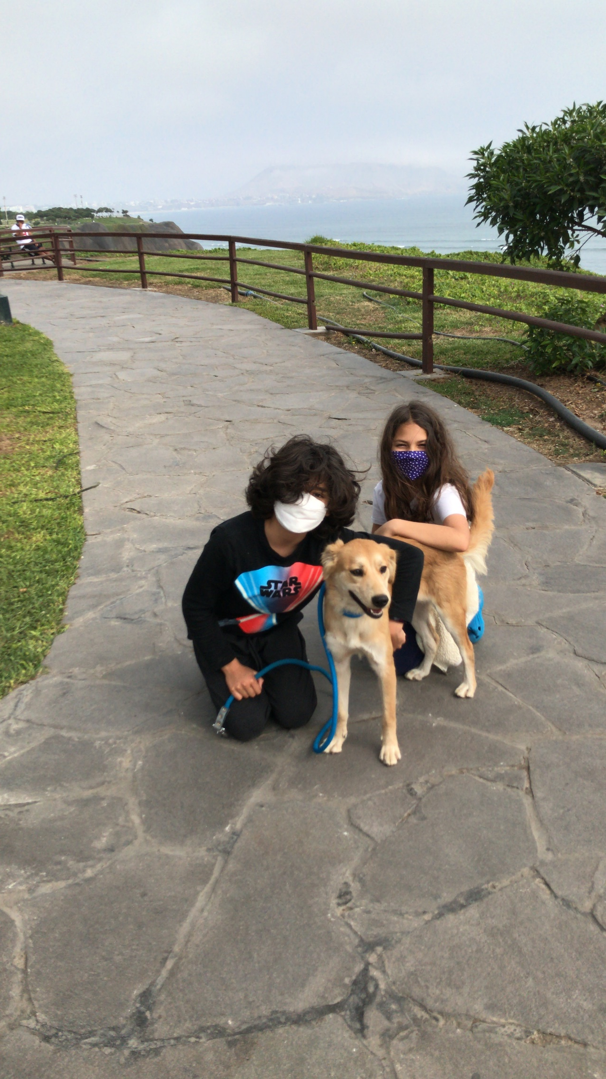
Thank you! Gracias!

