Slide 1
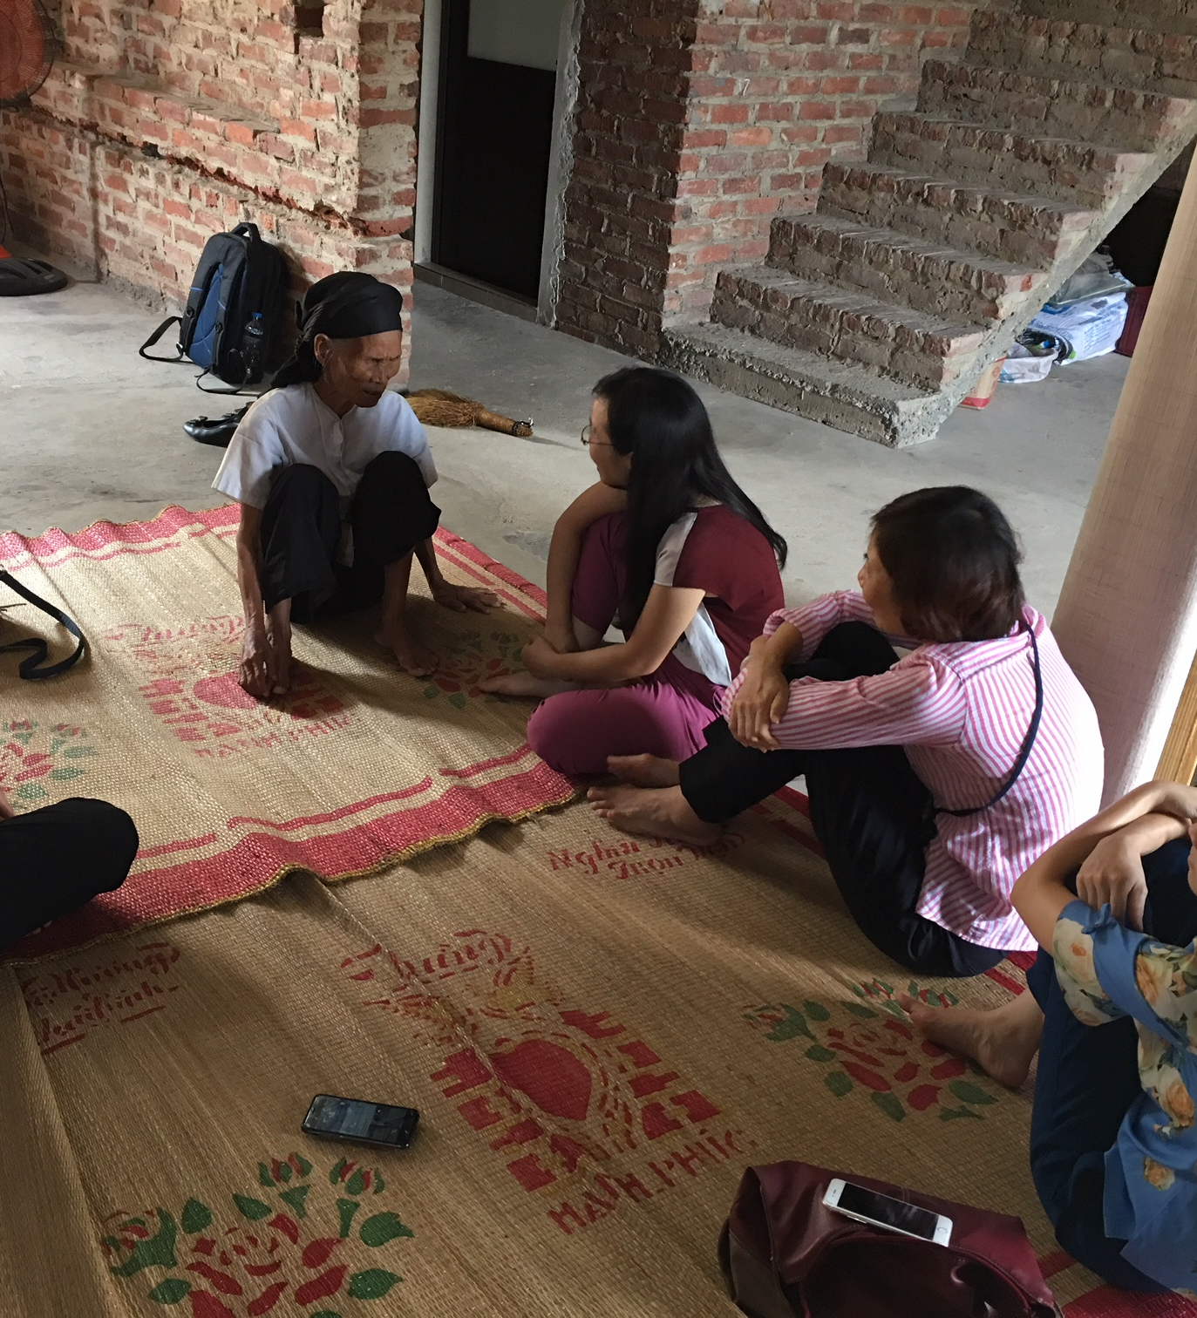
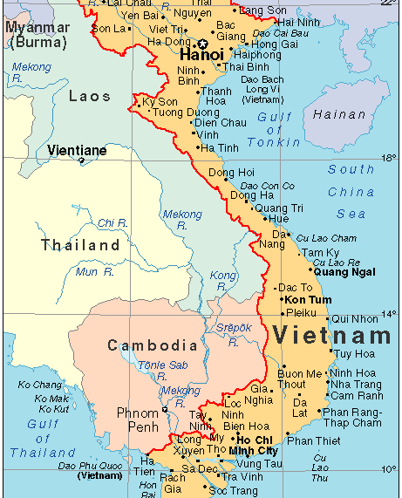
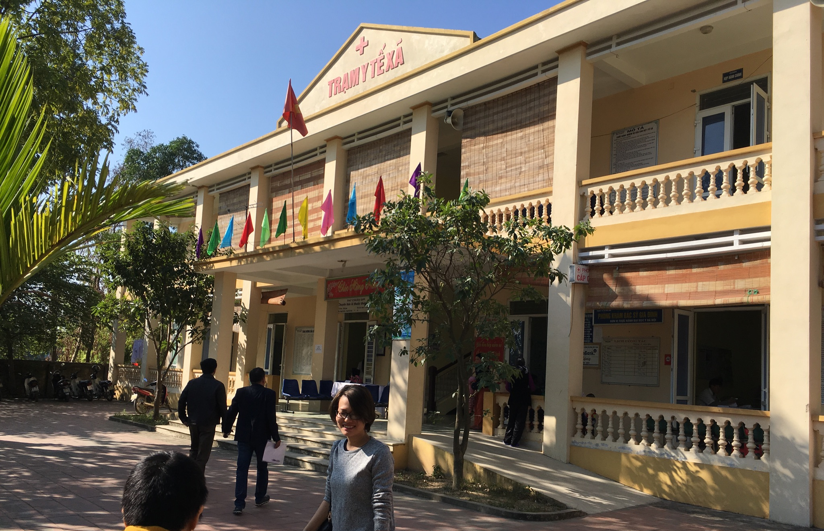
Advancing Interventions to Support Alzheimer’s Family Caregivers in Vietnam
Ladson Hinton MD
University of California, Davis
May 20, 2020

Slide 2
What is dementia?
  A syndrome characterized by cognitive decline and functional decline
    Cognitive decline → functional decline = dementia
Caused by a variety of degenerative diseases in the brain (e.g., Alzheimer’s, vascular, Lewy Body)
Not caused by delirium, depression
Symptoms are cognitive, functional, behavioral
2

Slide 3
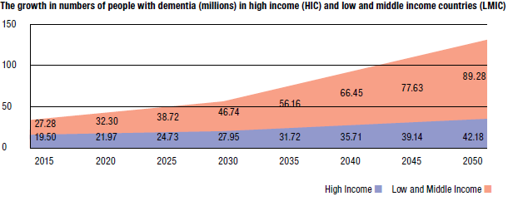
Dementia in LMIC
Source: Alzheimer’s Disease International, World Alzheimer Report, 2015.
Notes:
Available at: http://www.alz.co.uk/research/files/WorldAlzheimerReport2010.pdf (PDF, 1.3M).
Many low and middle-income countries are facing challenges not unlike our own. For example, supporting caregivers is rural areas is an enormous issue for countries like China and Vietnam, not only due to the lack of availability of supports and services but also the internal migration of many younger, working-age adults to urban areas for better-paying jobs, eroding the social support systems for older adults living with dementia.
Dr. Wakefield mentioned that many other countries face challenges in rural areas. Global challenges facing aging populations. “Rural communities are reipe for innovation and new care models (and interventions!).” Dr. Dilworth-Anderson mentioned going to rural areas in UK and seeing similarties.
2/3 of those cases will be in low or middle low income countries….

Slide 4

Dementia impact on family caregivers
High economic costs
Increased risk for depression and poor self-rated health
Dementia-related behavioral problems are particularly difficult for families
Strong evidence base showing that family caregiving interventions are effective in US

Slide 5
Published November, 2019

Slide 6

R21 Grant
Grant title: Adapting and Testing an Alzheimer’s Caregiver Intervention in Vietnam, R21AG054262 (2016-2019)
Funding agency: National Institute on Aging (NIA)/Fogarty International Center
Principal Investigators: Ladson Hinton MD, Huong Nguyen PhD
Vietnam Co-PI: Pham Thang MD

Slide 7
R21 Study to develop and test a family caregiving intervention in Vietnam
Literature review
Key informant interviews
Adapting and manualizing the intervention
Pilot case series
Pilot cluster RCT

Slide 8

REACH VA Intervention
Almost 2 decades of work demonstrating effectiveness of model
  REACH, REACH II
  REACH-VA (Nichols LO et al. Gerontologist, 2016)
Multicomponent intervention
  Education, skill-building, problem-solving, stress reduction
4-6 core sessions over 2-3 months
Delivered by nurses and MDs in the home
Intervention manual and caregiver materials modified and translated into Vietnamese

Slide 9

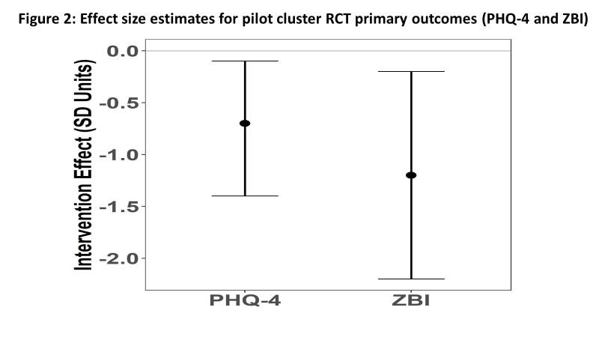
R21 AG054262 (2016-19)
First study to show that a community intervention is effective in lowering stress and burden in family caregivers of persons with dementia in Vietnam
Notes:
There are couple of possible reasons for the larger effective sizes. One is that the baseline for most of these families was that they had received very little information or support for their caregiving. In addition, we had as an inclusion criteria a moderate degree of caregiver burden.

Slide 10
Next steps: R01 study
Advancing Alzheimer’s family caregiving interventions and research capacity in Vietnam
National Institute on Aging, AG064688
Aim 1. Test the efficacy of REACH VN in a cluster RCT of 32 clusters (350 family caregivers) in Vietnam.
Aim 2. To identify barriers and facilitators of REACH VN implementation in a community setting through formative evaluation conducted in parallel with the cluster RCT.
Aim 3. Strengthen and build national capacity in caregiving and other ADRD research through the creation of a network of researchers and a program of mentoring and pilot grant support.

Slide 11
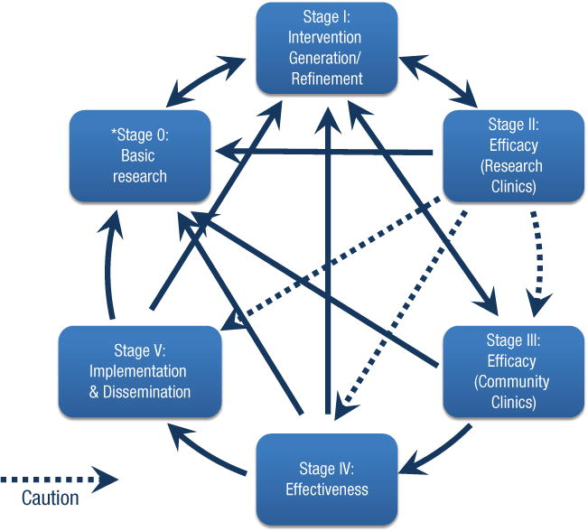
National Institute on Aging Stage Model of Behavioral Interventions
https://www.nia.nih.gov/research/dbsr/stage-model-behavioral-intervention-development

Slide 12
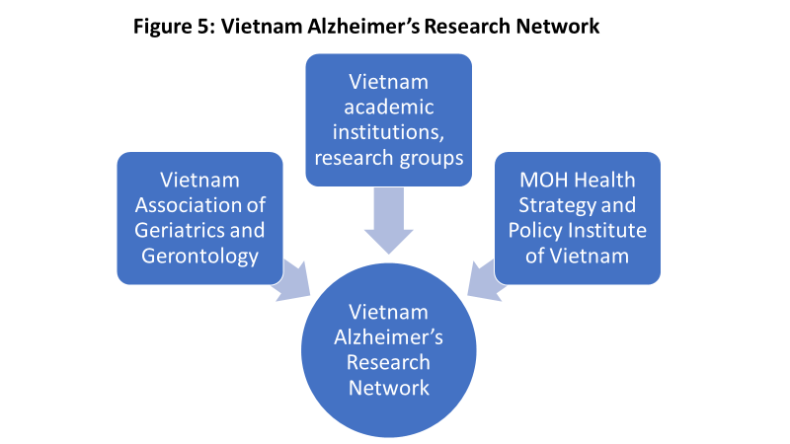

Slide 13

Questions?

