Slide 1
HANOI MEDICAL UNIVERSITY
CENTER FOR TRAINING AND RESEARCH ON SUBTANCE ABUSE – HIV
BUILDING A CAREER IN GLOBAL HEALTH: PERSPECTIVE OF A RESEARCHER BASED IN
A LOWER MIDDLE-INCOME COUNTRY
GloCal Career Development Webinars
May 28, 2019
LE MINH GIANG, MD, PhD
Associate Professor and Chair, Department of Global Health
School of Preventive Medicine and Public Health
Deputy Director, Center for Training on Research on Substance Abuse - HIV
Hanoi Medical University, Vietnam

Slide 2
My Path in Global Health
VN
MD training (general practitioner) at Hanoi Medical University (1992)
US
Master (2004) and PhD training (2012) at Columbia University
(medical anthropology/sociomedical sciences)
US/VN
Social Science Research Council (SSRC’s Dissertation Fellowship)
US/VN
First involvement with NIH-funded grant (Role: Project Director)
VN
Deputy Director, Center for Training and Research on Substance Abuse-HIV, Hanoi Medical University (since 2014)
Dissertation title: “Governing Masculinity: How Structures Shape the Lives and Health of Dislocated Men In Post-Doi Moi Vietnam»
R01DA016188 “Male Injecting Drug Users in Vietnam: Ethno-Epidemiology of HIV Risk” (PI: Michael C. Clatts) from 2003 - 2008
Chair, Department of Global Health (2015) at School of Preventive Medicine and Public Health (since 2015)
Part-time employee at NDRI Inc. in NYC (2003 – 2008)

Slide 3
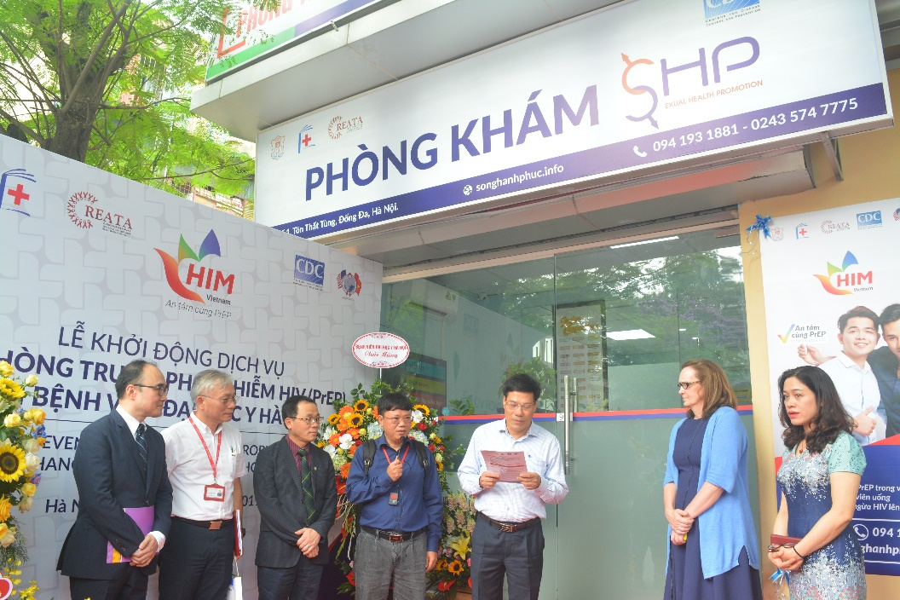



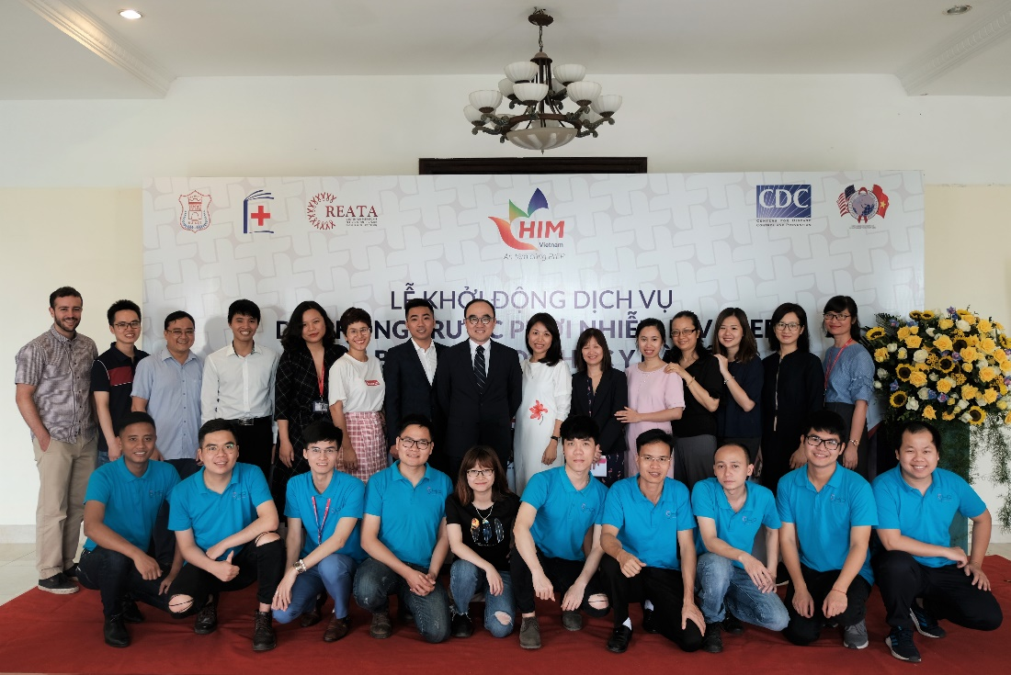
Center for Research and Training on
Substance Abuse – HIV (CREATA-H)
2004
2011
2014

Slide 4
How We Built CREATA-H: 2003 to 2019
2003
2008
2007
2008
2012
2017
R01DA033673 (PIs: Goldsamt, a former colleague at NDRI, Clatts and Giang) “Implementation of a Sexual Health Intervention for Young MSM in Two Vietnamese Cities”, 2012 – 2017 (Co-PI)
R01DA022170 (PI: Michael Clatts) “Diffusion of HIV-1 in Emerging Male Sex Work Venues in Southeast Asia”, 2008 – 2012 (Project Director, Co-Investigator)
2008
2012
Ford Foundation Grant (PI: Le Minh Giang and Michael Clatts) “HIV Risks among Young MSM in Hanoi: Health Service Approach To Prevention”, 2008-2009
R01DA016188 (PI: Michael Clatts, a former professor at CU) “Male Injecting Drug Users in Vietnam: Ethno-Epidemiology of HIV Risk” (Project Director)

Slide 5
How We Built CREATA-H: 2003 to 2019
2008
2018
R24HD056691 (PI: Jennifer Hirsch, a mentor at CU and then Jennifer Hirsch & Richard Parker, my advisor at CU) “Social Science Research and Training on HIV/AIDS: Department of Sociomedical Sciences and Hanoi Medical University Partnership (STAR-I & STAR II)” (Project Director and Co-Investigator)
2011
2020
2015
2020
R01DA040510 (PI: Gavin Bart, a MMT technical advisor for Vietnam since 2010) “Population Pharmacokinetics: Methadone – Antiretroviral Interactions in Vietnam” (Co-Investigator & PD)
R01DA037441 (PI: Todd Korthuis, a Fulbright scholar 2012 -2013 at HMU) “Buprenorphine to Improve HIV Care Engagement and Outcomes: A Randomized Trial” (Co-Investigator & PD)
2014
2018
SAMSHA 1UD1-TI023603 (PI: Richard Rawson then Sherry Larkins, from UCLA’s Integrated Substance Abuse Program) “Vietnam-HIV Addiction Technology Transfer Center: VHATTC” (Phase I, II & III)” (HMU PI)

Slide 6

How We Built CREATA-H: 2003 to 2019
2014
2016
R03DA037783 (PI: Le Minh Giang) “The Family as Recovery Capital for HIV-Infected Injection Drug Users in Vietnam”
2022
2016
2019
CDC US/PEPFAR GH12-1232 and GH000794 (PIs: Le Minh Giang & Vu Bich Diep) “HIV Incidence and the Dynamics of Behavioral Change among MSM and Transgender Women in Hanoi, Vietnam (HIM-Hanoi Study)”
ANRS12351 (PI: Le Minh Giang and Didier Laureillard, a colleague from CHU Nimes, France) “Determinants of Very Late Presentation to HIV Care: A Social Science Study Embedded in the STATIS Clinical Trial”
2016
2018
2016 - now
One unscored and one unfunded NIH application ☹

Slide 7
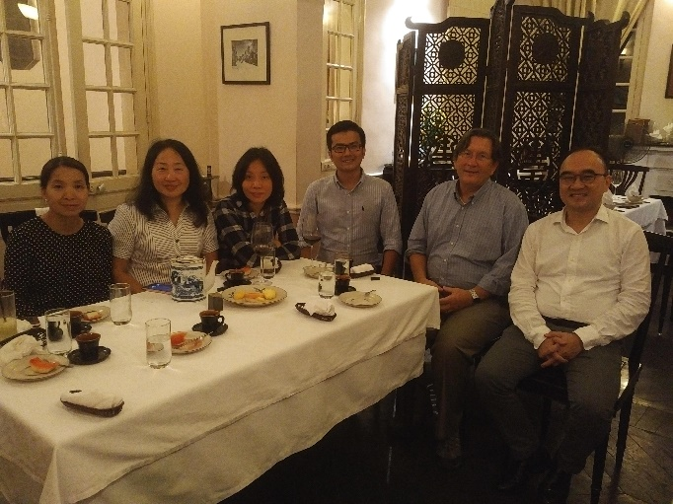
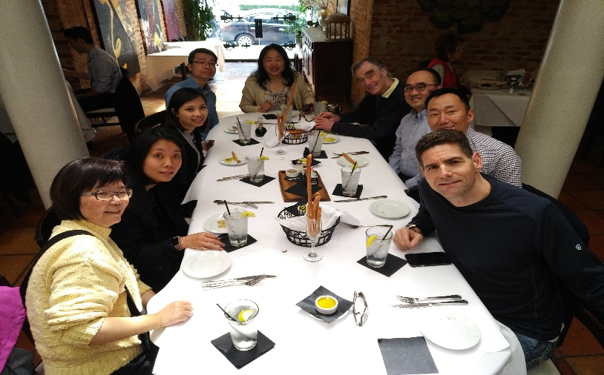
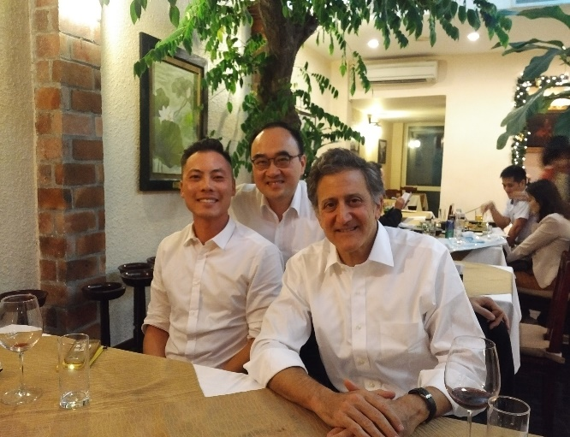
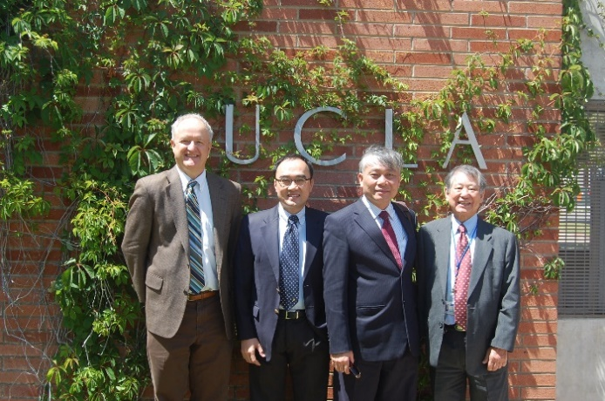
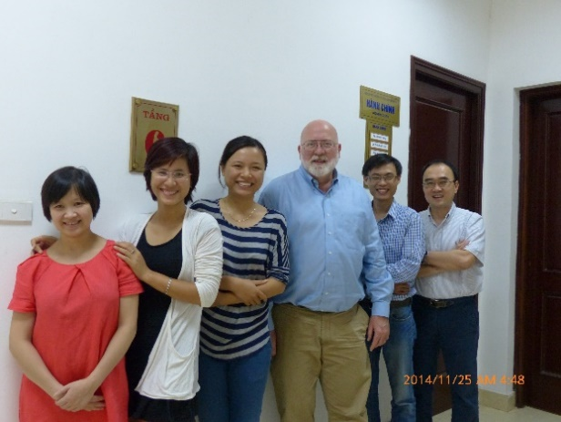
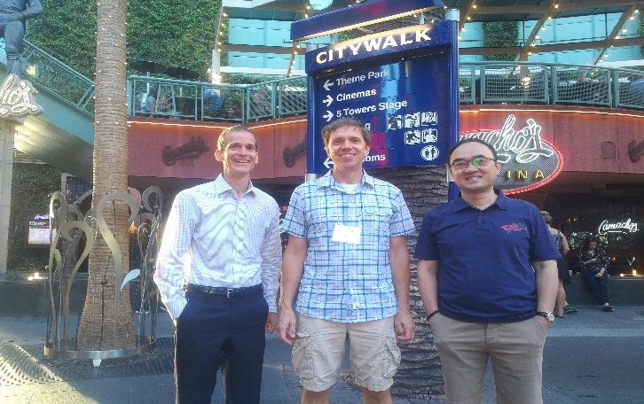
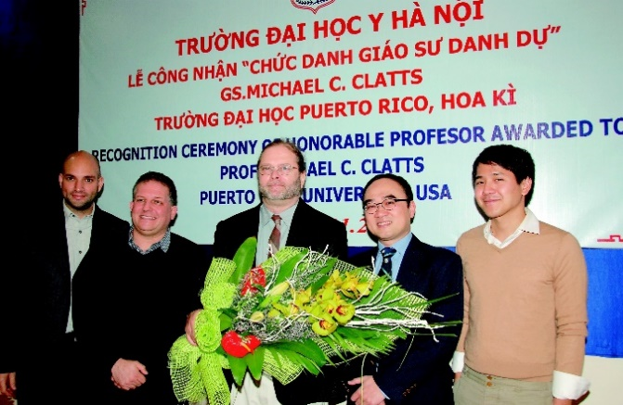
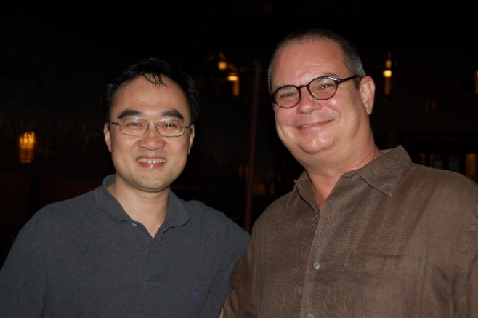
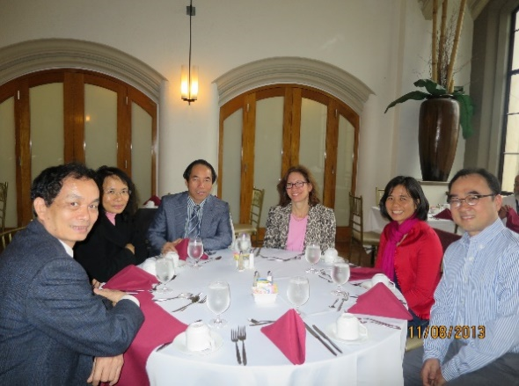
Partnerships ARE KEY!

Slide 8
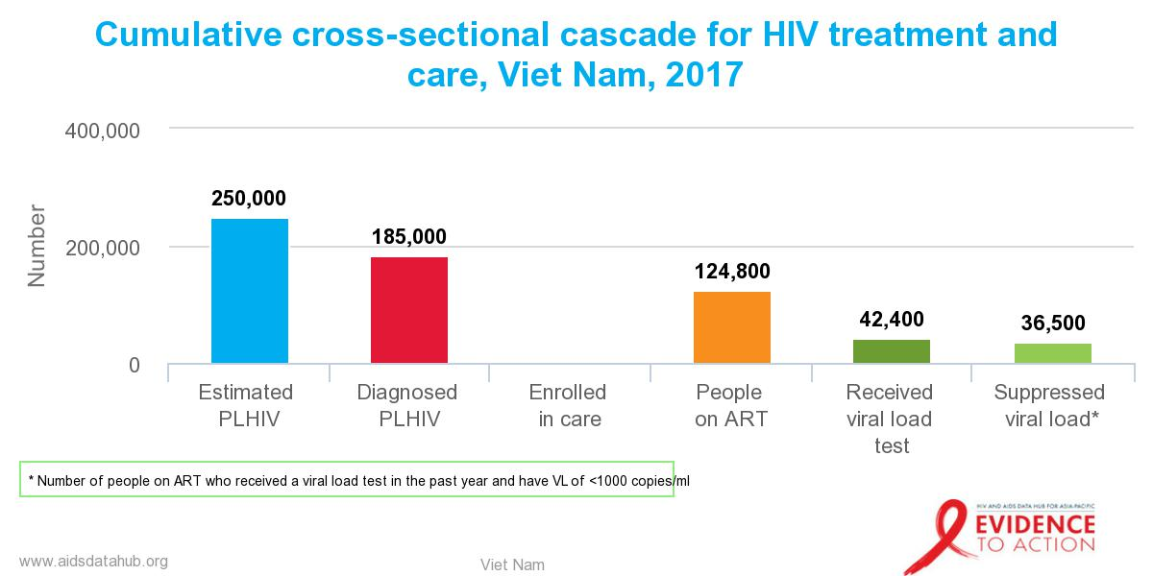
Cascade of Care:
Where Your Expertise Can Be Helpful?
First in HIV care (Greenberg et al. 2009, Health Affairs), and now promoted for adoption in other fields such as addiction (Williams et al. 2018, JSAT)
Revealing “break points” along the care continuum.
Understanding where our team at CREATA-H can contribute is critically important

Slide 9
IN SUMMARY:
BUIDING A CAREER IN GLOBAL HEALTH
You all have so much potentials and strengths → You will become champions in global health!
Some suggestions:
  Understanding your country’s cascade of care in the global context and knowing where you and your team can contribute
  Being prepared for opportunities, even smallest
  Learning to take one step backward to make two steps forward
  Building a dedicated team: you need both people who support you as well as people who want to work for you (at least for a while ☺)

Slide 10
HANOI MEDICAL UNIVERSITY
CENTER FOR TRAINING AND RESEARCH ON SUBSTANCE ABUSE-HIV
THANK YOU FOR YOUR ATTENTION
leminhgiang@hmu.edu.vn

