Slide 1
Emerging Opportunities in Global Health
Andres G. (Willy) Lescano, PhD, MHS, MHS Associate Professor, Universidad Peruana Cayetano Heredia
Adjunct Professor at Tulane, Wake Forest, Johns Hopkins and Texas Medical Branch University
Head, Emerge , Emerging Diseases and Climate Change Research Unit
Sponsored by training grant NIH/FIC D43 TW007393

Slide 2
El burro por delante (a bit about myself)
Quantitative ID field epidemiologist
Worked for nearly 25 years, mostly in Peru: PRISMA NGO, Cayetano University and NAMRU-6
Research in parasites & emerging infections. Epi capacity building (~115 publications, H-index: 18)
Interests: emerging diseases & climate change, parasitic infections, surveillance & outbreak response

Slide 3
Peru’s potential and role
High ecologic/pathogen diversity. Large Amazonic region
Intense travel, migration and tourism
No emerging diseases academic reference center, only public (INS) and international one (NAMRU-6)
Multiple, recently emerged/diagnosed pathogens
Little explored vectors and reservoirs

Slide 4
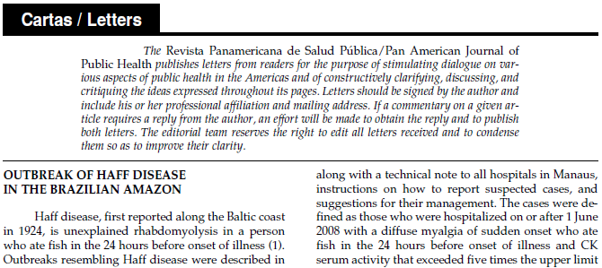
Experience in outbreak investigations

Slide 5
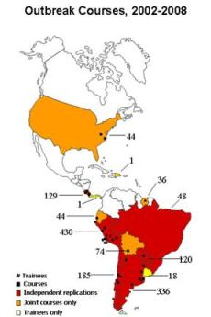
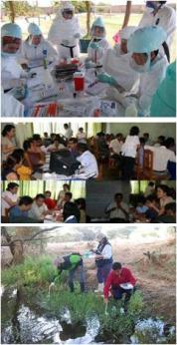
Outbreak Investigation Training
Hands-on, five-day classroom-based course
>1600 students from 15 countries trained in >40 courses
Standardized, validated curricula in multiple formats & languages
Collaborates with Ministries of Health, PAHO/WHO, CDC & USAID
Served as model for multiple other training programs

Slide 6
Steps of an outbreak Investigation (CDC 3030g, Reingold 1998)
Establish the existence of an outbreak
Verify the diagnosis
Define and identify cases
Perform descriptive epidemiology
Determine who is at risk
Develop hypotheses
Evaluate hypotheses
Refine hypotheses and conduct additional studies
Implement prevention and control measures
Communicate the findings
Notes:
Al investigar un brote la velocidad es esencial, pero obtener la respuesta correcta es esencial también. Para satisfacer ambos requerimientos, los epidemiólogos se acercan a las investigaciones sistemáticamente, siguiendo los siguientes 10 pasos:
Los pasos se presentan aquí en orden conceptual. En la práctica, sin embargo, varios pueden hacerse a la vez o pueden hacerse en orden diferente. Por ejemplo, las medidas de control deben ser implementadas en cuanto la fuente y el modo de transmisión son conocidos, que puede ocurrir temprano o más tarde en una investigación

Slide 7
Diverse, exciting opportunities “Just come”
Clinical rotations, with research components
Field and laboratory research
With universities, research centers or NGOs
Medical missions, including surgical or even non-medical
MSF, academic, faith-based
Public health: surveillance, outbreak investigation & response, program evaluation
Working with the host country government

Slide 8
Stay and commit
Most productive if staying a long time, avoid voluntourism
Very difficult in early career stage
Try to establish a long-term line of research and build on it
Do as I say, not as I do
Commit to a few places, build local capacities and establish long-term partnerships

Slide 9
Don’t be a ‘two-week wonder’
Can’t learn or achieve much in short stays
Have reasonable expectations and don’t be an imposition
“It takes six months to find where the bathrooms are, and two years to start being productive”
Try to learn and always ask how to be of help

Slide 10
Medical missions & “voluntourism”*
Clear benefit for traveler, less clear to host
Are they addressing needs (Sanchez JF 2015)
Do they have an impact on the beneficiaries or host populations?
Are they a cost-effective?
Do they erode the trust on and use of existing services?
http://cmajblogs.com/voluntourism-call-it-a-spade-and-use-it-carefully/

Slide 11
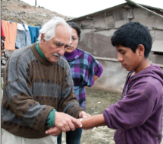
Some personal/close experiences
“Just come”
Being there*
“Physician-researcher Robert H. Gilman believes every discovery has its place” *
“The people here need me like a hole in their head” **
* http://magazine.jhsph.edu/2007/Fall/features/being_there/
** http://magazine.jhsph.edu/2012/spring/features/la-familia-gilman/page-1/

Slide 12
Criticisms & Challenges*
Lack of bidirectionality and reciprocity: inequality of resources in senders/hosts
Risks & costs to students
Cultural shock & sensitivity
Resources of host institutions strained by unilateral flow
*Crump & Sugarman, JAMA 2008
Bozinoff et al, Medical Education 2014

Slide 13
What has changed
Greater diversity of fields of application
Many programs, opportunities and support

Slide 14
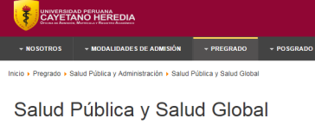
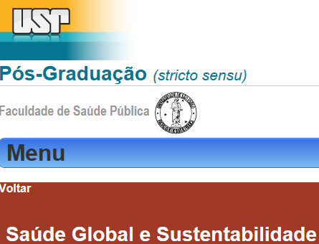
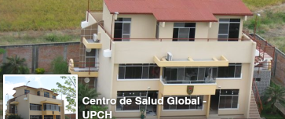
The Americas, work in progress
More research and international students
Very few programs and centers
Implementing the concept is not automatic

Slide 15
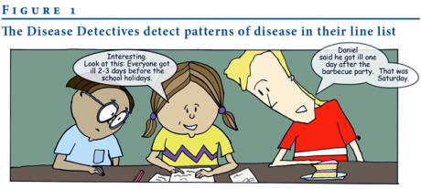
Outbreaks: be a disease detective
Unconventional epidemiological studies:
Require prompt design & execution, small sample size, public & political pressure
Responsibility of Ministries of Health, understand their expectations and your role
Three key questions:
agent, source &
mechanism
Euro Surveill 12(11):E071122.4
CDC “Solve the outbreak” app
www.cdc.gov/mobile/applications/sto/

Slide 16
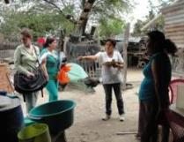
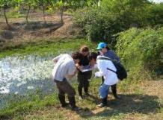
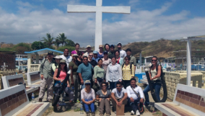
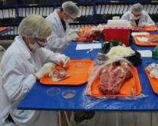
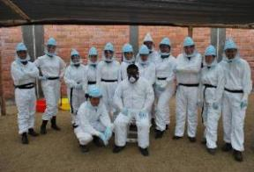
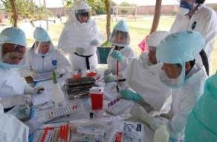
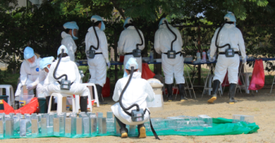
Join our Peru Field Epi course August 6-16, 2018

Slide 17
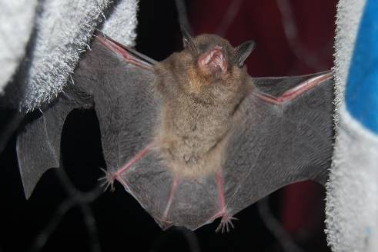
Thank you

Slide 18
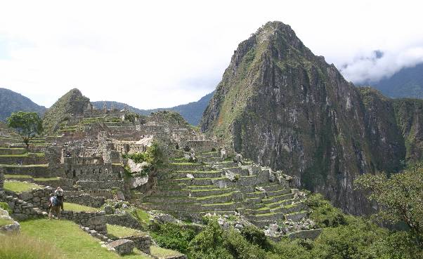
Any questions?
willy.lescano@upch.pe
+51 94761-9799

