Slide 1
Early career – clinical training
Medical school – Duke University
  Concentration in microbiology and infectious diseases
Residency in pediatrics
  University of California, San Diego and San Diego Children’s Hospital
  Hospital for Sick Children, Toronto
Chief residency in pediatrics, UCSD

Slide 2
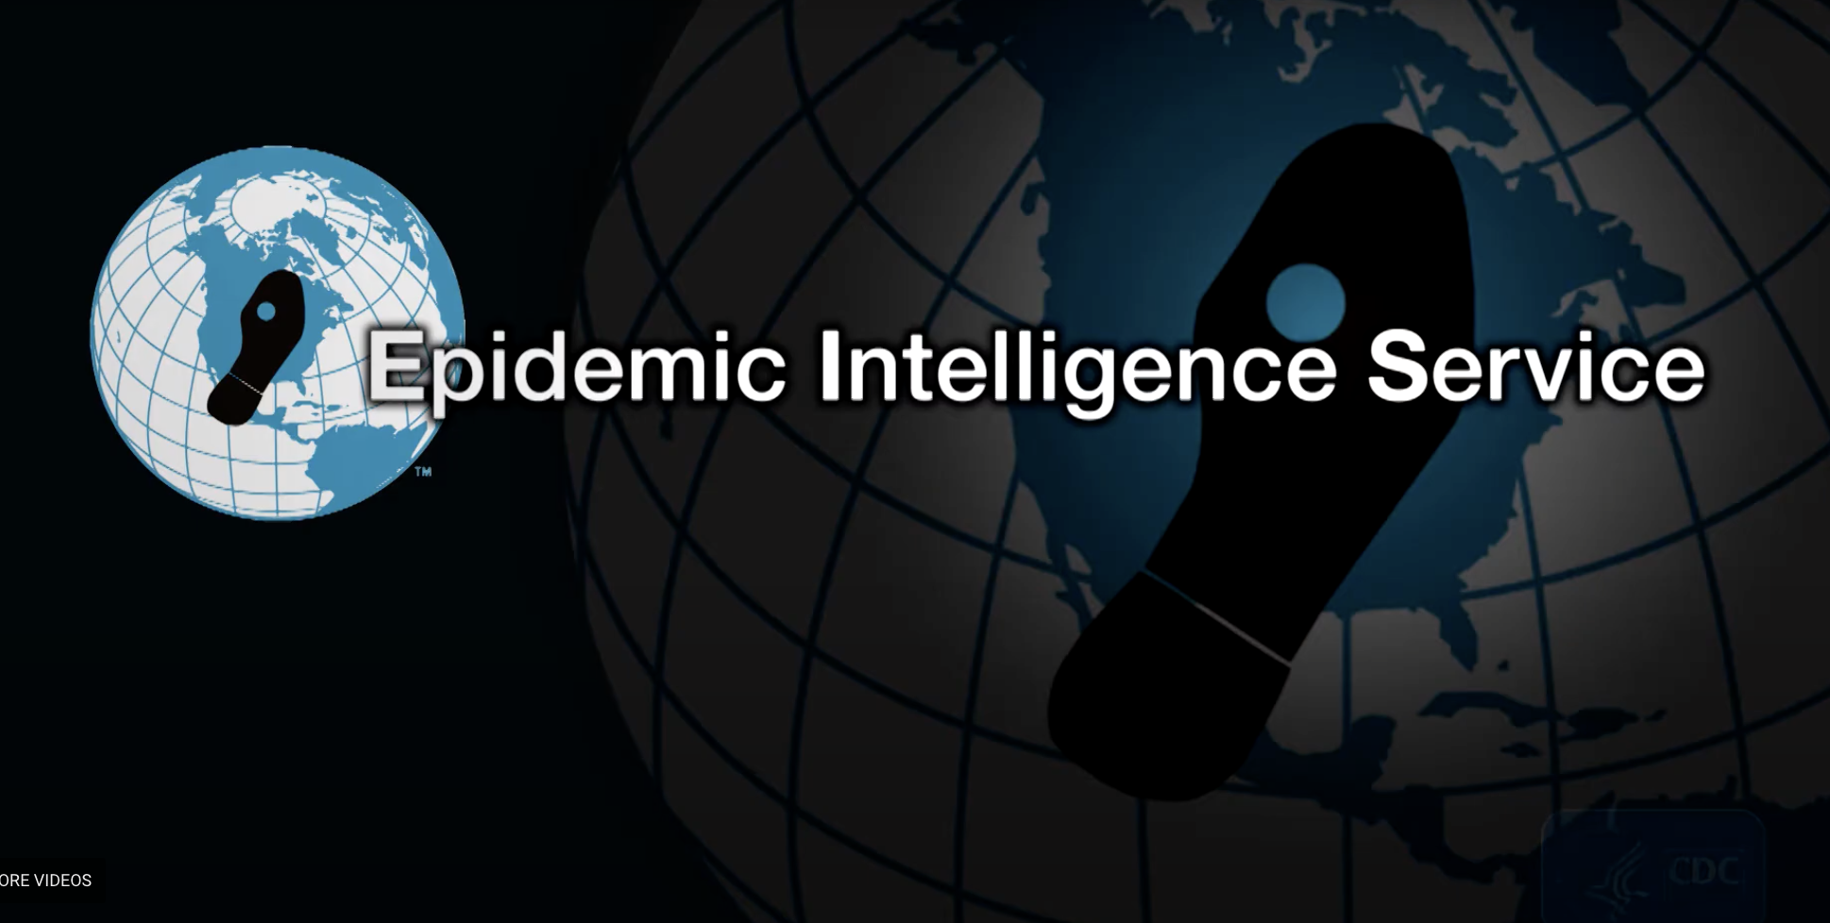
Fellowship training at CDC
First year in Division of Viral Diseases at CDC Atlanta
  Major outbreak investigations in Taiwan (poliomyelitis)
  California (hemolytic-uremic syndrome)
  Wisconsin (Kawasaki syndrome)
  Minnesota (Reye’s syndrome)
  Kentucky (hepatitis A)
Second year stationed at the New York City Department of Health
  Malnutrition in Mozambique
  Seconded to FBI for Los Angeles Olympics

Slide 3
Public health practice career
New York City Department of Health (1983-1985)
  CDC assignee
  Director, Division of Immunizations; Acting Director, Division of Tropical Diseases
San Francisco Department of Public Health (1985-1990)
  Transferred by CDC from NYCDOH to SFDPH in 1985 to help set up AIDS programs
  Major responsibility was the San Francisco City Clinic Cohort Study
  Later became Medical Director and then Director of the AIDS Office, succeeded by Sandra Hernandez and Mitch Katz
California Department of Public Health (1990-1995)
  Chief, Infectious Disease Branch and State Epidemiologist, 1990-1993
  Deputy Director for Prevention Services and State Health Officer, 1993-1995

Slide 4
Early academic career
Associate Dean, UC Berkeley School of Public Health (1995-1997)
  Also became Director of Preventive Medicine Residency Program, which was moved to UCSF in 1997
Professor of Epidemiology at UCSF (1997-now)
  Original projects
    ITAPS
    Cochrane Collaborative Review Group on HIV Infection and AIDS
    Valley Fever Vaccine Project
    California Chlamydia Action Coalition
  Led redesign of California Department of Public Health for Governor Wilson
  Primary funders: NIMH and California HealthCare Foundation

Slide 5
Later academic career
Converted from adjunct to in-residence to ladder rank
Continue to direct Joint Residency Program in General Preventive Medicine and Public Health (now in collaboration with Kaiser San Francisco)
Have been Vice Chair and division chief in DEB since 1997, currently Head, Division of Infectious Disase and Global Epidemiology
Since 2002 have been deeply involved with PEPFAR and CDC in area of strategic information
Have been one of a handful of UCSF experts on outbreaks: SARS, 2009 pdm H1N1 flu, Ebola, Zika and now SARS-CoV-2
Funding a complex mix of international (WHO, WB, UNAIDS, GF), federal (mostly CDC but also NIH, HRSA, FDA), state and SFDPH funds and some philanthropy (mostly Gates but also CHCF).
For 2021-22 acting executive director of Institute for Global Health Sciences

Slide 7
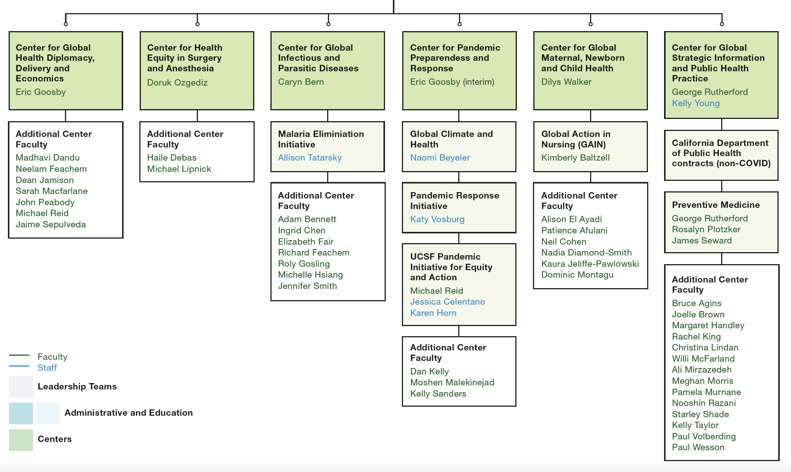

Slide 8
What’s been important in my career
Understanding biology and infectious diseases
Deep understanding of epidemiology as foundational science for public health practice
Understanding culture, geography, history
Understanding government
Languages
Communications - lots of experience in dealing with the press and the public

Slide 9
What haven’t I done that might have helped
Pediatric infectious disease fellowship (sort of did it in medical school)
MPH
PhD in epidemiology
Speaking French better!

