Slide 1
Career path
George W. Rutherford, M.D.

Slide 2
Early phase
Undergraduate education – languages and area studies
Medical school – emphasis in infectious diseases and microbiology
Pediatrics residency – UCSD and Hospital for Sick Children, Toronto
Attended at Hospital Infantil in Tijuana
Chief resident and diversion into intensive care
Lesson: good foundations are good foundations

Slide 3
Fellowship
Epidemic Intelligence Service officer at CDC
One year in Atlanta with focus on childhood syndromes of unknown etiology and viral diseases
One year at New York City Department of Health with focus on immunizations but also Tropical Medicine
Overseas assignments in Taiwan, Mozambique
Did one post-EIS year at NYCDOH with early involvement in HIV (1984)
Ann Intern Med 1985; 102:616-18.

Slide 4
Public health practice phase
Posted by CDC to San Francisco Department of Public Health in 1985
Specific assignment was to be PI of CDC-sponsored HIV studies and to run AIDS surveillance
Founded AIDS Office in 1986
International AIDS Conference 1990
Went to California Department of Health Services in 1990
Chief of Infectious Disease Branch and State Epidemiologist
Deputy Director and State Health Office 1993-1995
Large overview of communicable disease control and state-level public health practice
Lesson: don’t be afraid of working in government

Slide 5
Faculty phase
2 years at the School of Public Health as Professor and Associate Dean
Came to UCSF full time in 1997
Initially as director of CAPS International Program
Research portfolio mix of domestic (coccidioidomycosis, chlamydia, syphilis) and international (Cochrane Collaboration)
Became director of Institute for Global Health in 2001

Slide 6
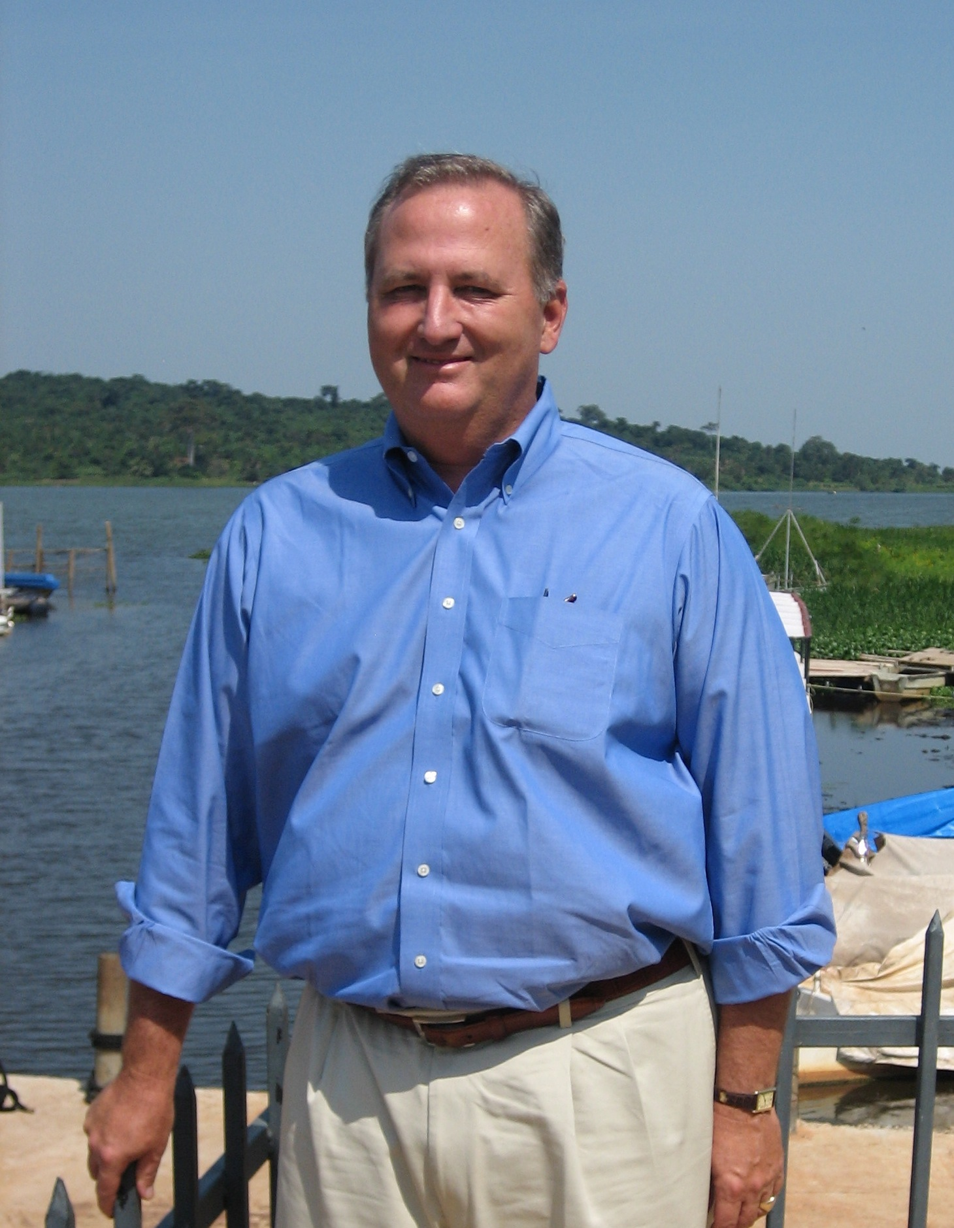
Faculty phase, II
Major role in PEPFAR beginning in 2002
Global Strategic Information group in Institute for Global Health Sciences
Retain public health focus
California Department of Public Health
Chair, California TB Elimination Advisory Committee
Working on California PH Observatory
Director, Residency Program in General Preventive Medicine and Public Health
Major teaching role in IGHS and DEB
Major administrative role in DEB
Vice Chair and Head, Division of Infectious Disease Epidemiology (27 faculty members)

Slide 7
Mentorship
Find a mentor – having the right mentor is hugely important
Become a mentor – at a certain stage in your careers, you should go out of your ways to mentor a newcomer (in academia, business, etc.)
As Sheri Weiser says, ”Leave a trail of breadcrumbs.”
Find collaborators and friends – look outside your department, your institution and your field

Slide 8
Lessons
Don’t be too parochial in your education – leave the Bay Area and California
Spend time overseas and immerse yourself in new cultures
If you don’t know another language, learn one; if you know another language, learn another AND maintain proficiency
Become an expert in something and a real expert in something even more narrow and stay on the cutting edge of that field
Be open to new ideas
Good sources of new ideas are your students, residents, fellows and colleagues
Learn how to be a good administrator. It’s going to part of your job someday, so embrace it and don’t avoid it
Remember … the best business calls are personal
Enjoy your retirements – I’ll probably still be working!

Slide 9
Most important lesson – be happy at your work
But yield who will to their separation, My object in living is to unite My avocation and my vocation As my two eyes make one in sight. Only where love and need are one, And the work is play for mortal stakes, Is the deed ever really done For Heaven and the future's sakes.
Robert Frost, Two Tramps in Mud Time, 1934

