Slide 1

GloCal Health Fellowship Career Development Webinar Series
Lessons Learned from My Research Career
Sung-Jae Lee, PhD
Professor-in-Residence
Psychiatry and Biobehavioral Sciences
UCLA David Geffen School of Medicine
Epidemiology
UCLA Fielding School of Public Health

Slide 2

Outline
  Lessons learned from my research career
    1. Building your research career
    2. Building your mentors
    3. Building your research partners
02

Slide 3
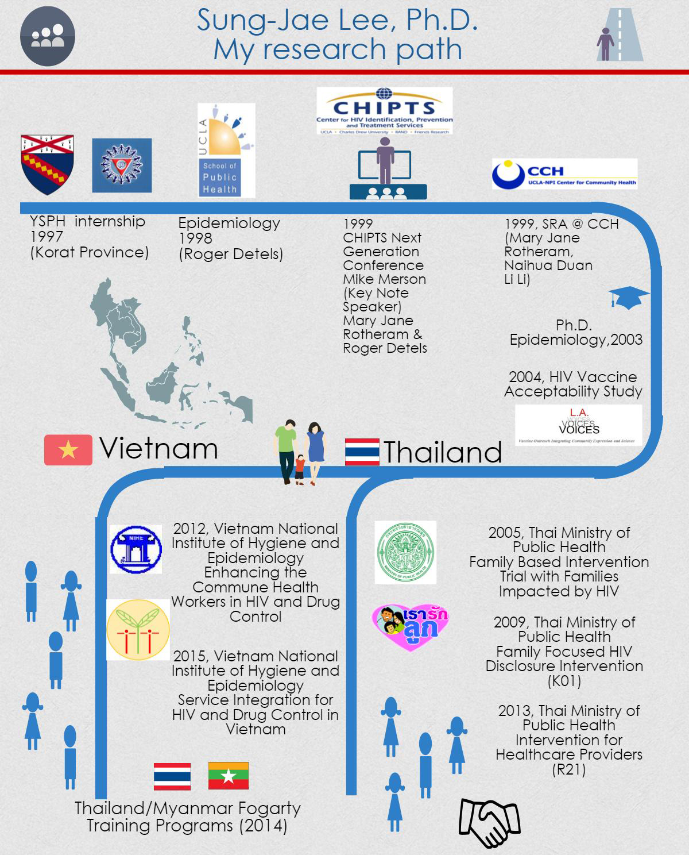
Key Milestones:
1996 BA, Tufts University
1997 Summer Fieldwork in Korat, Thailand (Sacks)
1998 MPH, Yale School of Public Health (Ickovics)
1998 PhD program in Epidemiology at UCLA FSPH (Detels)
1999 (CHIPTS Next Gen Conference, Merson & Rotheram)
1999 SRA at CCH (Rotheram, Duan, Li, Milburn)
2003 PhD, Epidemiology (CHIPTS Methods Core)
2004 HIV Vaccine Acceptability Study (Duan, Cunningham, Newman)
2005 F2F Intervention Trial in Thailand (NINR)
2009 K01 Thailand (NIMH)
2010 Assistant Professor-in-Residence
2012 Vietnam Health Worker Trial (Li) (NIDA)
2013 R21 Thailand (NICHD)
2013 Associate Professor-in-Residence
2014 D43 Fogarty Training Program in Thailand and Myanmar, Vietnam (2015) and Cambodia (2020) (NIH, FIC)
2015 Vietnam Integration Project (Li) (NIDA)
2016 Adolescent Medicine Trials Network (NICHD)
2020 Division of Population Behavioral Health (Milburn)
2020 Professor-in-Residence

Slide 4





Research Background
  Research and evaluation of trauma and resilience informed care for children, families and adults
HIV Research in Asia
  Thailand - Behavioral Interventions; HIV Disclosure
  Vietnam - Health workers; HIV and drug use
Health
Disparities
Adolescent Medicine Trials Network (ATN)
  Engaging with vulnerable youth at risk/living with HIV
Implementation
Science
Training & Mentoring
Consumer Preference
  Fogarty HIV Research Training Program (Thailand, Myanmar, Vietnam, Cambodia, China)
  Mentoring (MS, PhD, Research Staff)
  Biomedical interventions in the U.S., Thailand, Canada, Peru, Haiti
03
Notes:
JAE FIX CIRCLE

Slide 5
Building Your Research Career
Be proactive but selective
- Build your research portfolio to demonstrate expertise
- Pursue pilot projects that can lead to other projects
Consumer Preference Research using Conjoint Analysis
  HIV vaccine acceptability in the U.S., Thailand, Canada (2006, 2008, 2009, 2012)
  Willingness to participate in HIV vaccine trials in the U.S. (2006)
  Pre-exposure prophylaxis acceptability in Peru (2009)
  Willingness to test for HIV in the U.S. (2013)
  Acceptability of dual rapid point-of-care testing for syphilis and HIV in Haiti and Peru (2017, 2018)
  Acceptability of hospital directors’ preference in adoption of evidence-based interventions in China (2019)
  Acceptability of long acting injectable Antiretroviral Therapy in the U.S. and Africa (2020)
  Acceptability of COVID-19 vaccine among African American and Hispanic communities in Arizona and Florida (R21 under review)

Slide 6
Building Your Research Career
For faculty, demonstrate your competence in three key areas
- Research (projects, publications, conferences)
- Teaching (Seminars, Courses, Mentoring)
- Service (Committees, Boards, Task Force)
Faculty Research Teaching Service
Assistant Professor-in Residence
F2F
K01
Vaccine Acceptability
Vietnam
CHIPTS
R21
D43
ATN
CHIPTS
EPID 227
PH 150
NR160
Fiat Luxe
Methods Seminars
CHIPTS
DSMB (Addiction Medicine)
AA (Psychiatry)
EAB (Health Disparities)
Reviewer (Grants and Journals)
Task Force (Anti-Racism)
Associate Professor-in Residence
Professor-in Residence

Slide 7
Building Your Mentors
Be strategic!
(Most Mentors are incredibly giving and generous)
- Identify mentors who can address your training gaps
- Be open to learning new area/s
- Make sure it fits your research career path

Slide 8
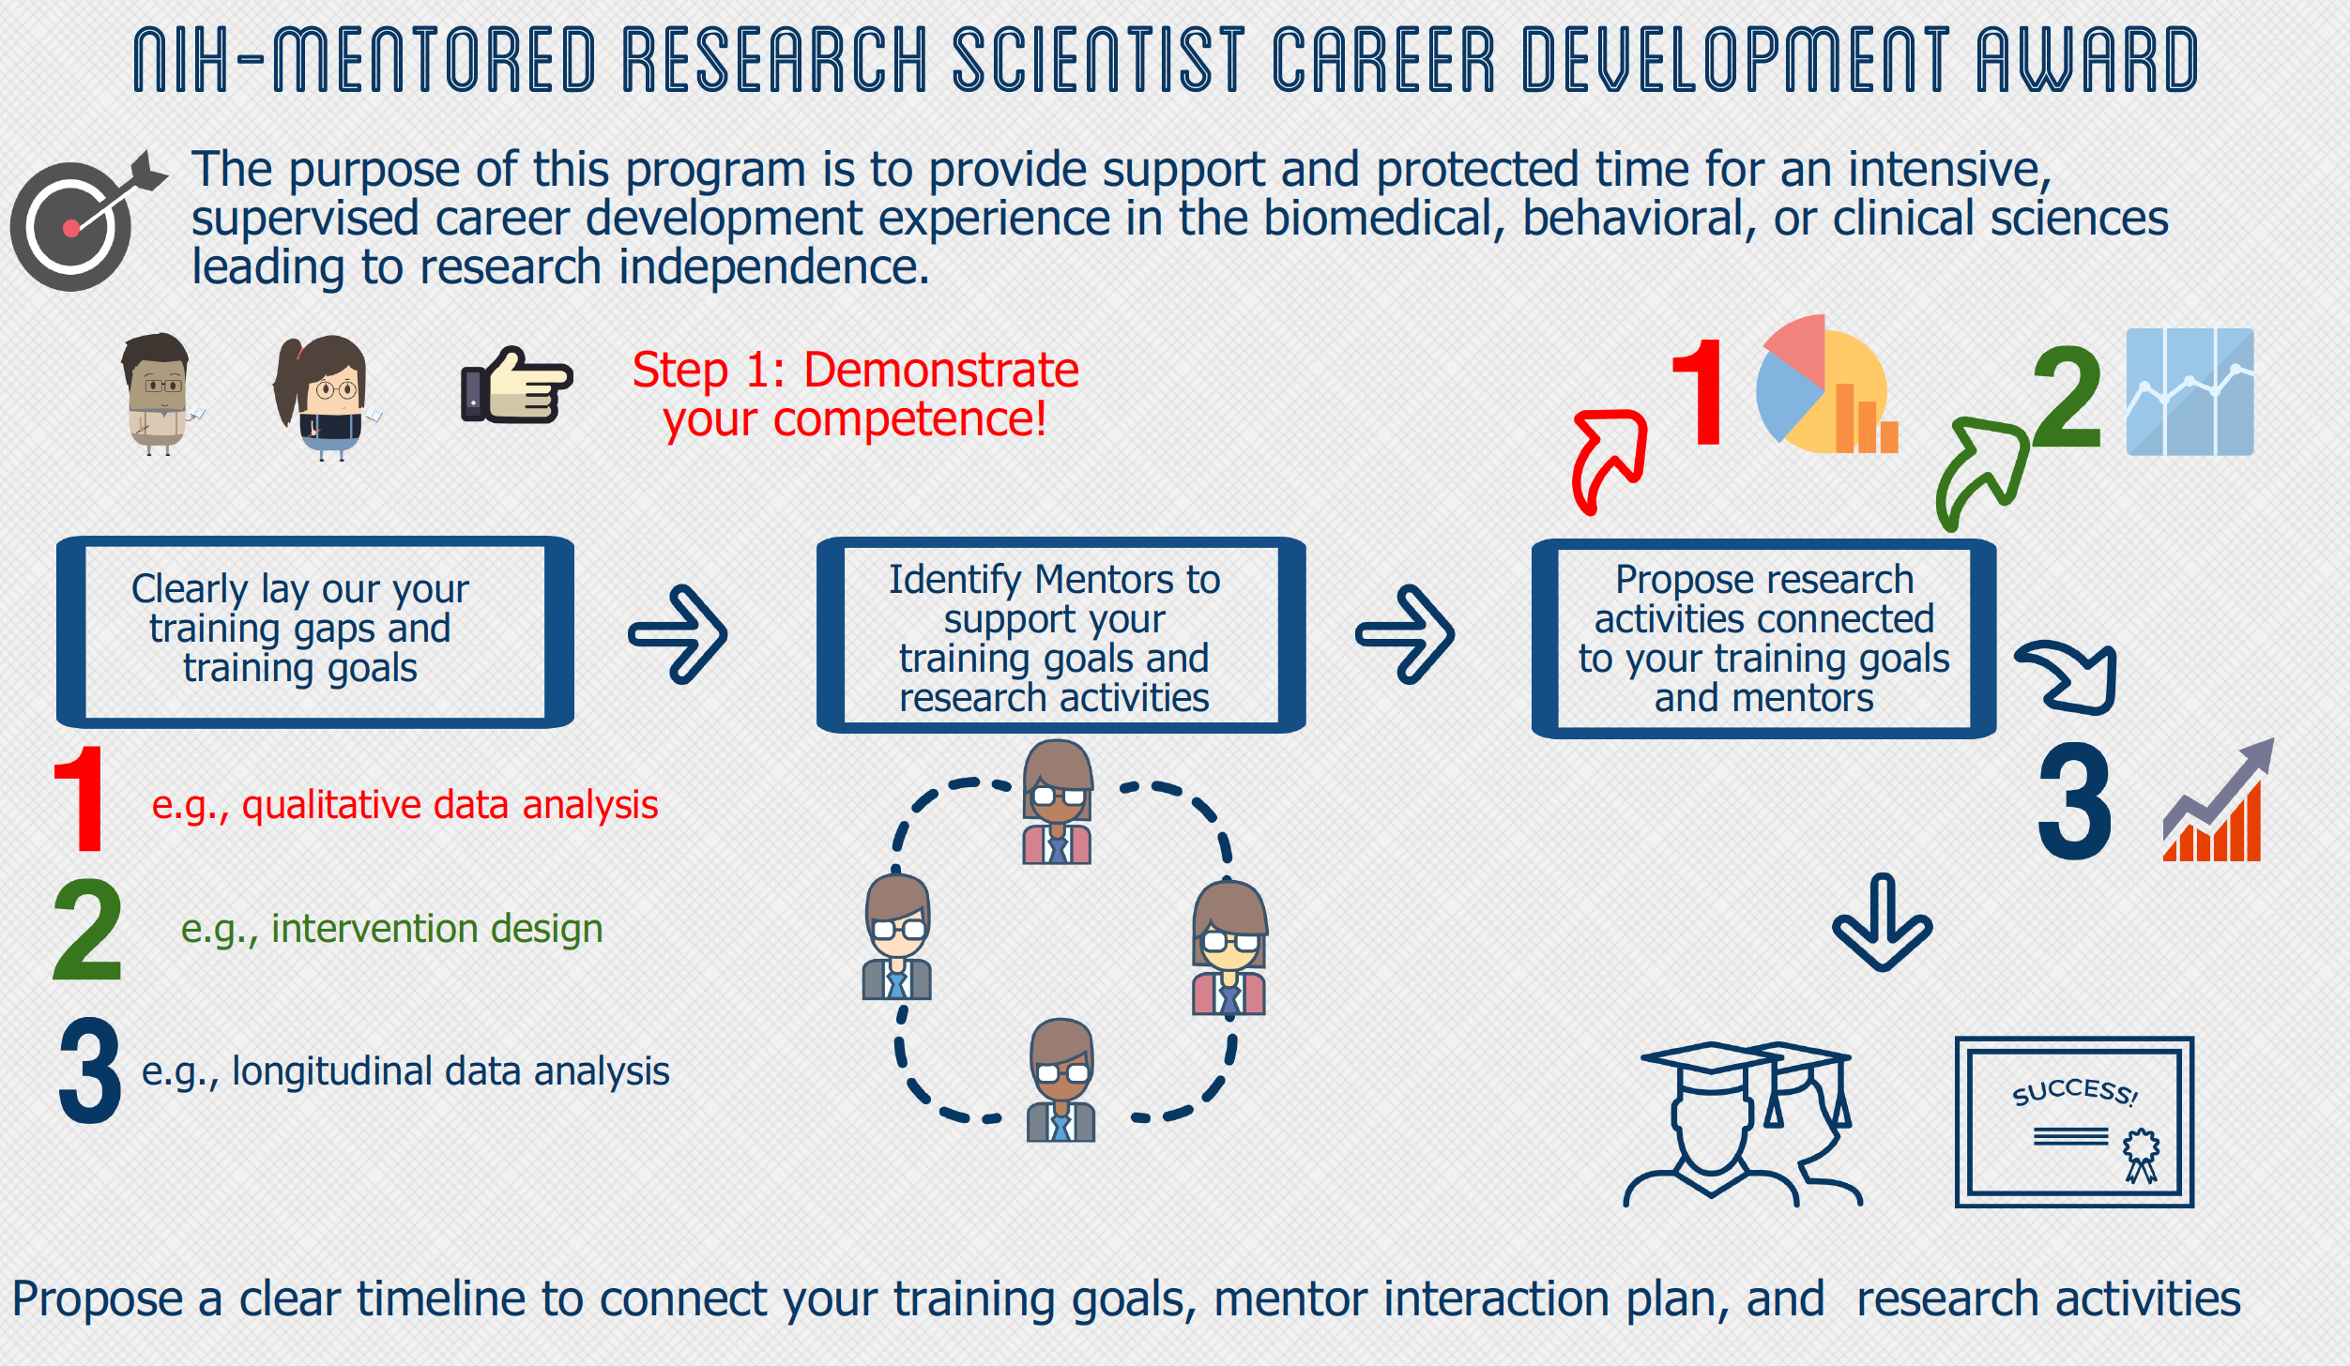

Slide 9
Building Your Research Partners
Listen First, Speak Later!
- Be open to learning from your community partners
- Acknowledge your limitations
- Present your strengths
- Respect and appreciate the collaborative process

Slide 10

Lessons Learned from My Research Career
Be proactive but selective
Demonstrate your competence and productivity in key areas
Identify Mentors to address your training needs
Listen first, speak later
Pay it Forward!!!!
46

Slide 11
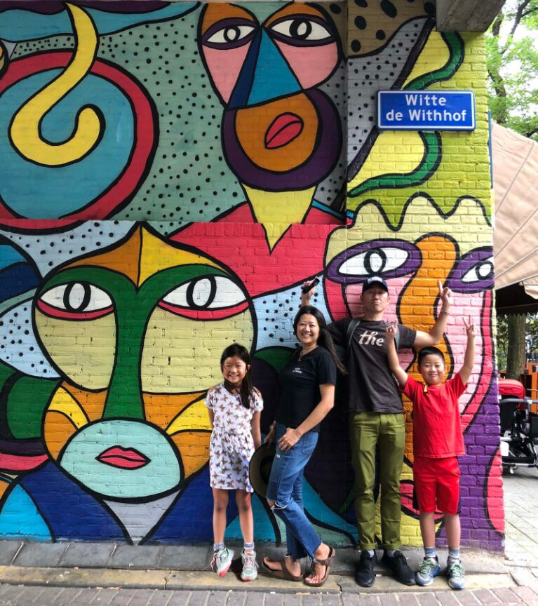
  Team Tang-Lee
Thanks!
  Roger Detels
  Mary Jane Rotheram
  Li Li
  Naihua Duan
  Bob Bolan
  Risa Flyn
  Norweeta Milburn
  Lee Klosinski
  Steve Shoptaw
  Billy Cunningham
  Ron Brooks
  Arleen Leibowitz
  Raphy Landovitz
  Tom Belin
  Scott Comulada
  Chunqing Lin
  Dallas Swendeman
  Frank Sorvillo
  Students & Mentees
  Fogarty Scholars
  LA LGBT Center
  ATN RERC Research Team
  Prevention COE Team
  Be Safe and Healthy!

