Slide 1

Career Trajectory
Lessons from research at the intersection of food insecurity and HIV/AIDS
Sheri Weiser, MD, MPH
Division of HIV, ID and Global Medicine
Department of Medicine
University of California, San Francisco

Slide 2

Menu
- Starter -
Career Trajectory
- Entrée -
Some Key Pointers
- Dessert -
Questions/Answers

Slide 3
Training
BS in Neuroscience from Brown University
  First research project very different

Slide 4
Training Cont.
Ministry of Health, Prague: Did neuroscience research
Masters of Medical Anthropology: Harvard
  Dr. Paul Farmer thesis advisor (TB among Ethiopian Immigrants in Israel)
  Another project under Arthur Kleinman

Slide 5
Training Cont.
MD: Harvard Medical School
  Project to understand drivers of Petrol Sniffing in Aboriginal community in Northern Australia
  Worked in Botswana for 6 months to understand barriers to ART adherence
  Schweitzer fellowship in Lambarane, Gabon
Residency: UCSF SFGH Primary Care Internal Medicine Residency
Fellowship at CAPS
MPH at Berkeley

Slide 6
Research Trajectory
Focus was largely on social and structural drivers of HIV/AIDS acquisition and health outcomes
Started with focus on mental health and HIV
Physicians for Human Rights Project in Botswana/Swaziland: gender inequality and HIV
Led to specializing in food insecurity

Slide 7
Early Faculty
K23 focusing on food insecurity and HIV prevention and treatment outcomes in Uganda
Other grants focusing on women’s empowerment indicators and health outcomes
San Francisco projects understanding food insecurity and HIV clinical indicators domestically

Slide 8
Transition to Independence
First R-01 followed K award----teasing apart mechanisms and pathways for how FI negatively impacts HIV and CV disease health
R34 followed by second R-01 to focus on agricultural and financial intervention as way to improve HIV health outcomes in Kenya

Slide 9
Branching Out Again
Move to diverse food security interventions domestically and internationally (food support, urban gardening, livelihood interventions)
Investigating diverse outcomes beyond HIV: Diabetes, CVD risk, maternal and child health, adolescent sexual and reproductive health
Moving into realm of climate change and health both in education and research

Slide 10
Mentoring as Big Focus
K24 Award to mentor in health disparities, and on research at the intersection of food insecurity, HIV and aging.
Mentoring over 50 students, fellows, faculty
Culminating in over 70 first author publications for mentees; 6 career development awards; many other pilot grants.

Slide 11

SOME FOOD FOR THOUGHT:
Lessons Learned
(All with a food metaphor!)

Slide 12
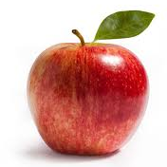
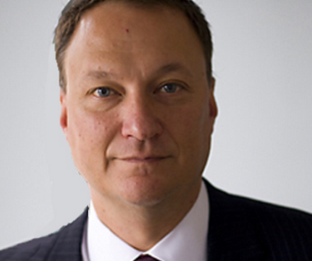

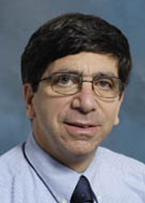

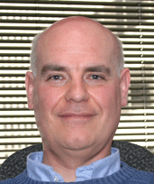
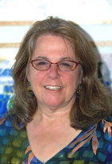
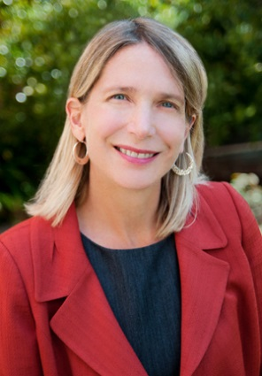
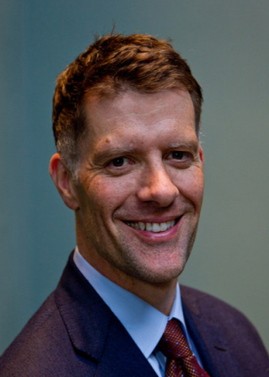
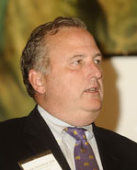
1. THE APPLE DOESN’T FALL FAR FROM THE TREE:
Having great mentors helps you become a better researcher
Paul Farmer
Ed Frongillo
Torsten Neilands
David Bangsberg
Diane Havlir
Grant Colfax
George Rutherford
Susan Kegeles

Slide 13


2. DON’T DRINK THE KOOL-AID:
Be open to advice…
…but hold your ground
Mentors have great wisdom, but don’t always have the answer
Know when to push back, and when not to push back

Slide 14
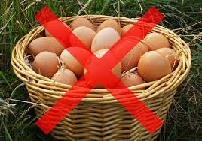
3. DON’T PUT ALL YOUR
EGGS IN ONE BASKET
Establish other mentors
One mentor does not usually fit all of your needs
Multiple co-mentors helps you towards independence from your primary mentor
Fly the coop early---you are ready for independent steps even before you realize it.

Slide 15
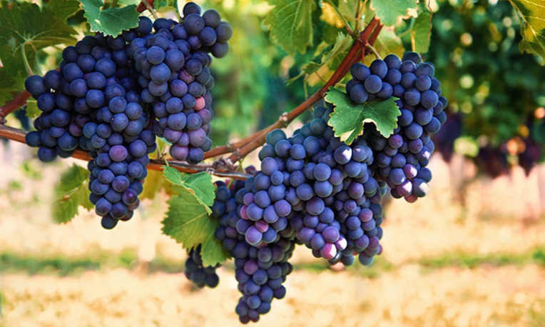
4. BEAR FRUIT
Focus on grants/papers that are needed for your promotion
Yet…balance things that directly
help you with needed experience

Slide 16

5. KNOW WHICH SIDE YOUR BREAD IS BUTTERED
Manage up: Take ownership
of and direct the relationship
Plan and set the agenda
Request feedback
Manage the information flow
Address issues of potential conflict (e.g., paper authorship) early---before they arise
Zerzan et al., Academic Medicine, 2009

Slide 17
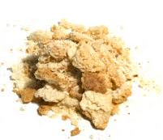
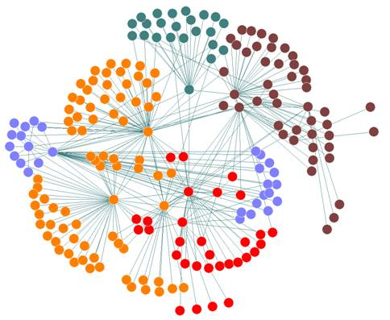
6. LEAVE A TRAIL OF BREADCRUMBS:
Your mentors, peers, and mentees
will become your colleagues
Think beyond the dyad to relationship constellations^{1,} or “development networks”²
Focus on peers
Mentoring relationships evolve over time
Share mentoring challenges and success with other mentors
1 Kram et al., Academy of Mgmt Journal, 1985
2. Higgins et al., Academy of Mgmt Journal, 2001

Slide 18
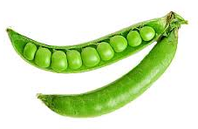
8. TWO PEAS IN A POD:
Collaborator chemistry
Work styles need to mesh (ex: detail oriented & plans ahead)
Find mentors/collaborators you are comfortable succeeding (& failing) in front of
Work should be fun—no room for bad chemistry
Shared values are key

Slide 19

9. HAVING YOUR CAKE AND EATING IT TOO:
Finding win-win situations
in collaborations
Look for situations that benefit mentor and mentee alike generally (though don’t keep tabs)
Look for colleagues, mentors, and mentees that complement your skills
Staus, Johnson et al., Acad Med., 2013

Slide 20
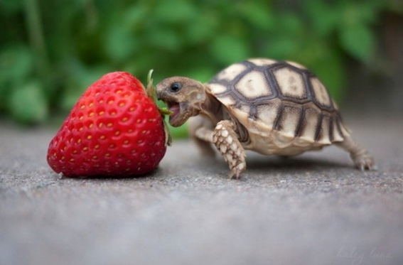
10. DON’T BITE OFF
MORE THAN YOU
CAN CHEW:
Manageable
challenges
Take on projects you know you can complete
Find balance that works for your family and lifestyle
Learn when to say no (including to mentoring)

Slide 21


11. GLASS HALF EMPTY OR HALF FULL?
Acknowledge your strengths and weaknesses
Be true to yourself as a researcher
Modeling has limits: if you are an introvert, you don’t need to emulate an extrovert style (or vice-versa)
Draw on your strengths
Don’t compare apples and
oranges

Slide 22
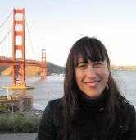
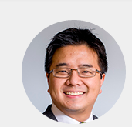

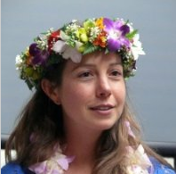
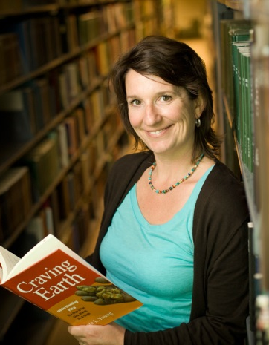
MENTEES: “Greatest thing since sliced bread”
Kartika Palar, PhD: (NIDDK K awardee)
Co-management of HIV and diabetes;
role of food insecurity and
other structural factors
Alex C. Tsai, MD, PhD (NIMH K awardee)
Food insecurity, stigma & mental health; livelihood interventions and stigma reductions
Sera Young, PhD (NIMH K awardee)
Food insecurity & MCH outcomes in HIV; water insecurity
Nadia Diamond-Smith, PhD (NICHD K awardee)
Role of gender inequality and food insecurity on maternal and child health in Nepal

Slide 23
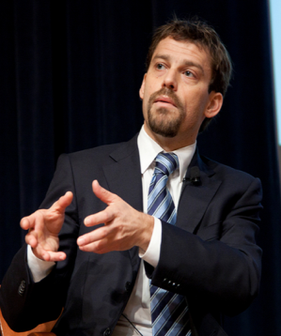

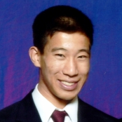
MENTEES: “Salt of the Earth”
Dan Kelly, MD, MPH
ID and TAPS fellow
Social and structural drivers of Ebola
Amy Conroy, PhD, MPH
Assistant Professor &
CFAR Mentee
Dyadic aspects of health within heterosexual and same sex couples
Jason Nagata, MD, MSc
Adolescent Medicine Fellowship
Food insecurity in pediatric populations

